Slide 1
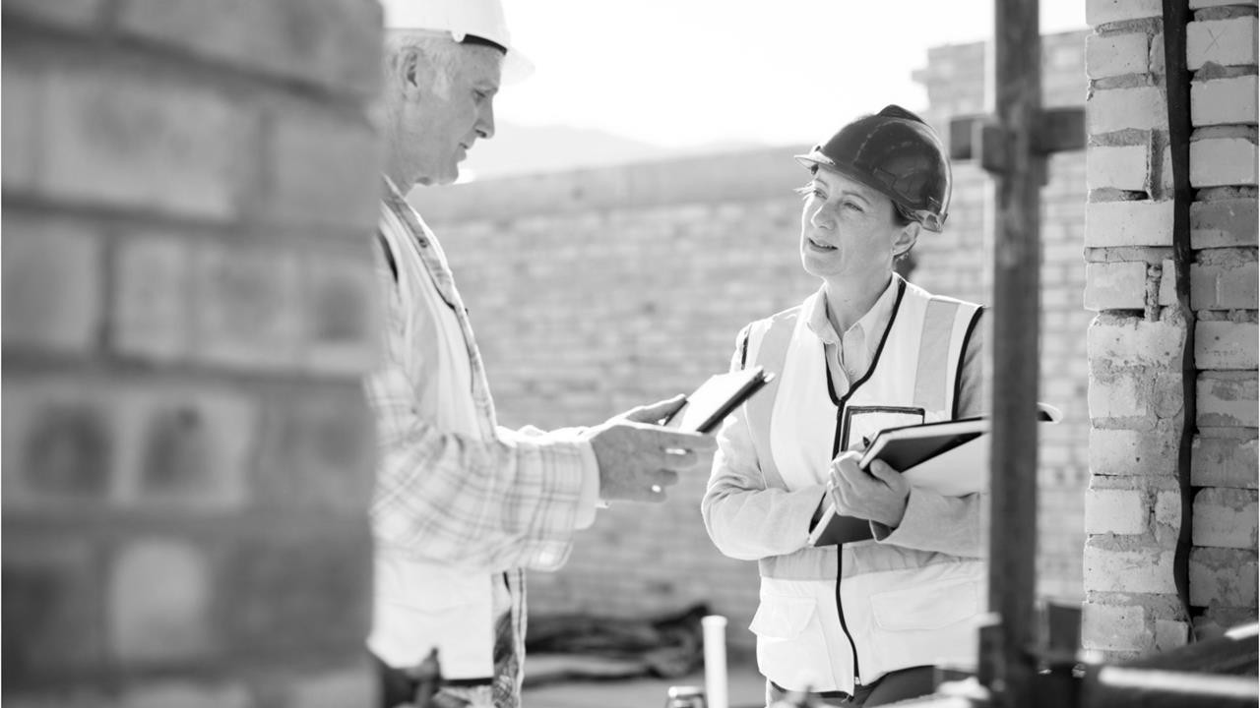
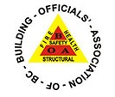
Hosted by Ken Kunka
August 26 , 2021
BOABC INFORMATION & STUDY SESSION
FIRE PROTECTION 9.10
FIRE BLOCKING – STOPPING - DAMPERS – PART 01

Slide 2
AGENDA
Welcome - Agenda
In The Know
What's New
Recent Interpretations – Fire Block/Stop/Damper
PUT IT IN THE
CHAT!
Comments and
Questions
Fire Protection
General – Concealed spaces
How Fire Spreads
Fire Blocking
Feedback and Future Sessions
Member Question
Links and Video
test

Slide 3
These sessions are intended to:
generate dialogue amongst members
be a source of advice, feedback and options
support members in their work
provide professional development focus on your questions and feedback
PURPOSE
These sessions are not:
the only means for dialogue amongst members
formal education and training
exam review

Slide 4
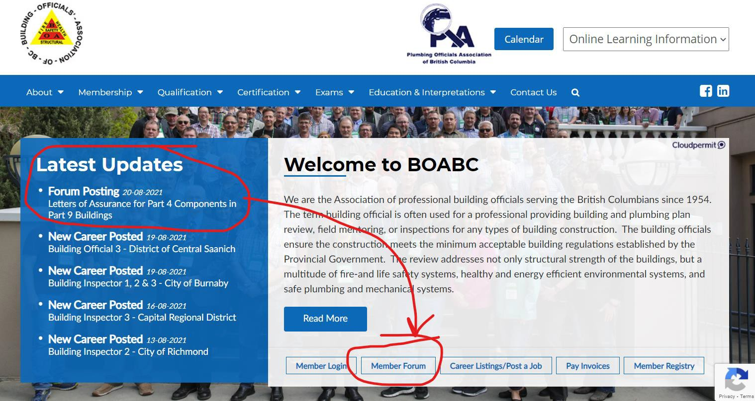
In The Know
 Member Forum
*Part 9 Engineering
 What's New

Slide 5
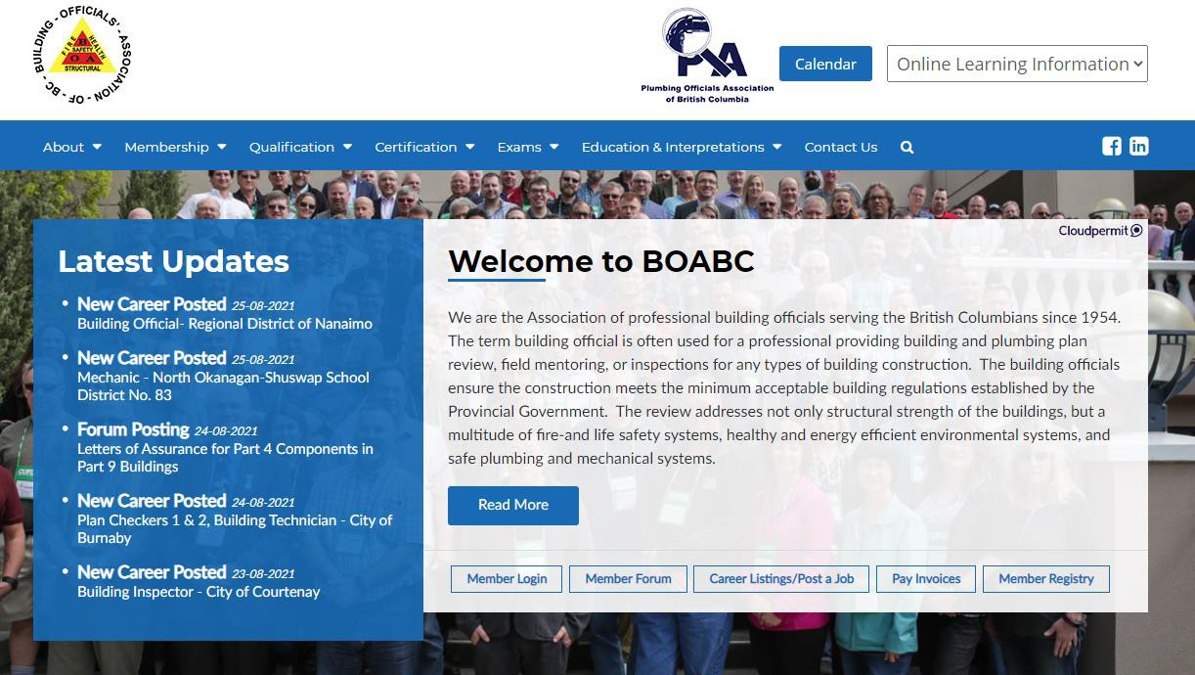
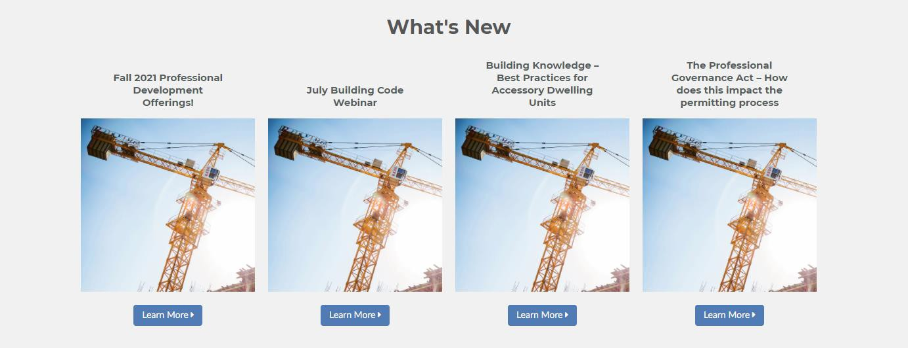
In The Know
 Professional Development Offerings
 What's New

Slide 6
Upcoming
Cloud Permit September 15th.

Slide 7
Upcoming
FIRESTOPPING WEBINAR BY HILTI
2 to 3 hours fall Webinar
date to be announced stay tuned. www.boabc.org

Slide 8
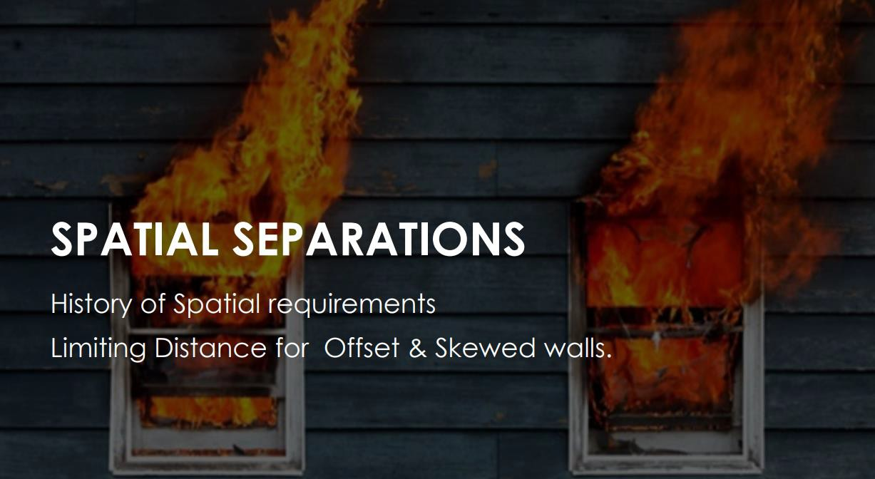
In The Know
 July 29 – Spatial Requirements Session saved online.
Lake Country Spatial Guide

Slide 9
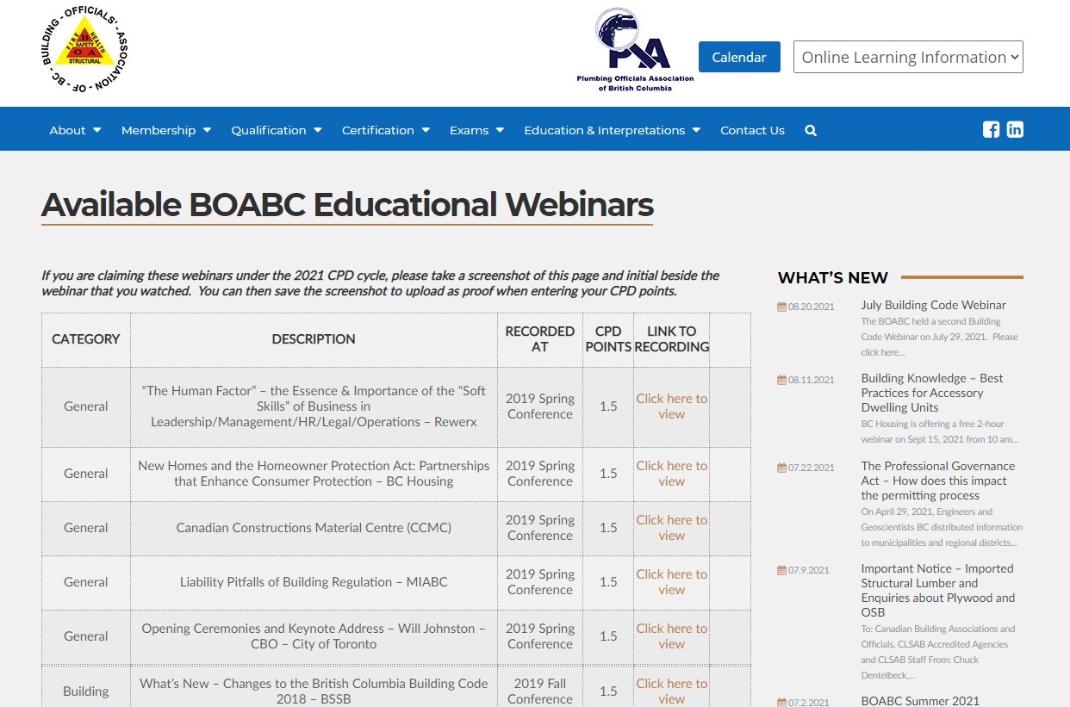
In The Know
FIRE SEPARATIONS

Slide 10
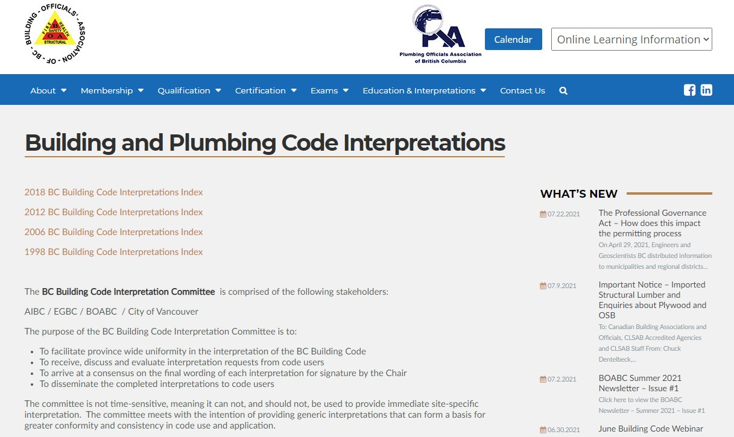
In The Know
2018 BCBC
 18-0007 - Fireblocking Within Rainscreen
 18-0019 - Motorized Smoke Dampers in
High Rise Building
 18-0021 - Firestopping at Noncombustible Outlet Boxes
 18-0052 - Activation of Smoke Dampers
 18-0055 - Firestopping vs Blocking in Floor/Wall Intersections in Conventional Wood Framing
 18-0058 - Fire block in SFD attic over 20m
 18-0067 - Fire Separation or Fire Rating of Roof over Elevator Hoistway
 18-0093 - Firestopping of Outlet Boxes
 18-0099 - Fire Blocking in a Lowered Ceiling
Recent Interpretations

Slide 11
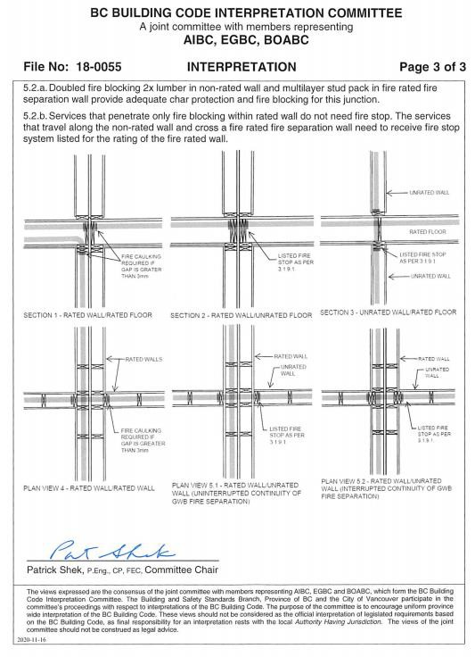
In The Know
18-0055 - RATED AND UNRATED ASSEMBLES
PLEASE REVIEW FOR
THE SEPTEMBER SESSION ON FIRE STOPPING

Slide 12
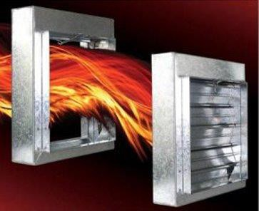
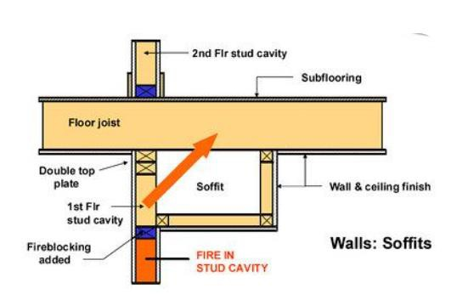
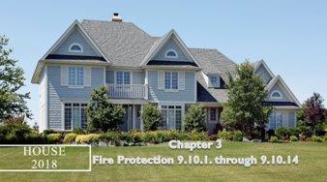
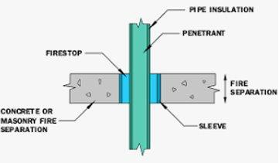
FIRE BLOCKING, FIRE STOPPING, FIRE/SMOKE DAMPERS.
PART 1

Slide 13
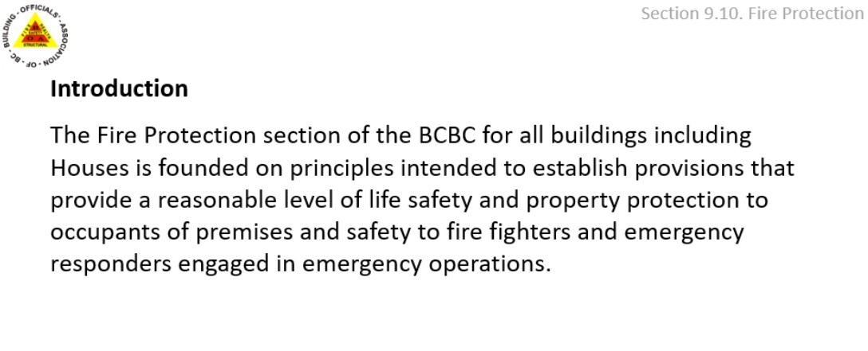
 T
TODAY'S SESSION WILL REVOLVE AROUND SIMPLE PART 9 BUILDINGS – 9.10 & SPECIFICALLY 9.10.16 FIRE BLOCKING

Slide 14
Defined Terms: (2018 BC Building Code):
Fire compartment means an enclosed space in a building that is separated from all other parts of the building by enclosing construction providing a fire separation having a required fire-resistance rating.
Fire separation (F.S.) means a construction assembly that acts as a barrier against the spread of fire.
Fire-resistance rating (F.R.R) means the time in minutes or hours that a material or assembly of materials will withstand the passage of flame and the transmission of heat when exposed to fire under specified conditions of test and performance criteria, or as determined by extension or interpretation of information derived therefrom as prescribed in this Code.
FIRE PROTECTION - GENERAL DEFINITIONS

Slide 15
Defined Terms: (2018 BC Building Code):
Fire stop means a system consisting of a material, component and means of support used to fill gaps between fire separations or between fire separations and
other assemblies or used around items that wholly or partially penetrate a fire
separation.
Fire block means a material, component or system that restricts the spread of fire within a concealed space or from a concealed space to an adjacent space. (no fire separations within a unit)
FIRE PROTECTION - GENERAL DEFINITIONS

Slide 16
 T
N

Slide 17
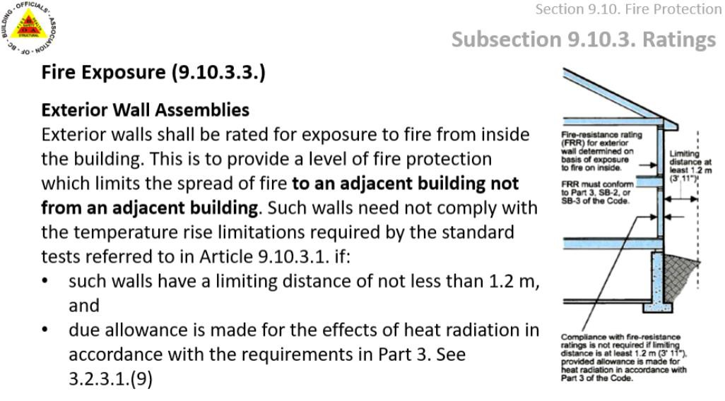
 T
N

Slide 18
 T
N

Slide 19
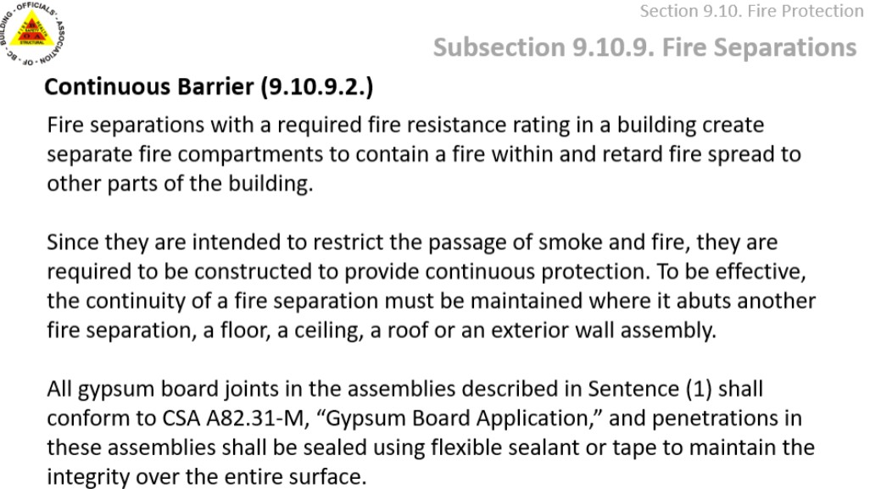

Slide 20
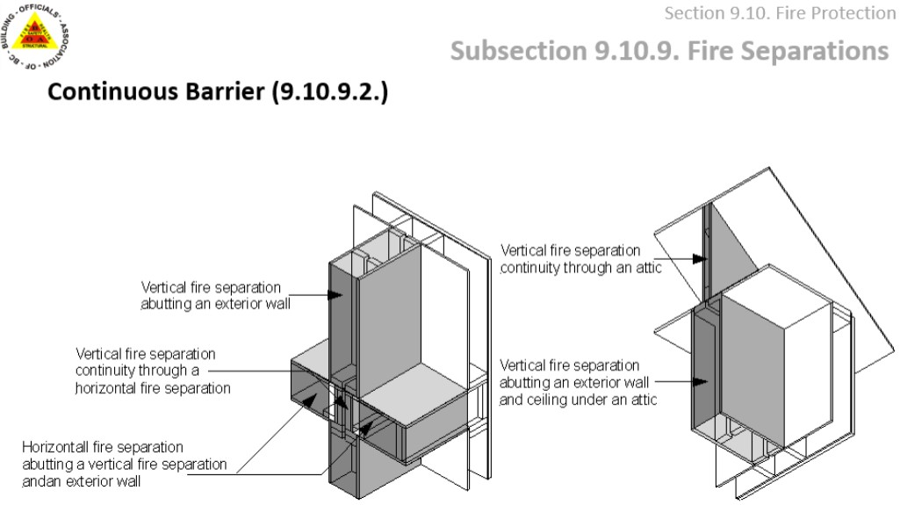

Slide 21
THINK - CONTAIN WITHIN THE BOX

Slide 22
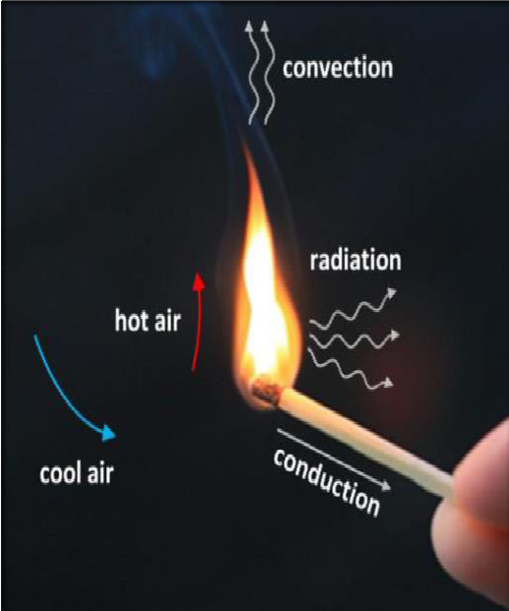
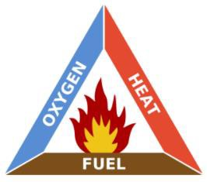
HOW FIRE SPREADS
 Conduction
 Convection
 Radiation
FIRE TRIANGLE
Controlling one will stop or reduce the spread of fire.

Slide 23
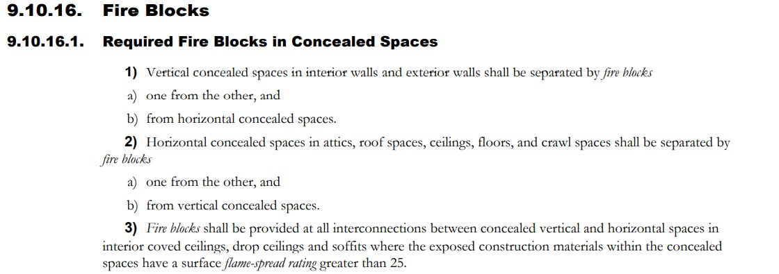
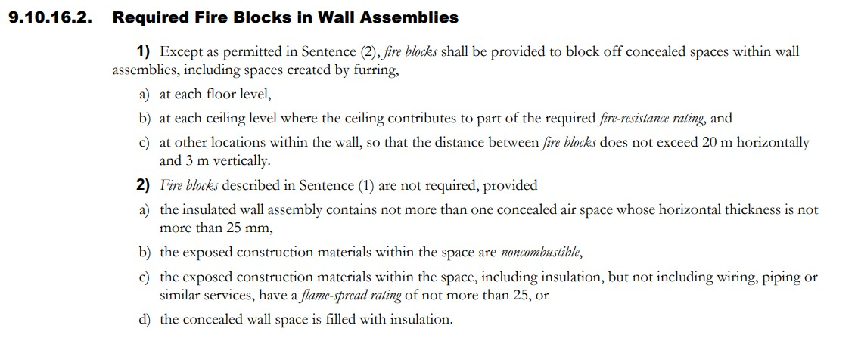
FIRE TRIANGLE
What factors of fire are being considered?

Slide 24
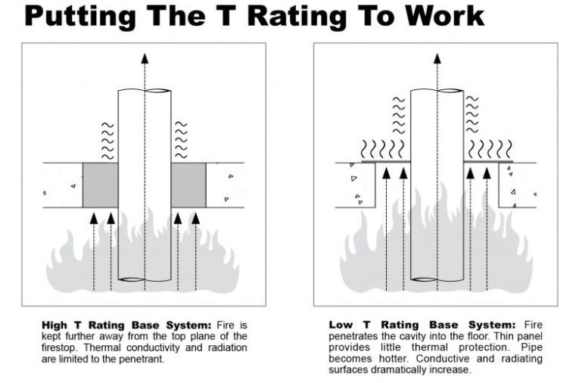
Fire Spread By Conduction
The fire will generally follow the heat or sometimes the heat from conduction may cause a new fire to ignite elsewhere. The heat from the fire is passed from molecule to molecule along the length of the material. The fire will generally follow the heat or sometimes the heat from conduction may cause a new fire to ignite elsewhere.
In houses, walls between rooms are built from materials which are good insulators this helps to keep the heat in the room on a winter's night and helps to slow the rate at which fires spread through houses.
 Conduction Video
HOW FIRE SPREADS

Slide 25
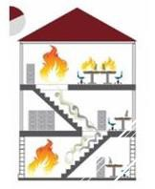
This type of heat transfer occurs only in liquids and gases. The heat from the fire can heat the air, to a very hot temperature. Hot air will always rise and it will flow under
Fire Spread By Convection
the ceiling of a room spreading the heat from the fire. This is the main
way in which a fire spreads throughout
a house. When a fire is burning large amounts of hot gases and smoke are produced. These will travel through the house in hot
air currents often igniting more
combustible materials causing the fire to spread.
Convection Video
HOW FIRE SPREADS

Slide 26
Fire Spread By Radiation
In this form of heat transfer, the heat does not travel through a material like conduction nor does it flow through air or liquid currents like convection. It simply travels in rays similar to sun rays, in straight lines away from the fire. The heat from the rays can be absorbed by combustible materials which cause them to heat up and perhaps ignite. The main principle
of radiation is: the closer the material is to the fire the more radiated heat it will receive. Certain
materials such as concrete do not allow radiation to pass through them. Therefore, materials like concrete are good construction materials to
help prevent fires spreading through houses or to nearby buildings. Radiated heat from a burning building can in some circumstances give
rise to fire in a nearby building.
 Radiation Video
HOW FIRE SPREADS

Slide 27
CONTROL FIRE AND SMOKE BY KEEPING IT IN THE BOX AND CONTROL ELEMENTS OF FIRE

Slide 28
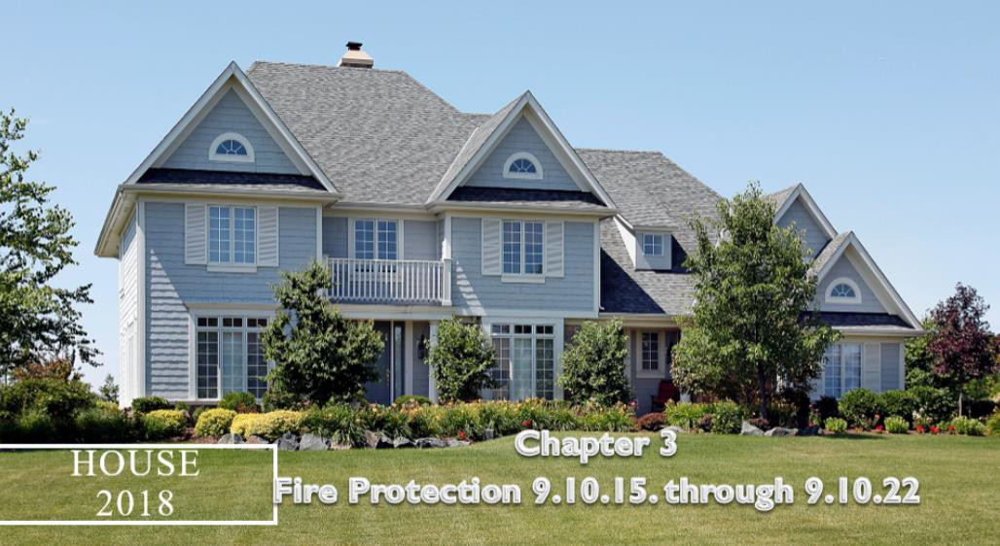
BOABC Module 03 (D – E –F)
Fire Protection 9.10.16.
Following slides taken from BOABC teaching module 03
FIRE BLOCKING 9.10.16

Slide 29
2012 BCBC CHANGES - FIRST DEFINED TERM FOR FIRE BLOCKING.

Slide 30
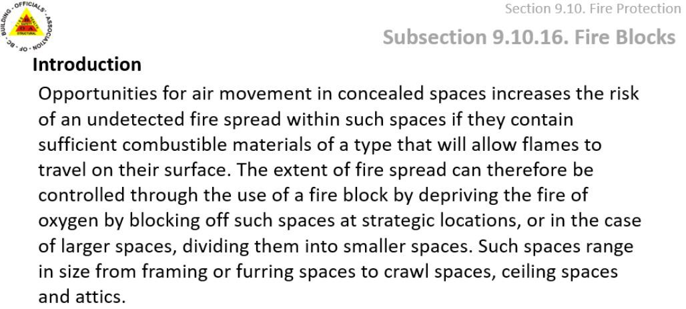
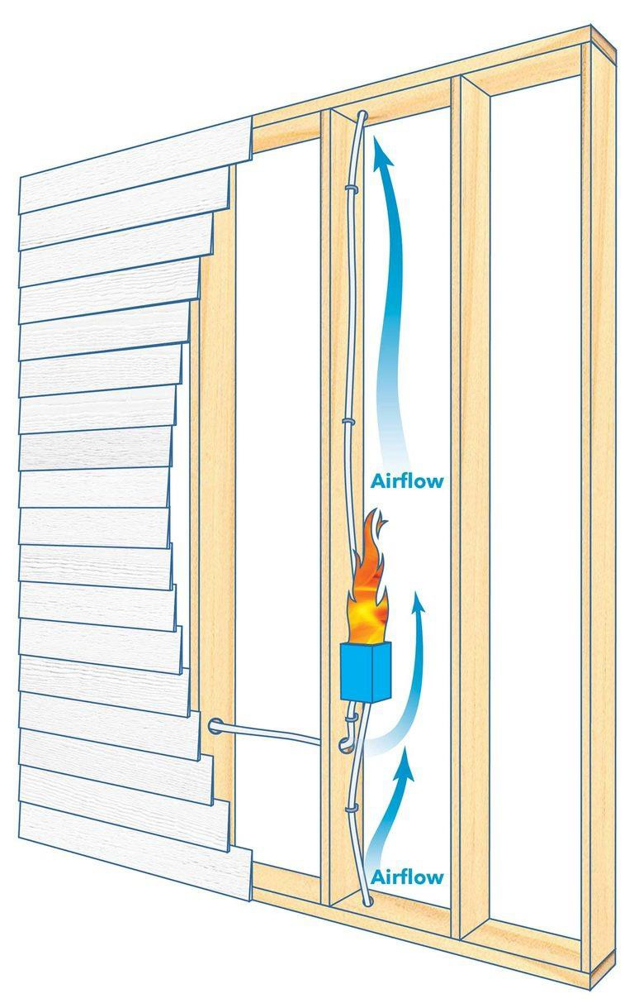
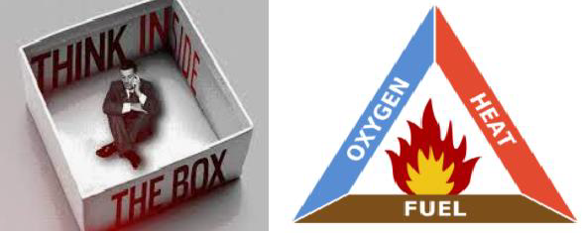
 T
N

Slide 31
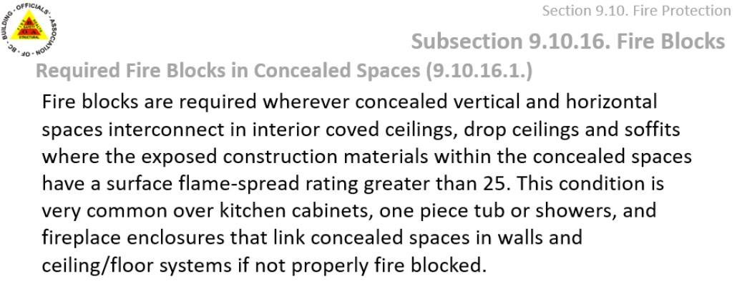
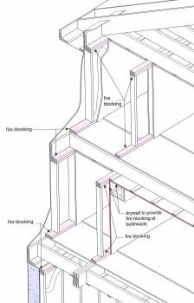
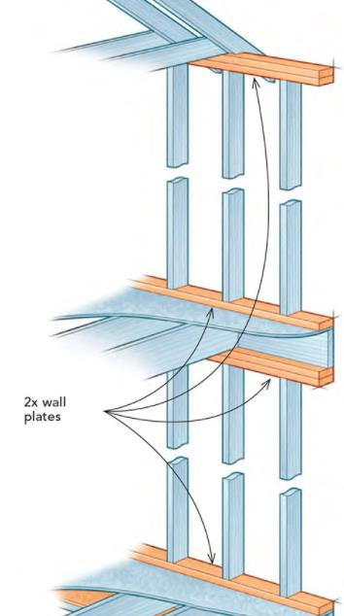
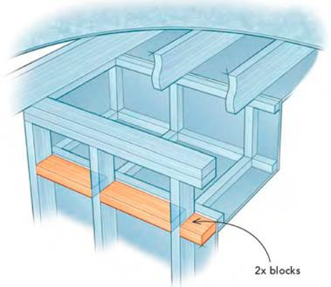
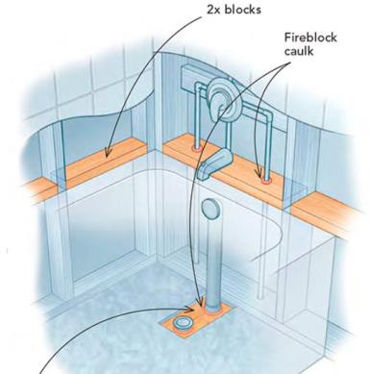
Figure from NBC
I llustrated Guide
 T
N
7 Common Fireblocking Locations - Fine Homebuilding

Slide 32
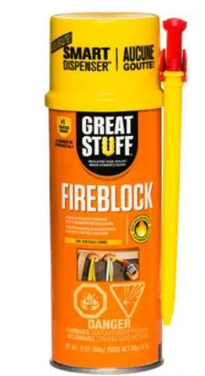
????
 T
FIRE BLOCKING MATERIALS
li to d e t
NC

Slide 33
FIRE BLOCKING -EXCEPTIONS
 T

Slide 34
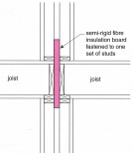
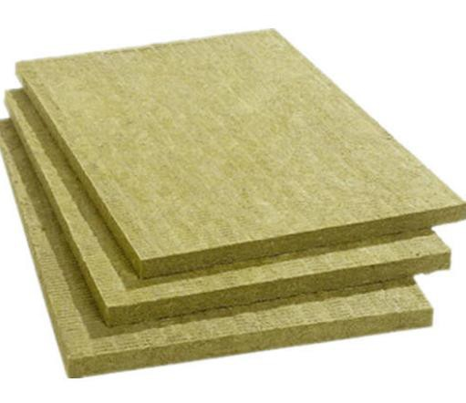
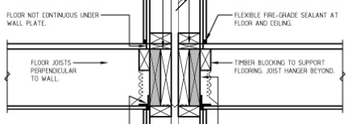
 T
Figure from NBC
I llustrated Guide
FIRE BLOCKING MATERIALS EXCEPTIONS
How often is this used?
Installed correctly?

Slide 35
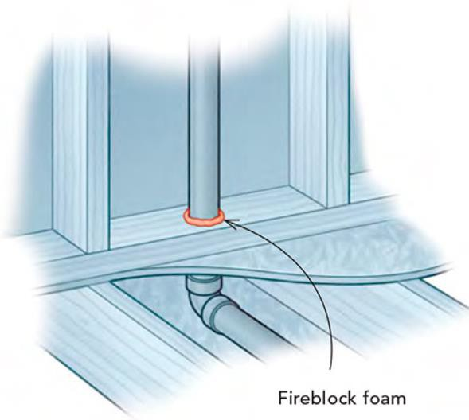
 T
FIRE BLOCKING MATERIALS EXCEPTIONS
How is this commonly done in the field?

Slide 36
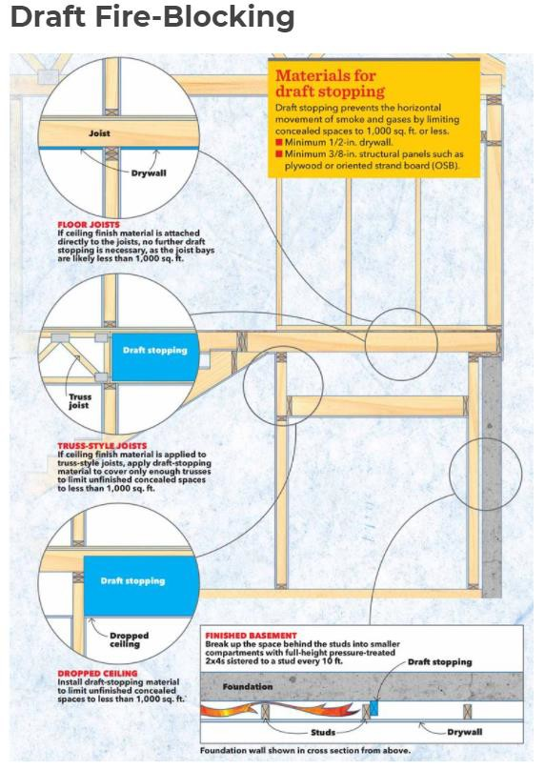
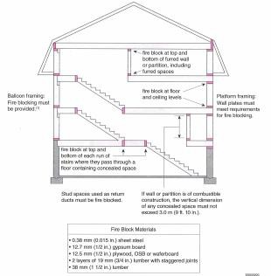
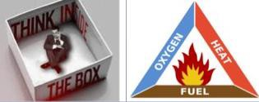
Figure from NBC
I llustrated Guide
 T
Fire Blocking Basics: What Every Homeowner Needs to Know | Family Handyman
FIRE BLOCKING

Slide 37
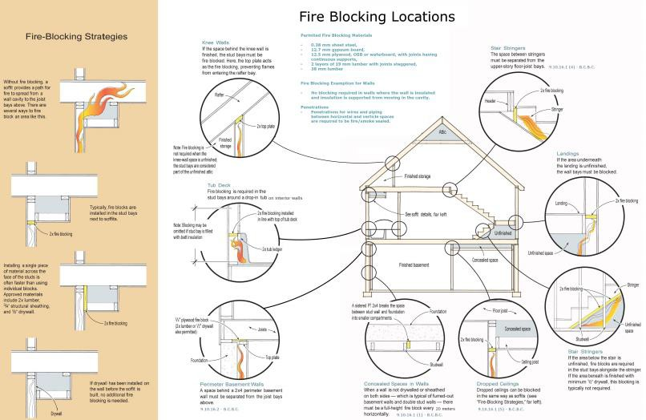
City of Penticton hand-out
 T
FIRE BLOCKING GRAPHIC
Who is allowing insul. Batts?
9.10.16.2 (d)

Slide 38
Member Question
MEMBER QUESTION – 9.16.10.1(5)

Slide 39
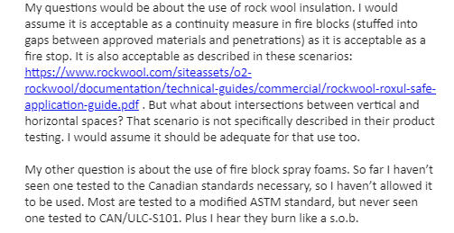
Member Question
MEMBER QUESTION – 9.16.10.1(5)
Rockwool Guide

Slide 40
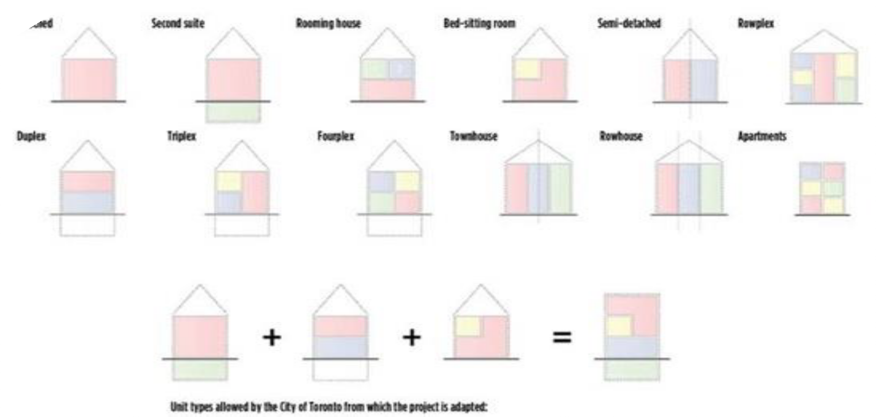
INDUSTRY CHALLENGES
 Lack of Fire Protection
knowledge
 Lack of training and
trade certification
 more complex
buildings/mixed uses
 Unclear drawings and specifications

Slide 41
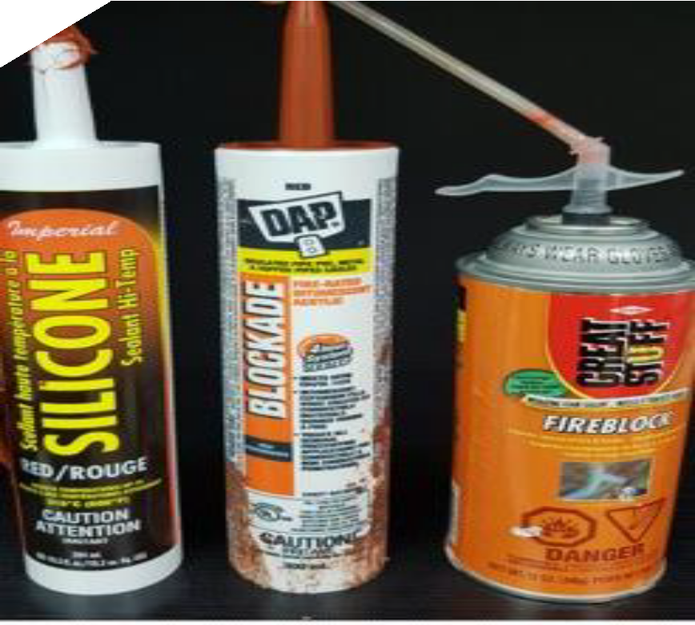
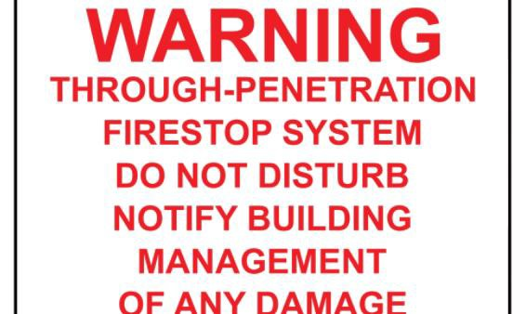
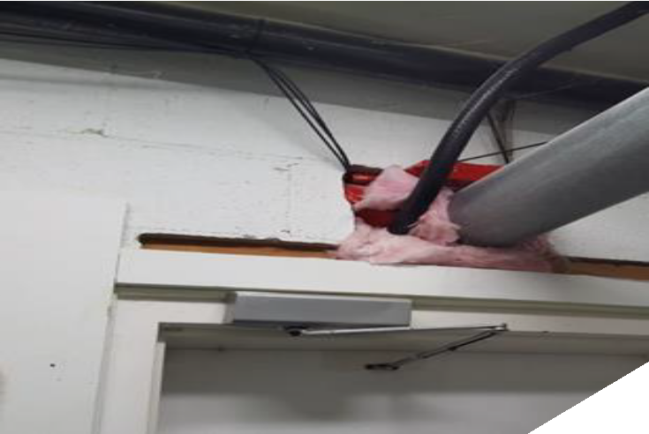
INDUSTRY CHALLENGES
 New products –
wrong application
 Mix and match of listed products
 General Contractor or Trades
 Post Occupancy alterations

Slide 42
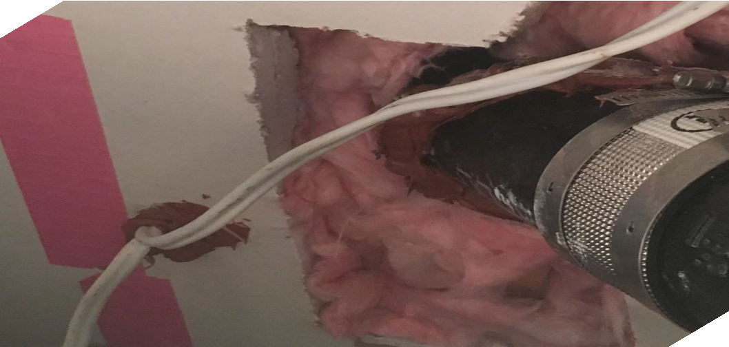
 Is your building department using a specific evaluation method & inspections?
INDUSTRY CHALLENGES
 How is that information provided on drawings and verified on site?
 Is this information understood by the design - builder - trades?
Please forward responses to BOABC – kkunka@boabc.org

Slide 43
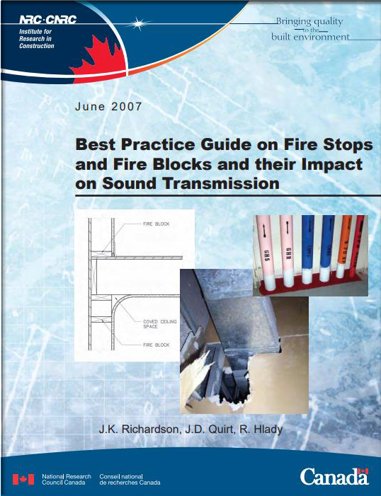
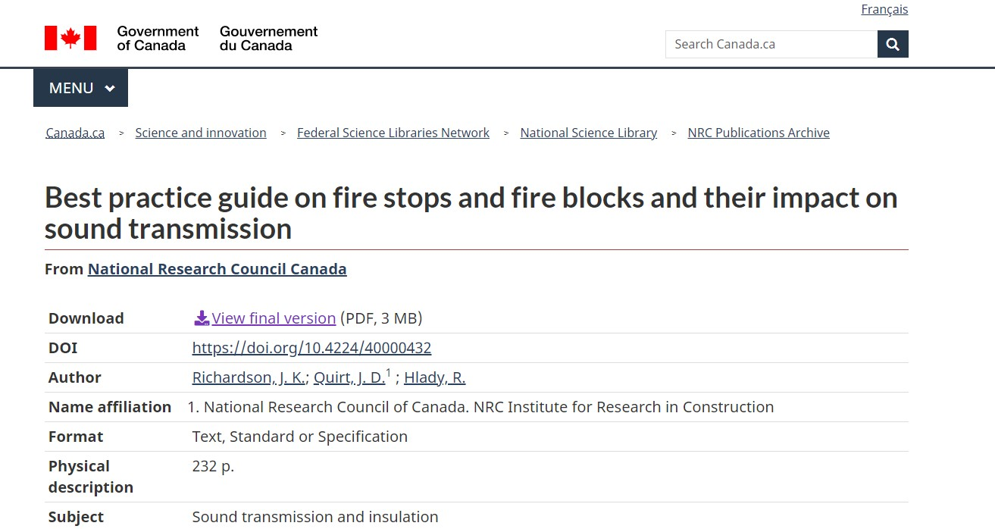
Best practice guide on fire stops and fire blocks and their impact on sound transmission - NRC Publications Archive - Canada.ca
CONTINUED EDUCATION AND RESEARCH

Slide 44
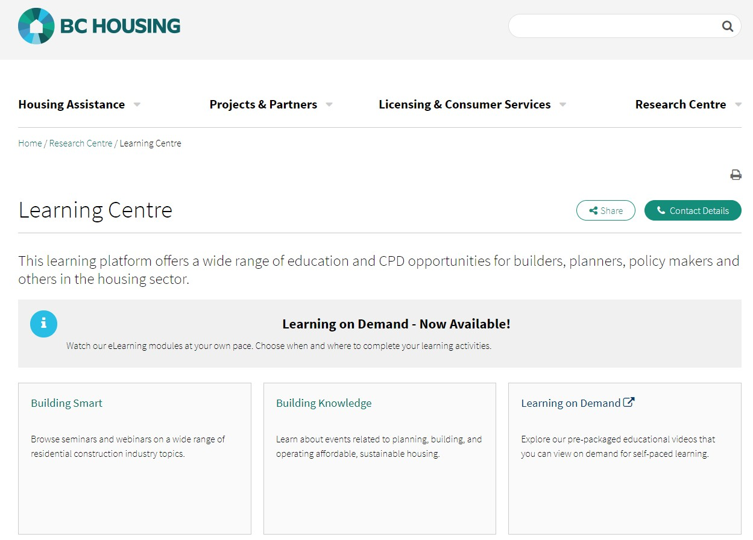
CONTINUED EDUCATION AND RESEARCH
Building Smart: Fire Regulatory Considerations Learning on Demand Centre Link

Slide 45
Next Session – Sept 23 FIRE BLOCKING, FIRE
STOPPING, SMOKE & FIRE DAMPERS – PART 2
OCTOBER 28
COLLECTING ENFORCEMENT EVIDENCE

Slide 46
Session feedback & future topics kkunka@boabc.org
BOABC
contacts
Zone
Meetings
Zone Directors - Mentors
Engagement & Communication Reminder
Member Forum Discussions

