Slide 1
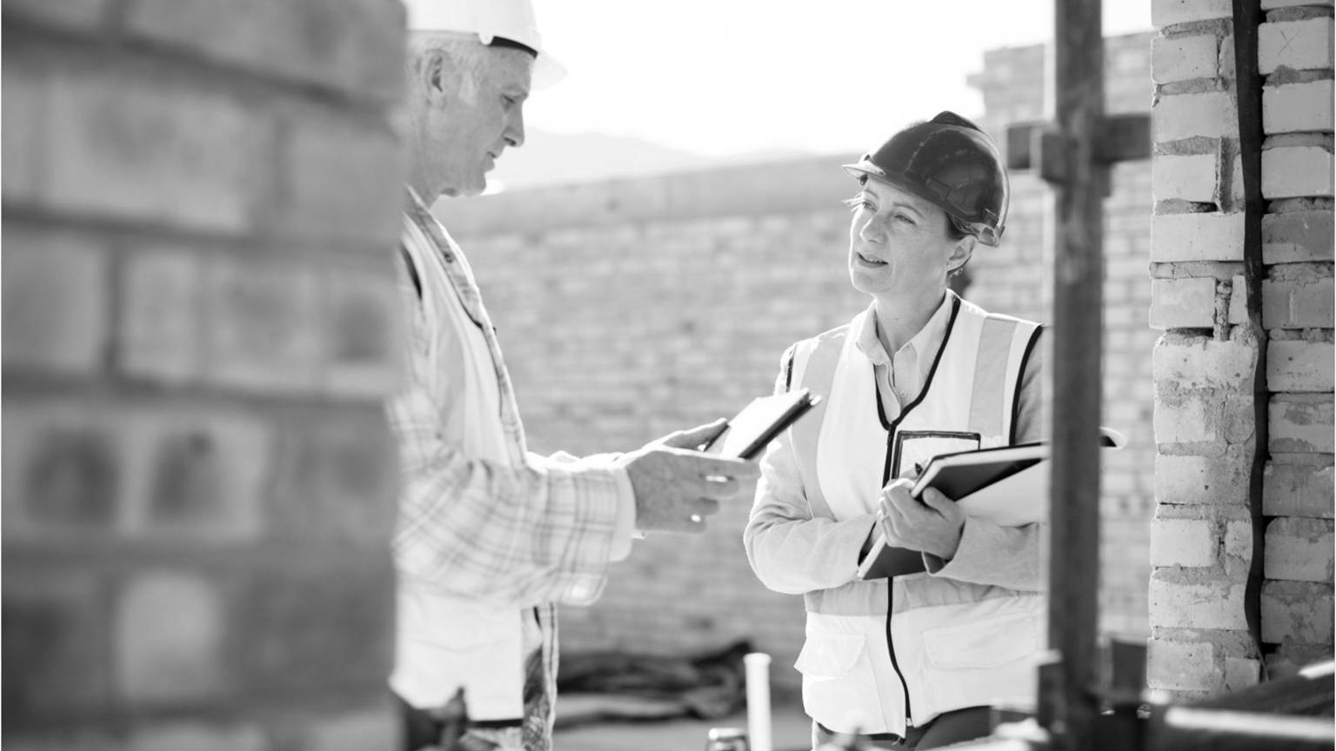
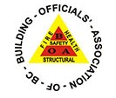
Hosted by Ken Kunka
July 29, 2021
BOABC INFORMATION & STUDY SESSION

Slide 2
Welcome - Agenda
In The Know
Recent Interpretations
AGENDA
Technical Bulletins
Code Appeals
Spatial Separations
History of spatial requirements
Limiting Distance – Offset and Skewed walls
Member Questions
Feedback and Future Sessions

Slide 3
These sessions are intended to:
generate dialogue amongst members
be a source of advice, feedback and options
support members in their work
provide professional development focus on your questions and feedback
PURPOSE
These sessions are not:
the only means for dialogue amongst members
formal education and training
exam review

Slide 4
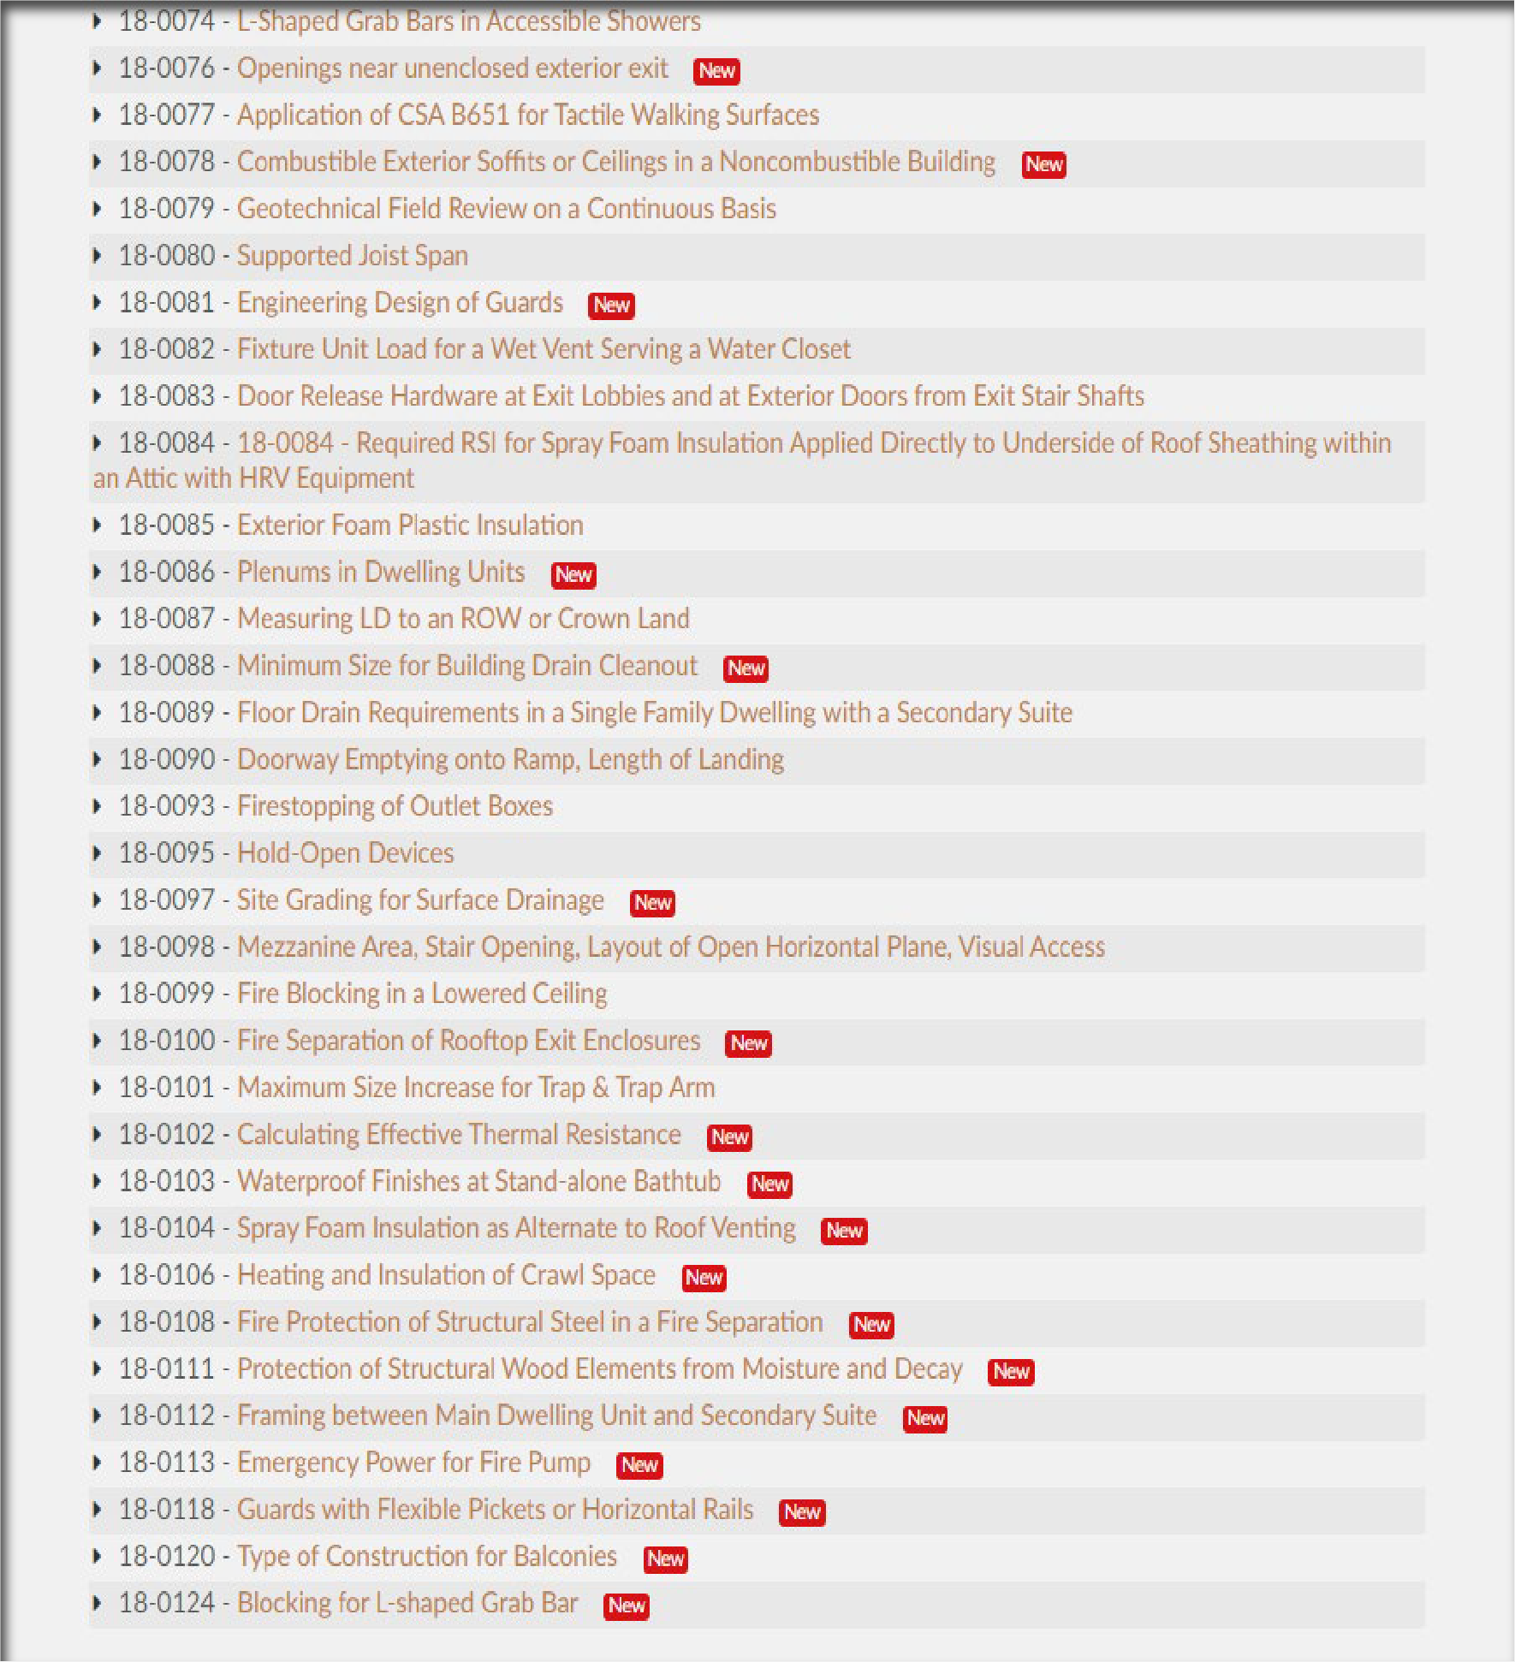
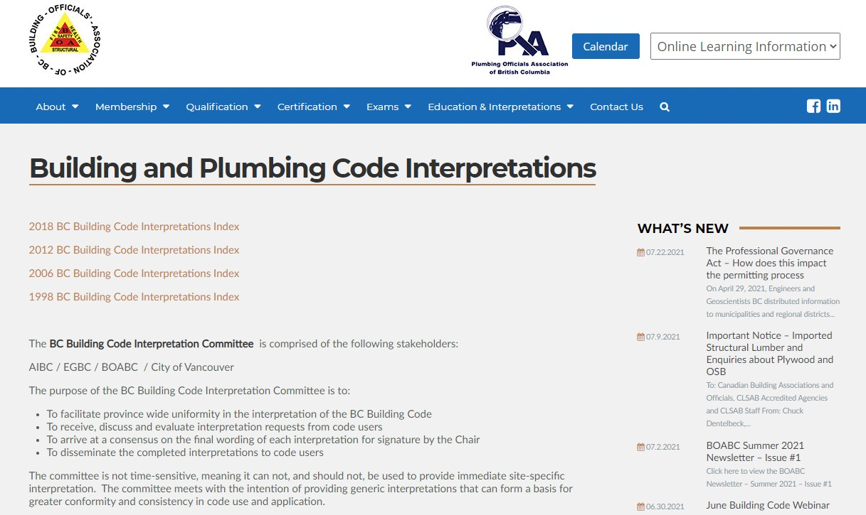
In The Know
Current Interpretations
CURRENT INTERPRET ATIONS

Slide 5
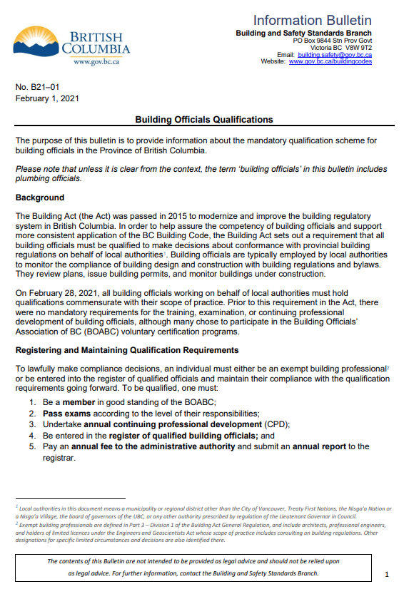
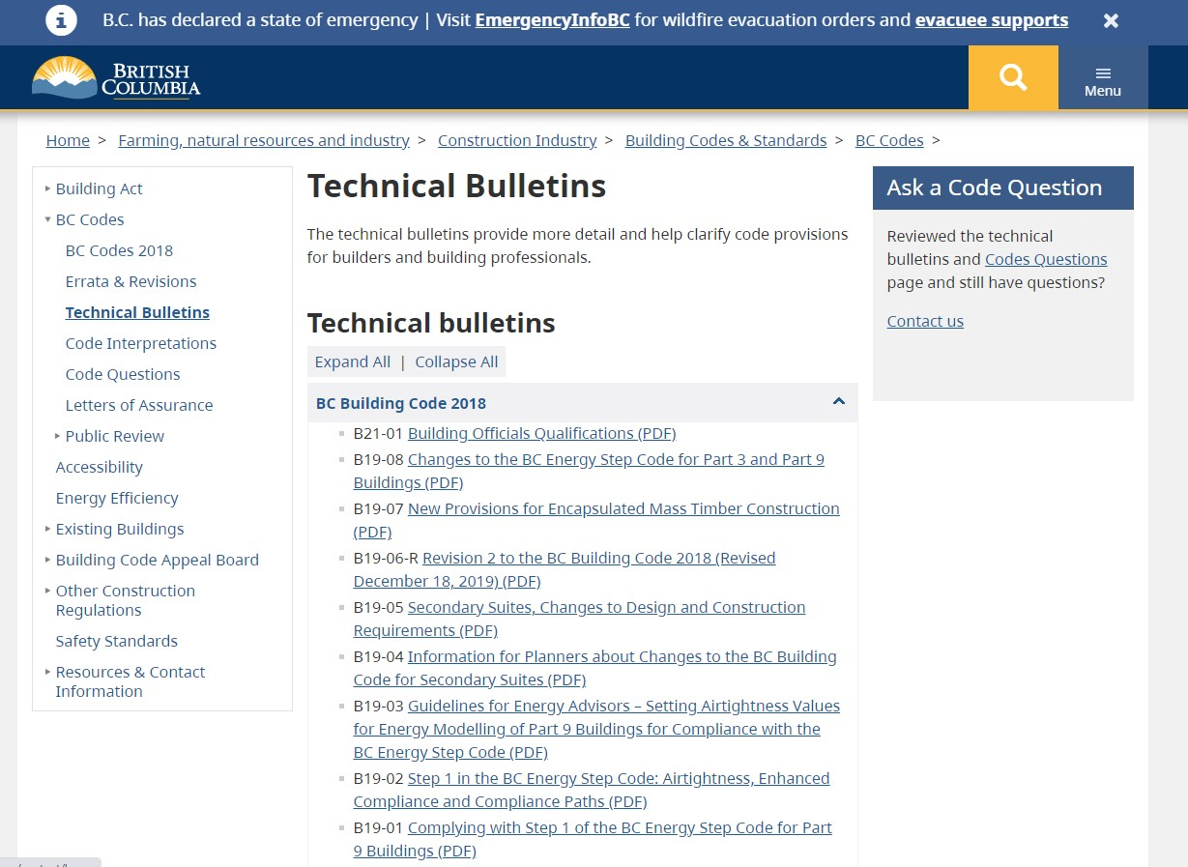
 These sessions are intended to:
IN THE KNOW - TECHNICAL BULLETINS

Slide 6
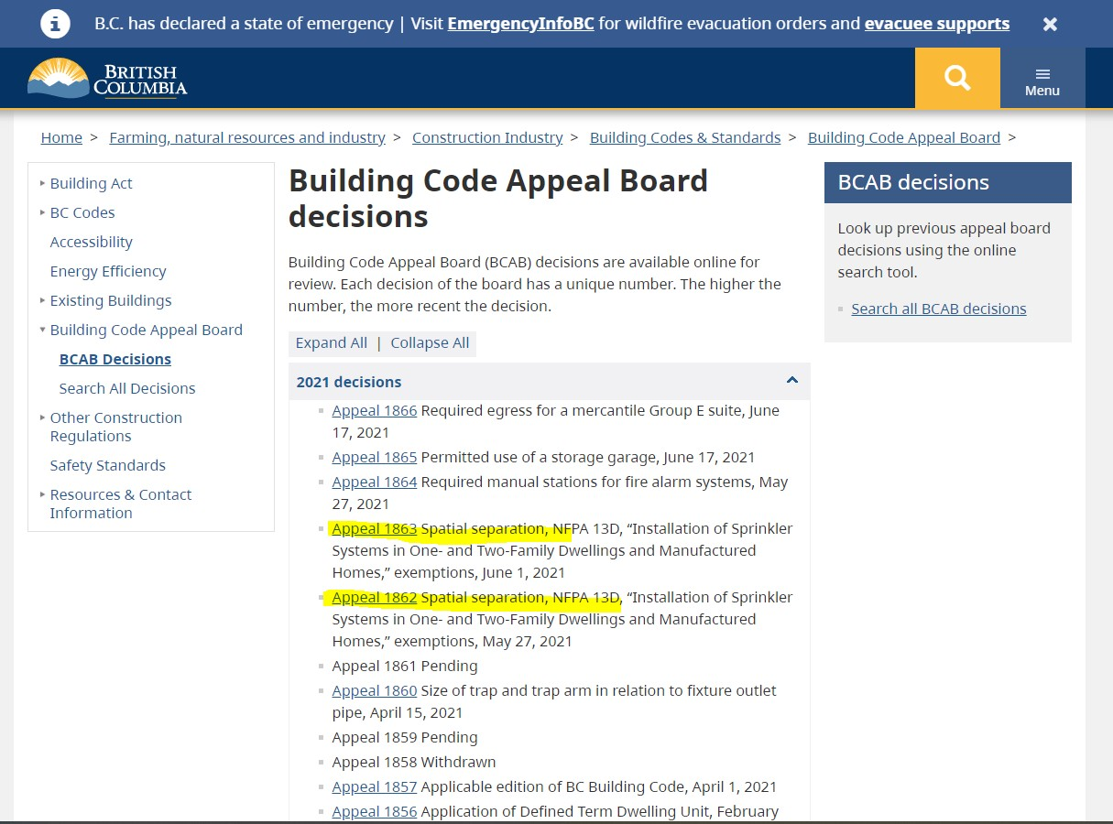
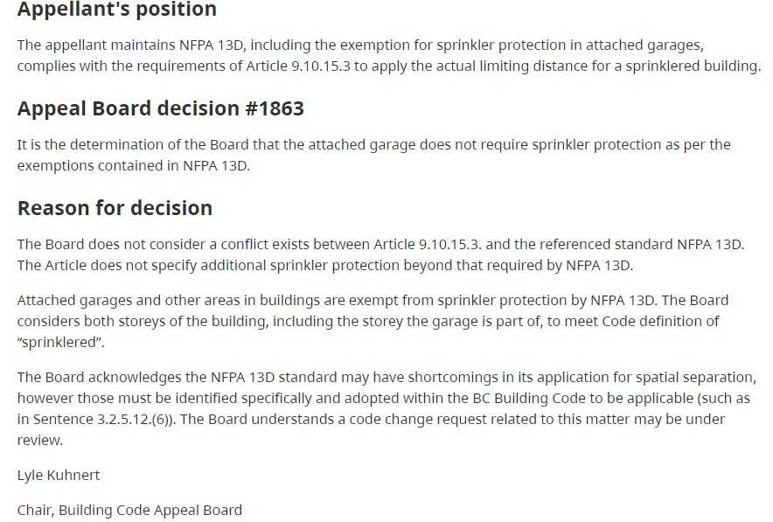
 These sessions are intended to:
IN THE KNOW - BUILDING CODE APPEALS

Slide 7
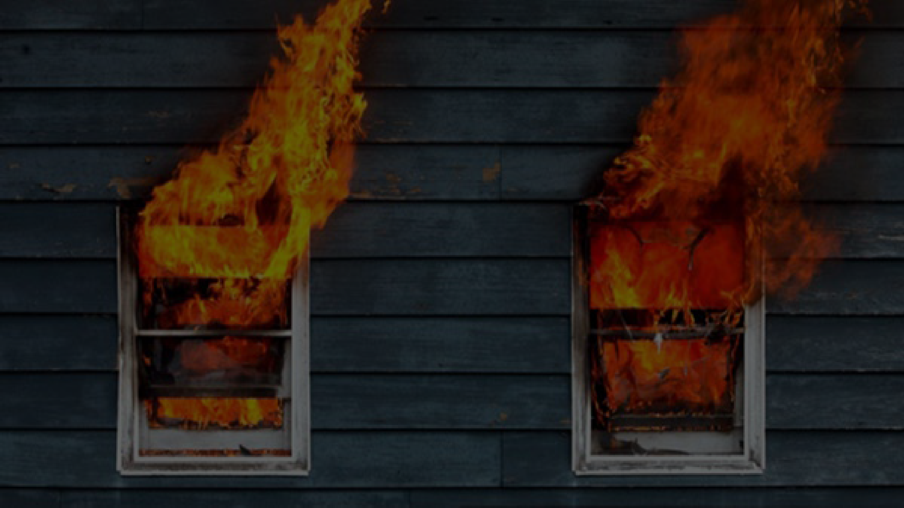
SPATIAL SEPARATIONS
History of Spatial requirements
Limiting Distance for Offset & Skewed walls.

Slide 8
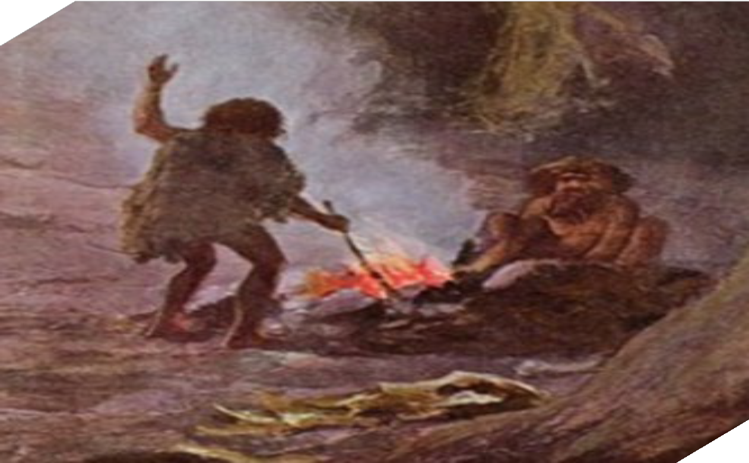
Fire
Years of experience, incidents, tragedies, and education has helped evolve how people handle, control, prevent, contain, and provide safe conditions with fire.
SPATIAL SEPARATIONS

Slide 9
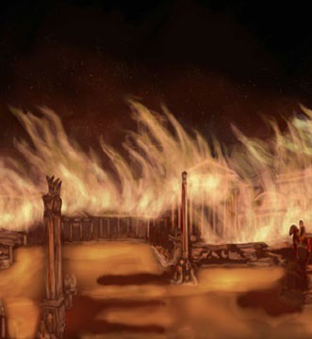
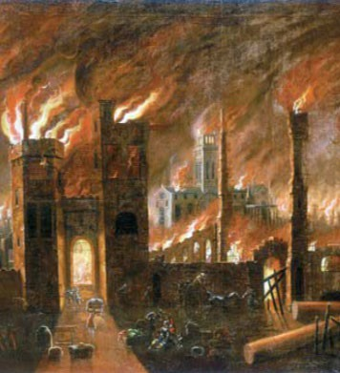
Rome 64AD – 6 days to bring under control Changes
Wider streets,
restrictions on the height of houses;
no common walls of buildings and homes that
were not constructed with fire resistant material such as stone.
London 1666* - It is estimated to have destroyed
the homes of 70,000 of the City's 80,000
inhabitants.
Changes – Rebuilding of London Act 1666
Among other things, the Act added or modified
regulations to:^{[1]}
 Architectural styles of buildings on designated High
Streets
 Heights of private homes
 Building materials (brick and stone preferred)
 Wall thicknesses
 Street widths
 Buildings within 40 feet of the Thames
 Jetties and similar overhangs (banned)

Slide 10
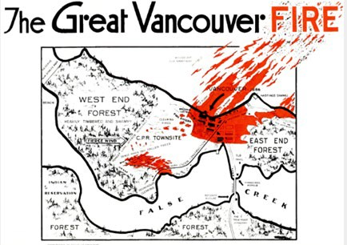
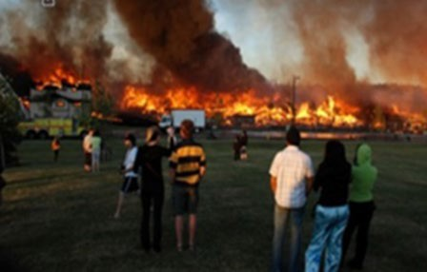
Vancouver - 1886
 Most of Vancouver structures were lost.
 Building rules – enhancement of Fire and Police Dept.
Recent tragedies - Alberta
More recently significant subdivision fires in Alberta has resulted in that province taking significant steps to code changes in spatial requirements.
These fires have led to more in-depth research and new changes to:
 Limiting distances and fire department response time
 Size/Spacing of Unprotected openings;
 Construction of exposing building faces;
 Projections.

Slide 11
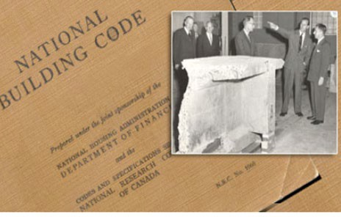
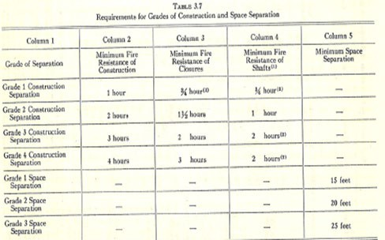
Original Spatial Regulations in the NBC
The NBC originally established the relationship of the size of the building and occupancy related to fire load and the distance to other buildings.
Referencing the 1953 National Building Code (NBC) “grade” separations determined by:
Separation (construction) – Fire Resistance of wall construction
Separation (space) – (Limiting Distance)
Fire load – lbs combustible material/square foot
SPATIAL SEPARATIONS HISTORY

Slide 12
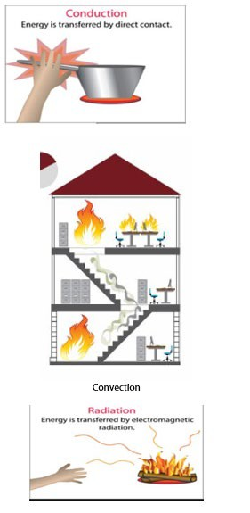
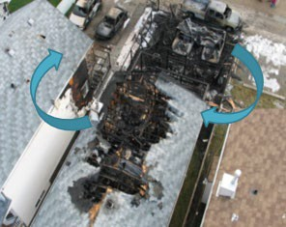
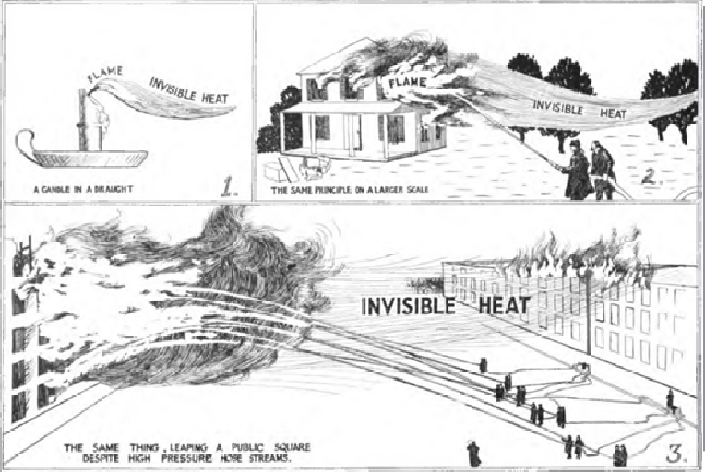
 Conduction
 Convection
 Radiation* - is typically the biggest factor in fire spread and therefore spatial standards have been set to control its effect on neighbour properties.
 The main principle of radiation is: the closer the material is to the fire the more radiated heat it will receive.
 Materials like concrete are good construction materials to help prevent fires spreading through houses or to nearby buildings.
HOW FIRE SPREADS

Slide 13
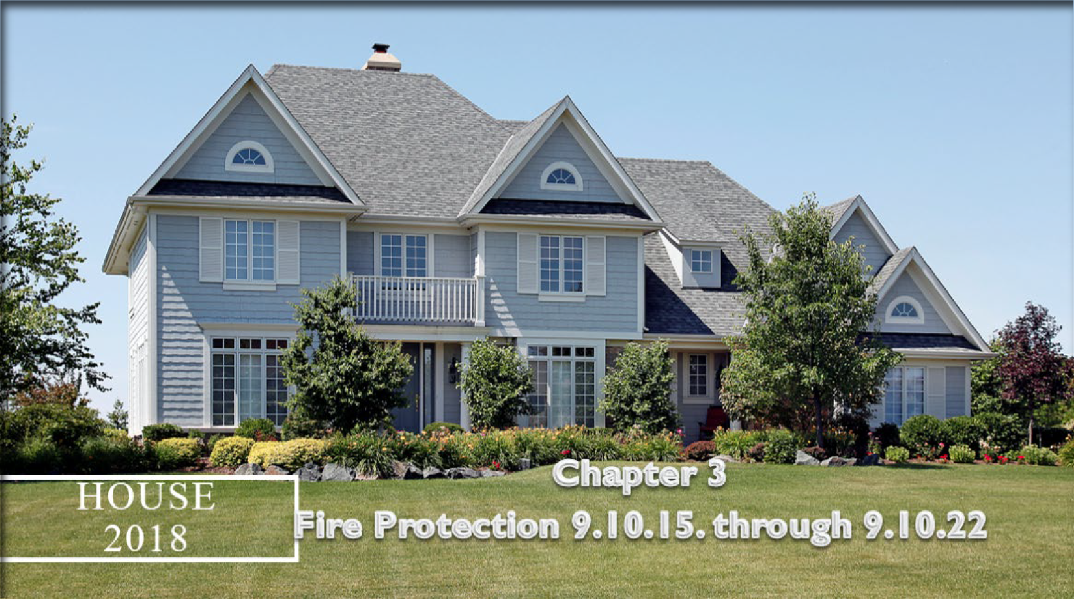
BOABC Module 03 Fire Protection 9.10.15.2
Following slides taken from BOABC teaching module 03
LIMITING DISTANCE OFFSET & SKEWED WALLS

Slide 14
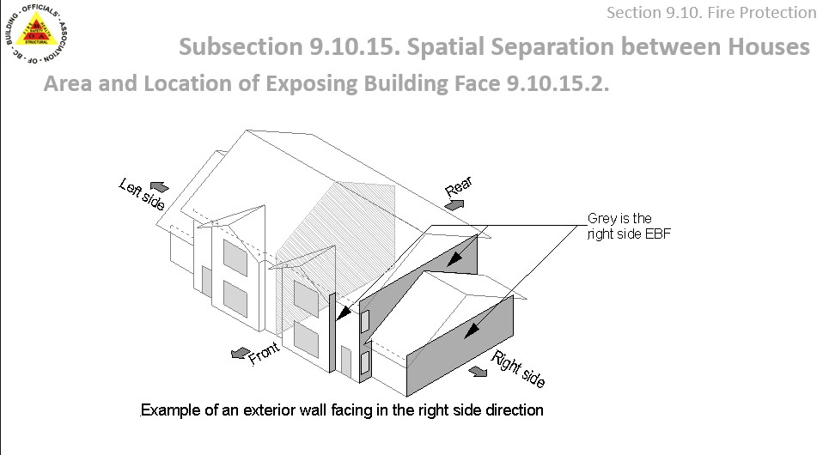
LIMITING DISTANCE OFFSET & SKEWED WALLS
9.10.15.4(2). Construction of Exposing Building Face of Houses
The Code places limits on construction of the exposing building f
There are three limiting distance ratios controlling fire

Slide 15
LIMITING DISTANCE OFFSET & SKEWED WALLS
9.10.15.4(2). Construction of Exposing Building Face of Houses
The Code places limits on construction of the exposing building f
There are three limiting distance ratios controlling fire

Slide 16
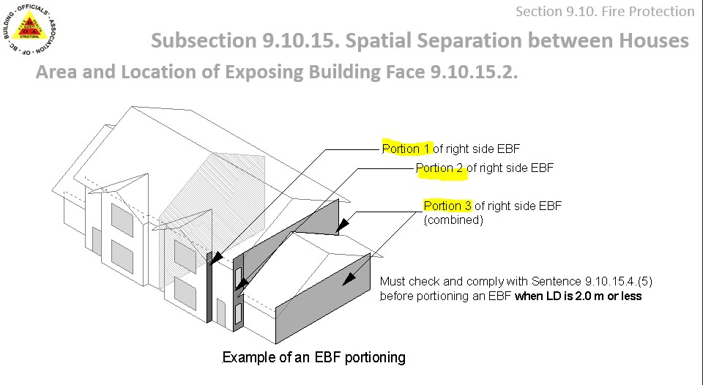
LIMITING DISTANCE OFFSET & SKEWED WALLS
9.10.15.4(2). Construction of Exposing Building Face of Houses
The Code places limits on construction of the exposing building f
There are three limiting distance ratios controlling fire

Slide 17
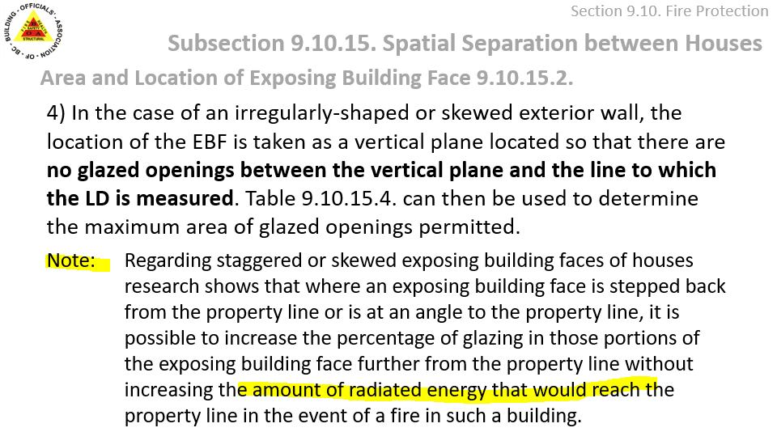
LIMITING DISTANCE OFFSET & SKEWED WALLS
9.10.15.4(2). Construction of Exposing Building Face of Houses
The Code places limits on construction of the exposing building f
There are three limiting distance ratios controlling fire

Slide 18
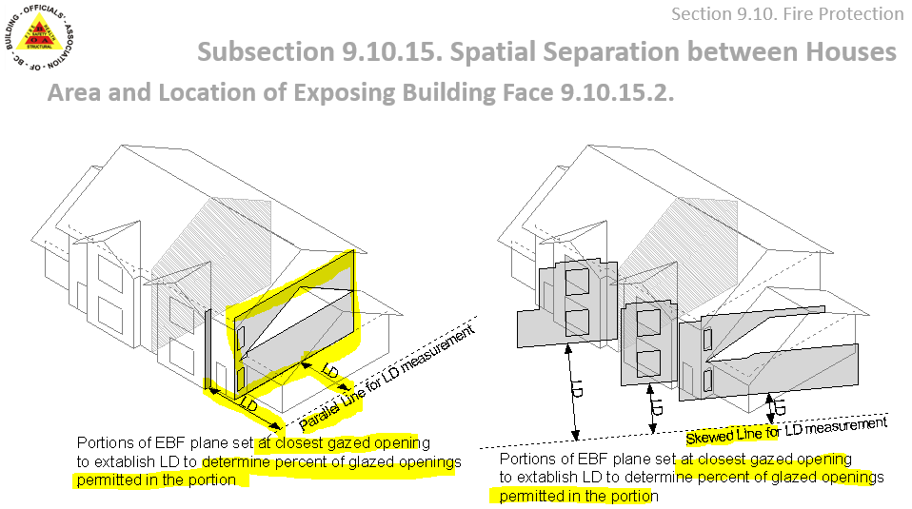
LIMITING DISTANCE OFFSET & SKEWED WALLS
9.10.15.4(2). Construction of Exposing Building Face of Houses
The Code places limits on construction of the exposing building f
There are three limiting distance ratios controlling fire
Percent of Glazed Openings

Slide 19
LIMITING DISTANCE OFFSET & SKEWED WALLS
9.10.15.4(2). Construction of Exposing Building Face of Houses
The Code places limits on construction of the exposing building f
There are three limiting distance ratios controlling fire

Slide 20
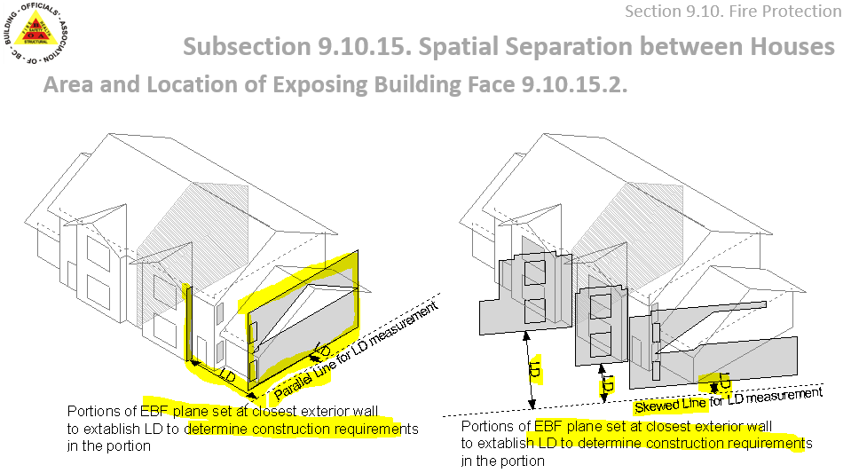
LIMITING DISTANCE OFFSET & SKEWED WALLS
9.10.15.4(2). Construction of Exposing Building Face of Houses
The Code places limits on construction of the exposing building f
There are three limiting distance ratios controlling fire
Construction Requirements

Slide 21
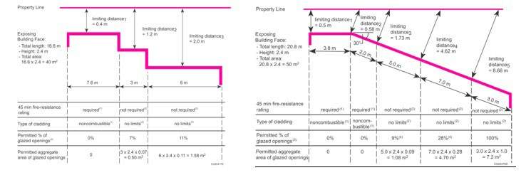
 These sessions are intended to:
 generate dialogue amongst members
 be a source of advice, feedback and options
 support members in their work
 provide professional development
 focus on your questions and feedback
 These sessions are not:
 the only means for dialogue amongst members
 formal education and training
NBC AND BCBC – OFFSET AND SKEWED WALLS NBC WEBLINK

Slide 22
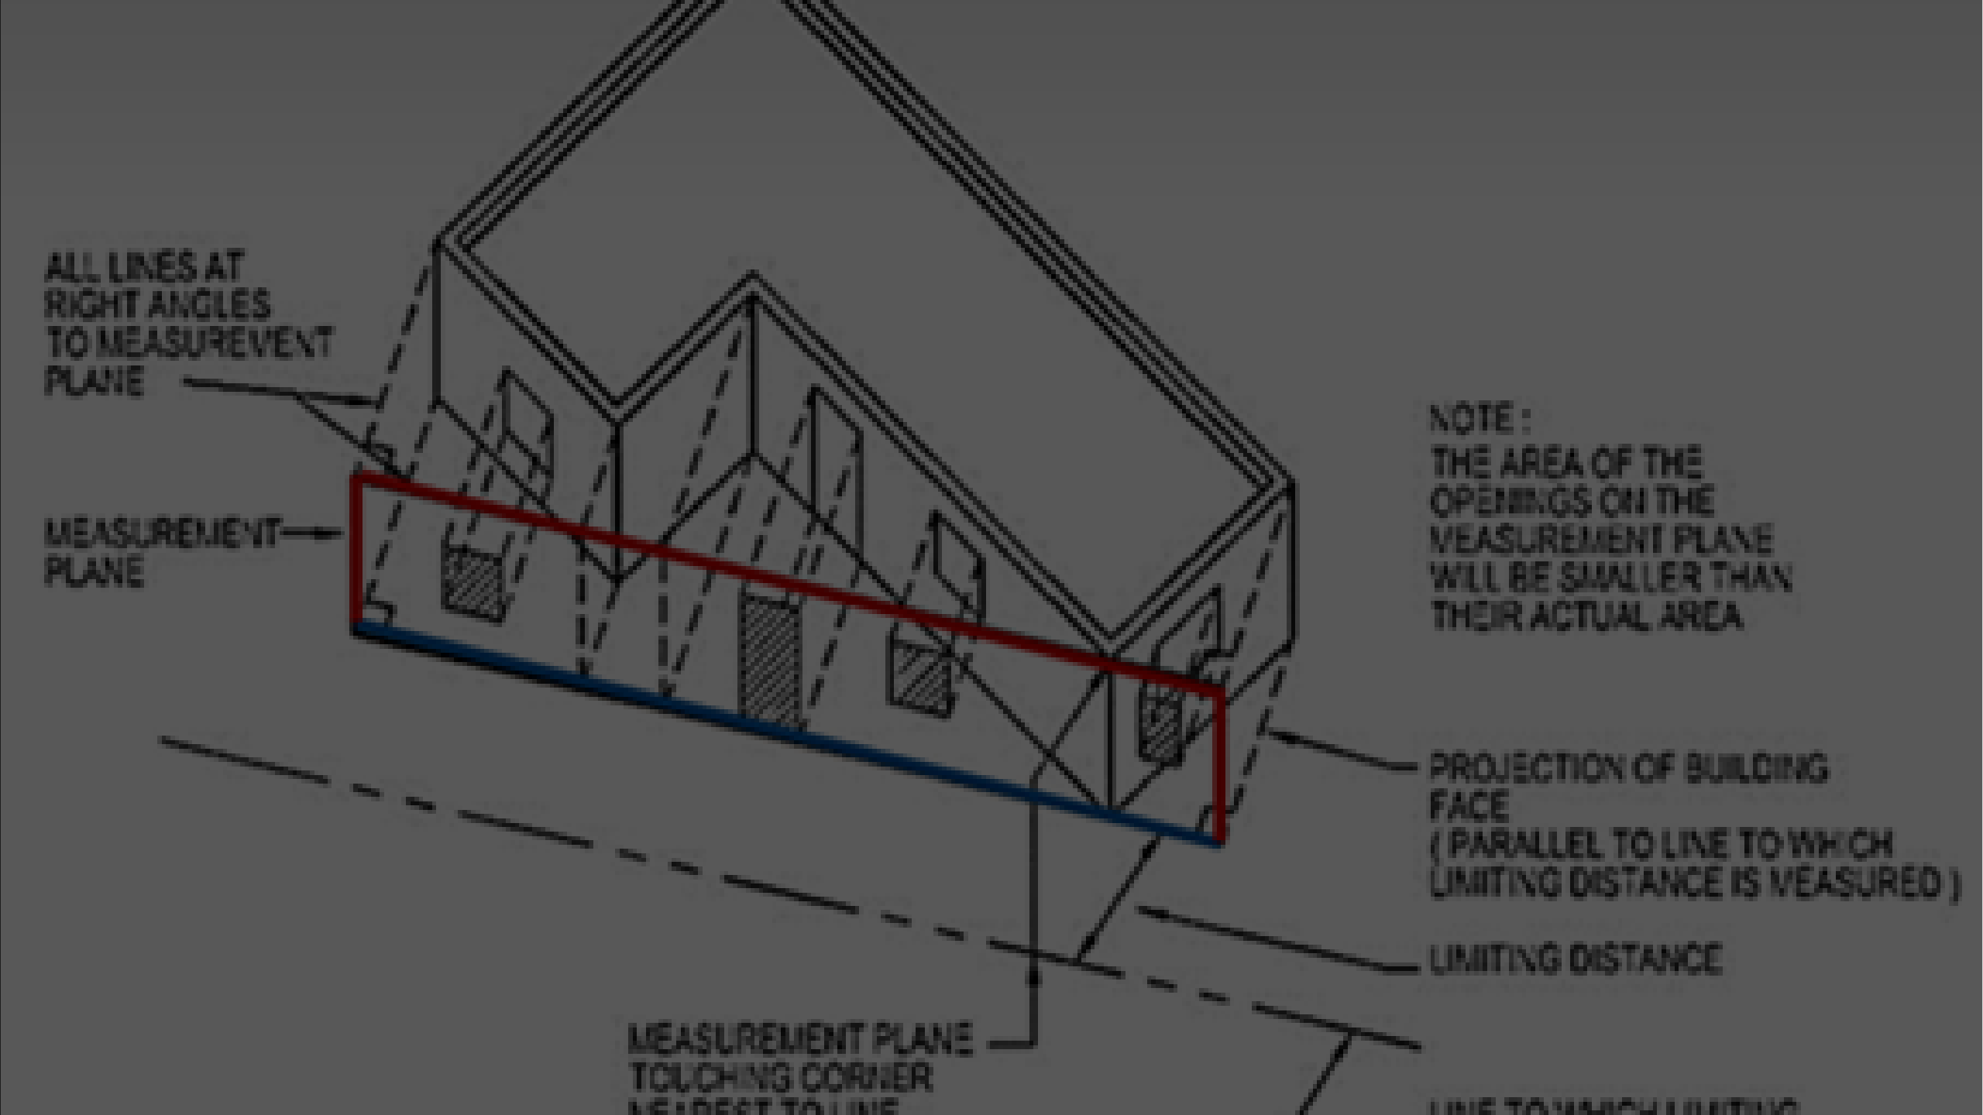
 Is your building department using a specific evaluation method?
 How is that information transferred to the drawings and verified on site? Revised drawings or markup notes?
 Is this information understood by the builder?
Please forward responses to BOABC – kkunka@boabc.org
CONSISTENT APPROACH

Slide 23
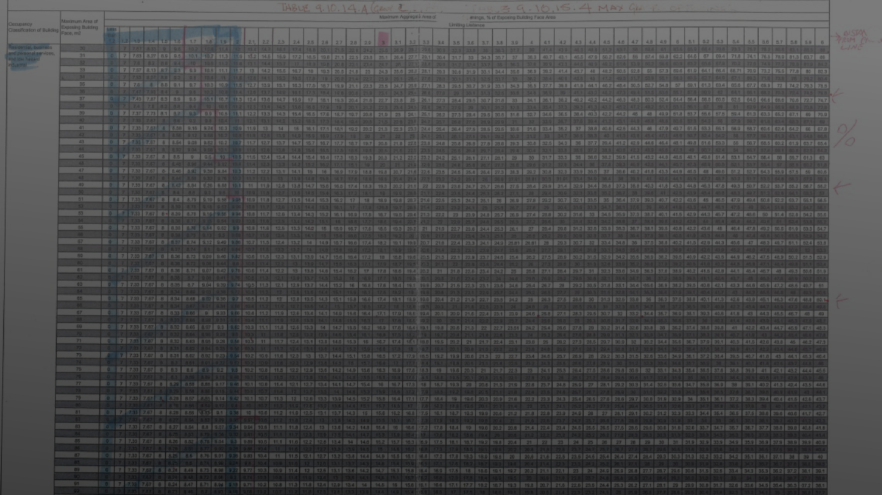
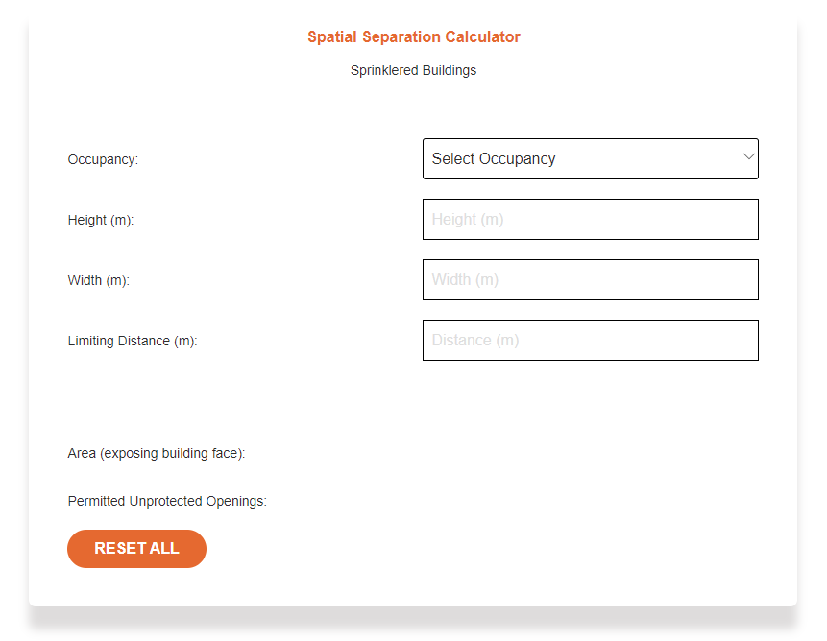
Eliminate interpolation errors to improve consistency
Requesting examples of tools used to calculate spatial requirements
https://vortexfec.com/spatial- separation-calculators/
SPATIAL CALCULATORS

Slide 24
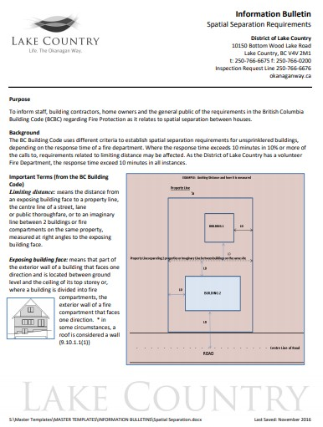
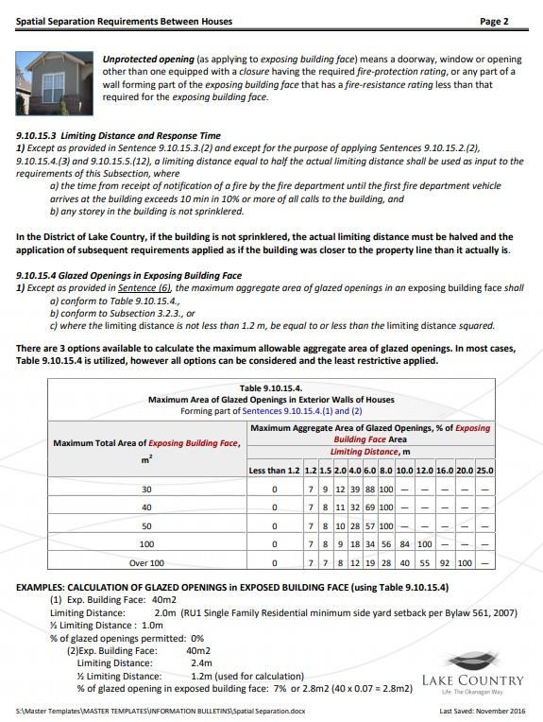
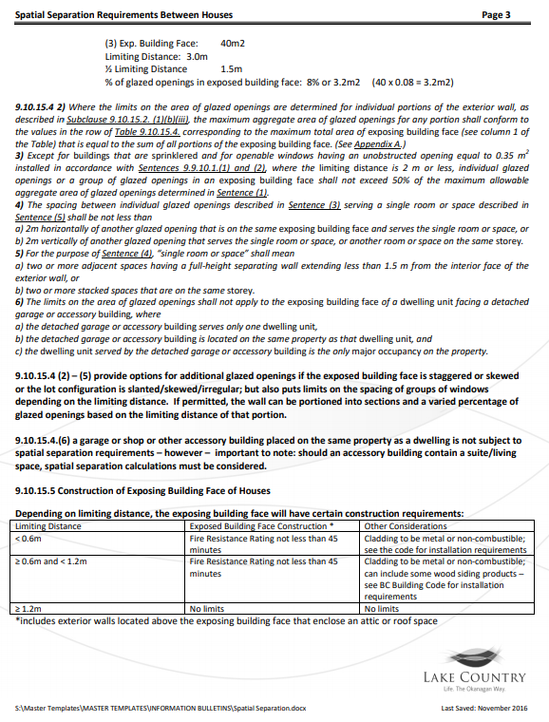
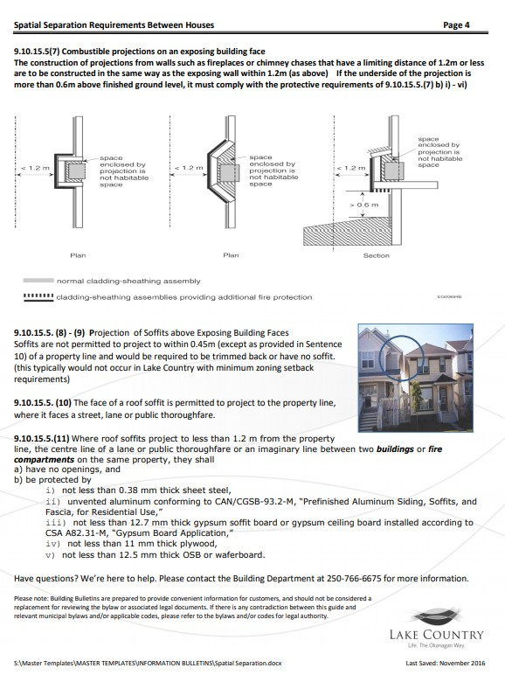
HOW CAN WE HELP BUILDERS AND DESIGNERS UNDERSTAND SPATIAL TO IMPROVE OUR EFFICIENCY AND CONSISTENCY?
SHOULD WE CREATE ONE COMMON DOCUMENT?
CONSISTENT APPROACH

Slide 25
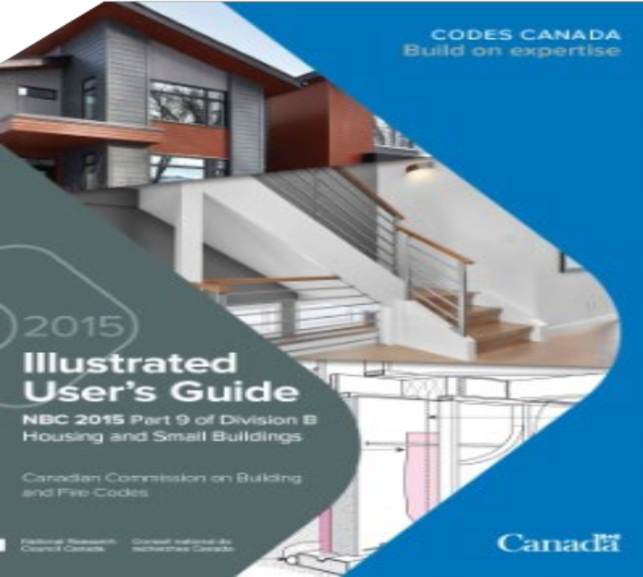
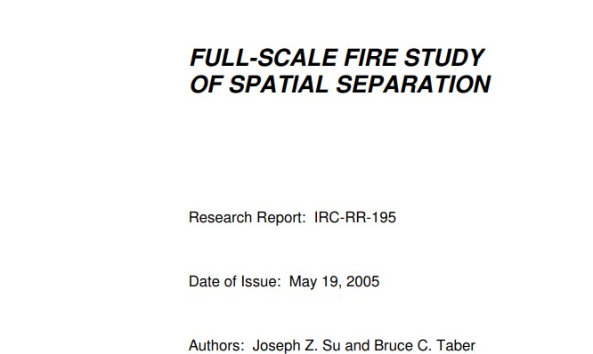
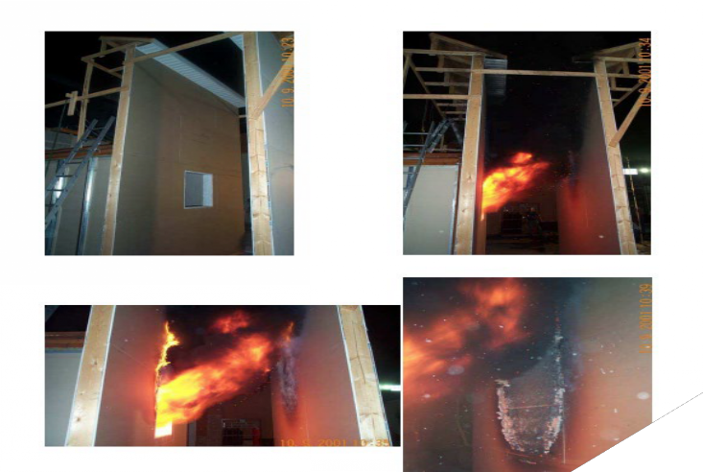
CONTINUED EDUCATION AND RESEARCH
https://nrc- publications.canada.ca/eng
/view/ft/?id=a3eb57c3-04cb- 4231-b2ad-e99c62dc9684

Slide 26
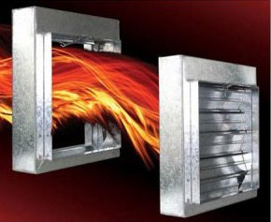
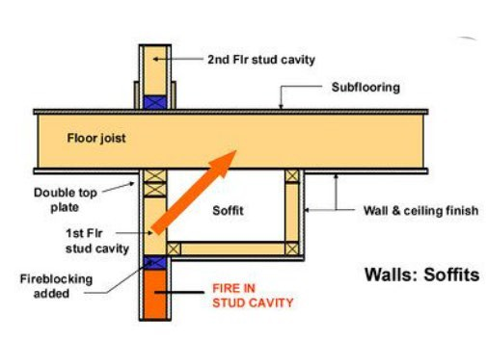
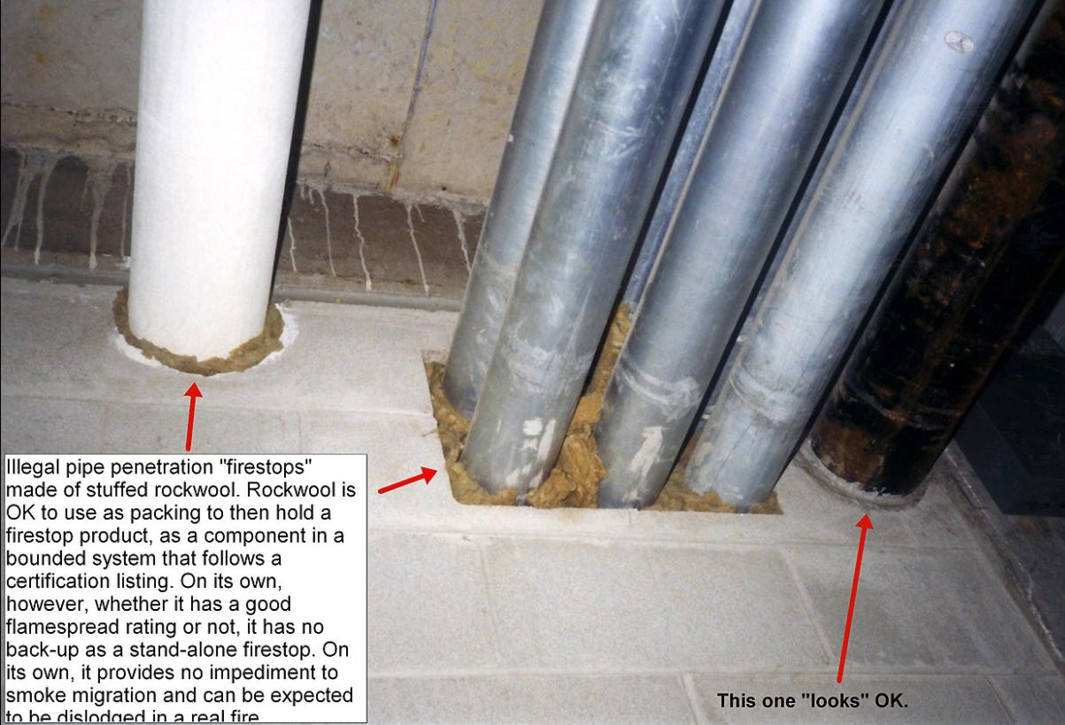
Next Session – Aug 26/21 FIRE BLOCKING
FIRE STOPPING FIRE/SMOKE DAMPERS
THE GOOD, THE BAD, THE UGLY

Slide 27
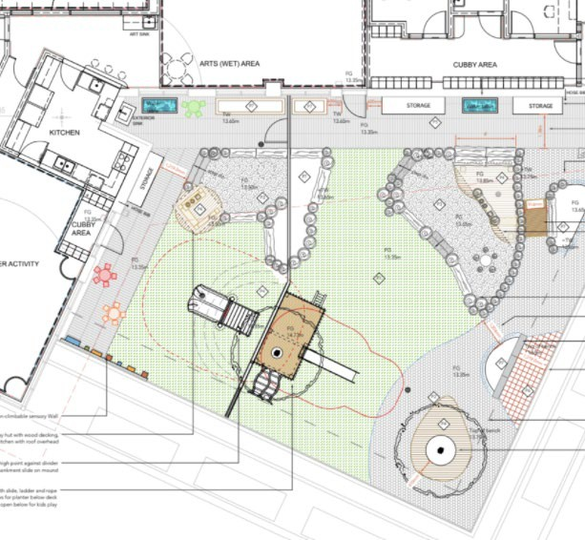
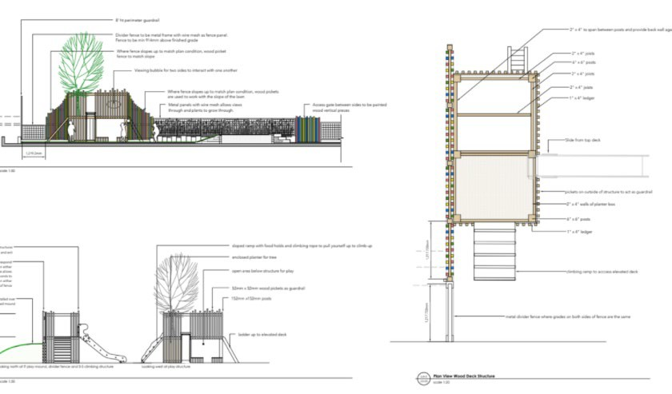
MEMBER QUESTIONS (TO BE ADDED TO FORUM DISCUSSION)
FOR FOLLOW UP
LOW PROFILE POT LIGHTS REQUESTING POLICY/EXAMPLES
FLASHING TAPES
REQUESTING POLICY/EXAMPLES
NEW
GRADE CLEARANCES – LESS THAN 150MM
FIRE DAMPERS - AUGUST SESSION
FARM BUILDINGS OVER 6OO SQM - SEE FORUM
NEW
COMBUSTIBLE PLAY EQUIPMENT – HIGHRISE (NEW) ARTICLE 3.1.5. BCAB #1479
ORIGINALLY BOARD CONSIDERED THE EXTERNAL LANDSCAPE ELEMENTS TO NOT PRESENT A GREATER HAZARD THAN OTHER ALLOWABLE COMBUSTIBLE ELEMENTS AND SUGGESTS AN EQUIVALENCY BE CONSIDERED.
-WAS THERE AN EQUIVALENCY?

Slide 28
Musings of a Code Nerd Relationship between Zoning,
Financing and Building Codes.
https://urbanomnibus.net/2015/03/the-tragic- poetry-of-building-codes/

Slide 29
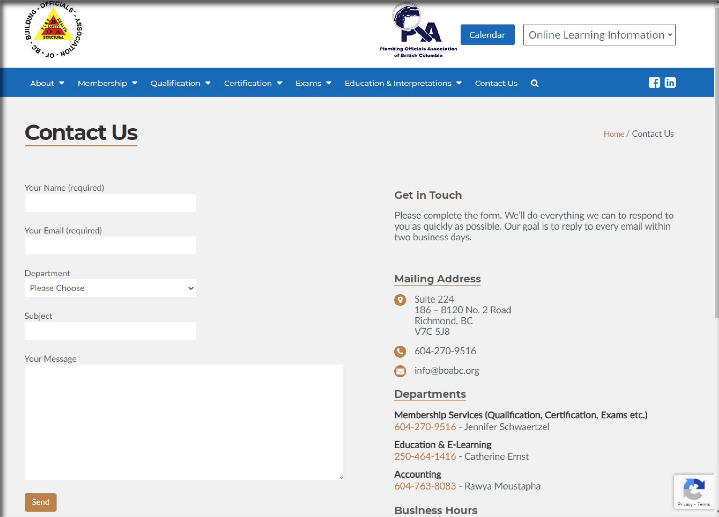
 Session feedback & future topics kkunka@boabc.org
 Engagement & Communication Reminder
 BOABC contacts
 Zone Meetings
 Zone Directors - Mentors
 Member Forum Discussions
NEXT SESSION IS AUGUST 26TH, 2021 FORUM DISCUSSION FIRE BLOCKING, FIRE STOPPING – FIRE/SMOKE DAMPERS

