Slide 1
BOABC Lunch & Learn
March 03, 2022
Hosted by Ken Kunka AScT, RBO
VP Education - BOABC

Slide 2
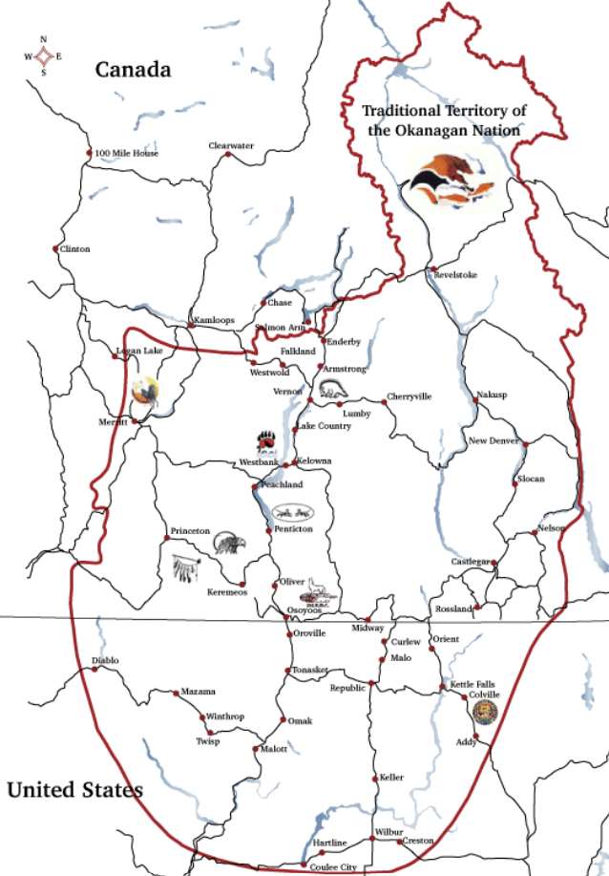
BOABC
Acknowledge the ancestral, traditional, and unceded territories of Indigenous peoples in British Columbia, on whose territory we are today.
Penticton - Syilx (Okanagan)

Slide 3
Ukraine
Holodomor Memorial Day or Holodomor Remembrance Day
Day of memory for victims of the Holodomors is an annual commemoration of the victims of the Holodomor, the 1932–33 famine that killed millions in Ukraine, falling on the fourth Saturday of November. The day is also an official annual commemoration in Canada, and observed by Ukrainian diaspora communities in other countries.

Slide 4
BOABC Mission
BOABC is dedicated to serving the best interests of the public in building safety by moving forward with the highest standards in professionalism, competency and consistent practice in the Building Community.

Slide 5
Objective of these sessions
Intended to:
- Generate dialogue among members,
- Be a source of advice, feedback and options
- Support members in their work
- Provide professional development focus on your questions and feedback
Not Intended to BE:
- The only means for dialogue among members
- Formal education and training
- Exam preparation

Slide 6
Rules of the Room
Registration is being tracked
Presentation is not recorded
Please use “Raise your Hand icon if you have questions – or put in the chat!
Please mute your microphone if you are not speaking.
You may need to turn off your video if your band width is poor.
Please follow up by email if you ahave a specific question or examples related to today’s discussion.

Slide 7
Agenda What’s New & Reminders Interpretations Education Opportunities - Conferences Building Official In Training (B.O.I.T) - Looking for input – trainees, mentors, employers Safe and Durable Balconies and Decks - Permit awareness - Code sections – potential failure points - BC Housing Guide Contact Us with questions or comments

Slide 8
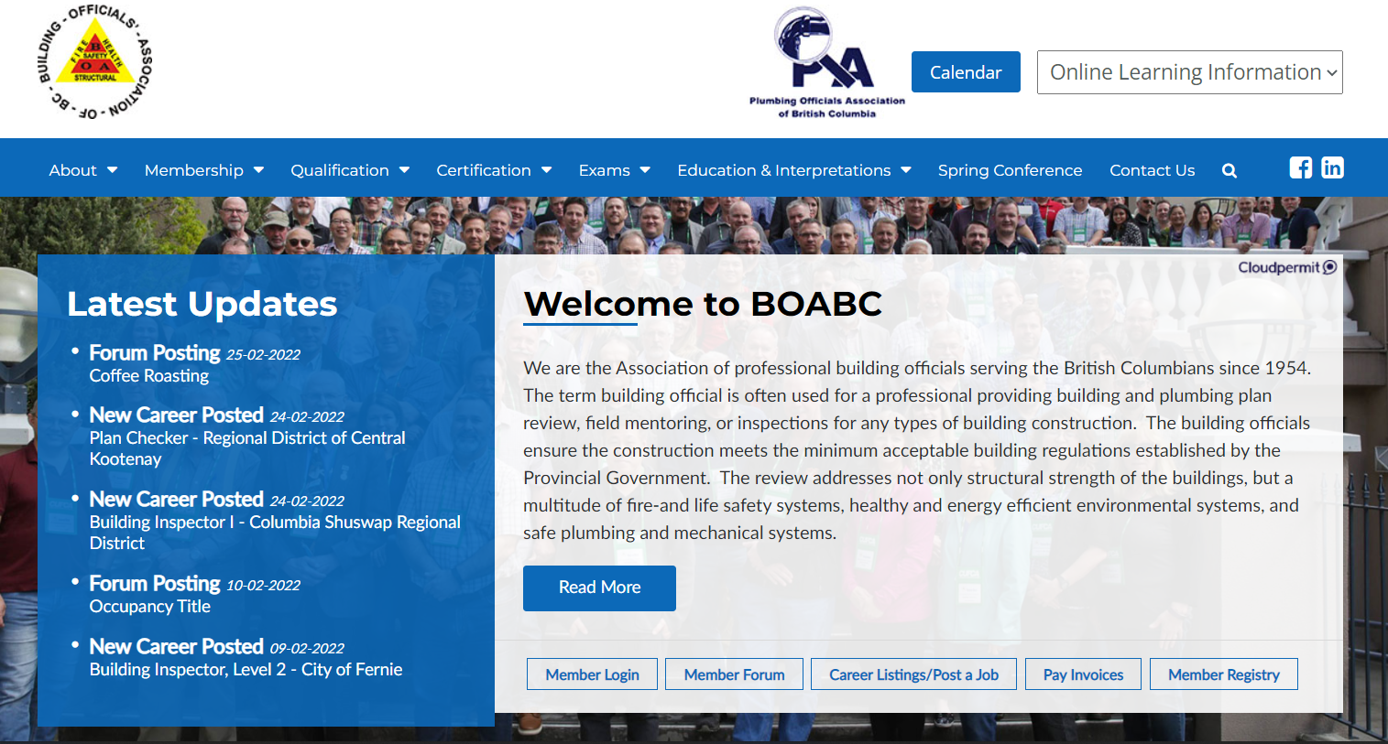

Slide 10
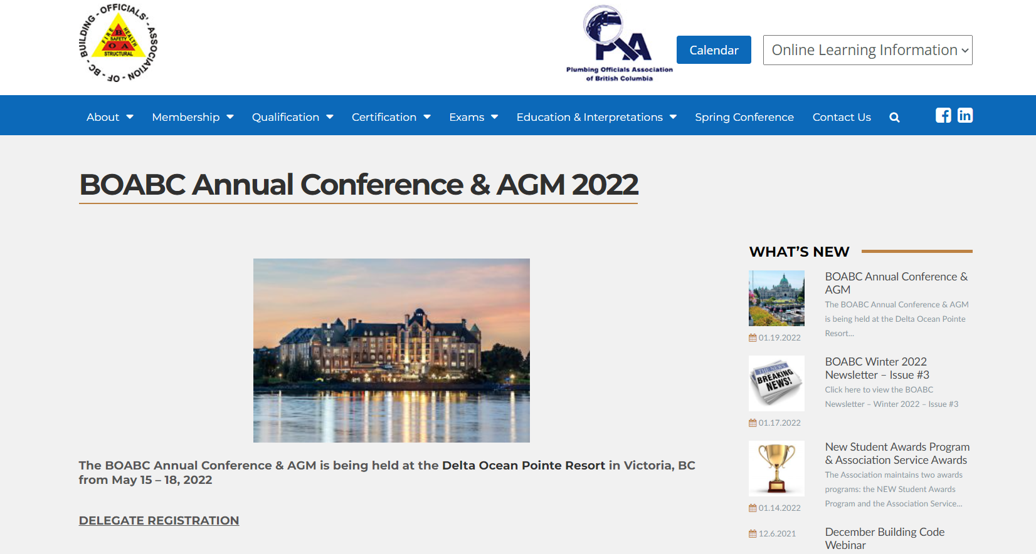
BOABC Annual Conference & AGM
May 15-18 - Victoria, BC
Delta Ocean Resort
CONFERENCE RATES
One day Conference Attendance – $425.00 plus GST
Two day Conference Attendance – $575.00 plus GST
Three day Conference Attendance – $700.00 plus GST
Banquet Ticket – $75.00 plus GST

Slide 11
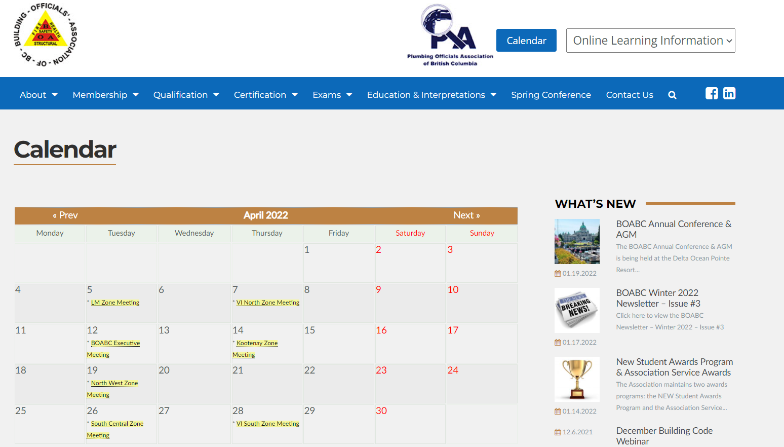

Slide 12
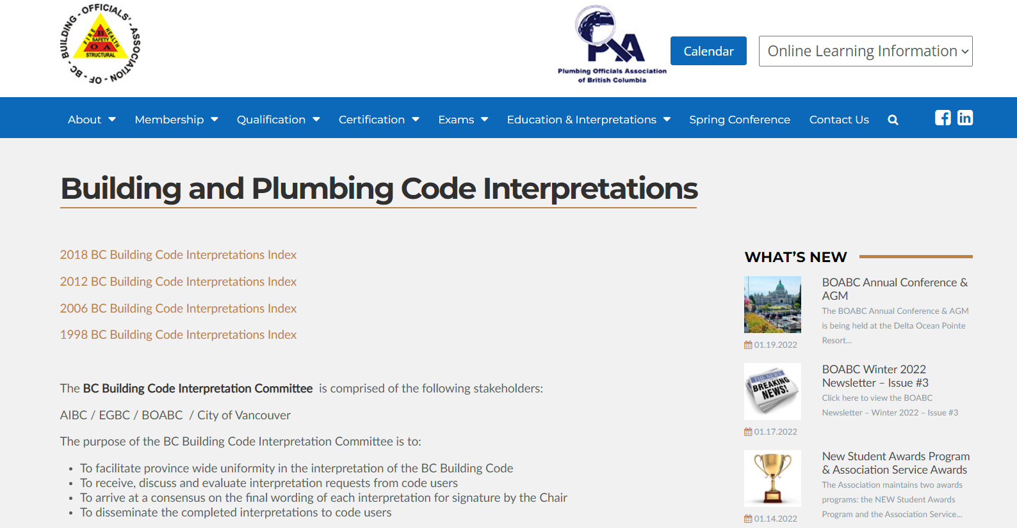
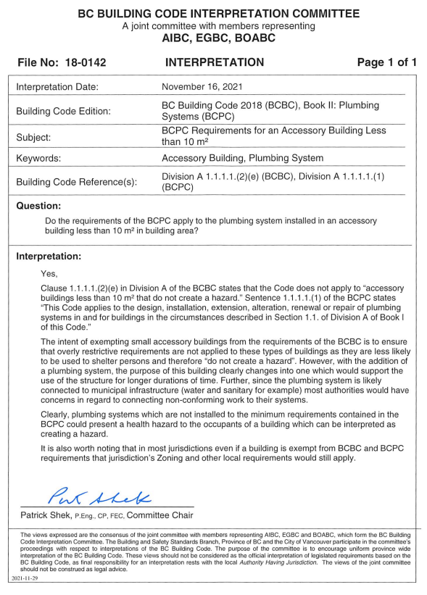
Most Building Bylaws leave out the “hazard” statement found in the Code

Slide 13
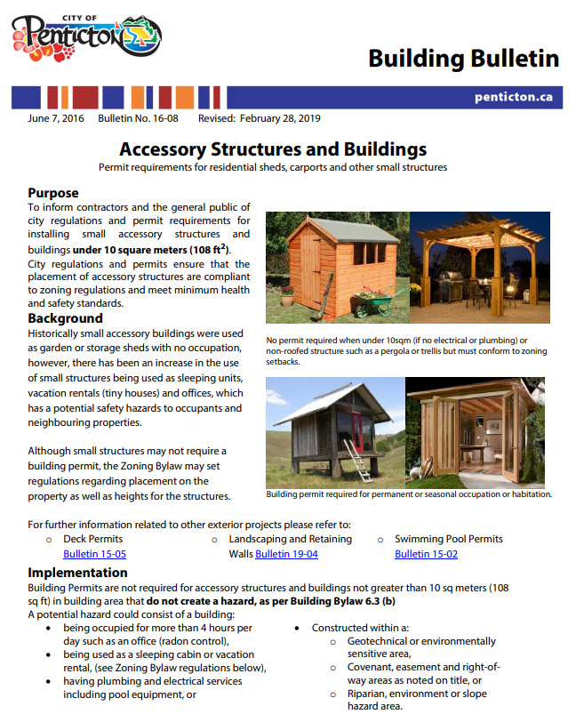
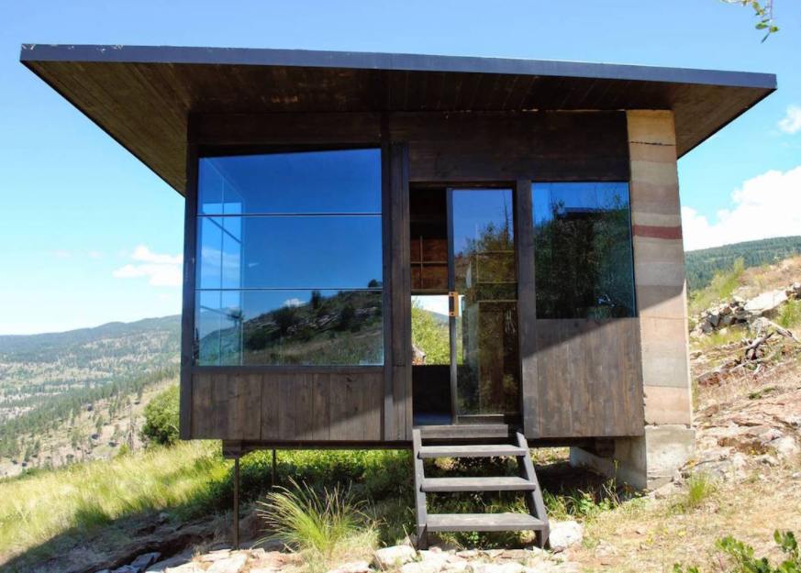
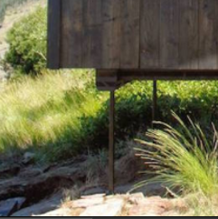
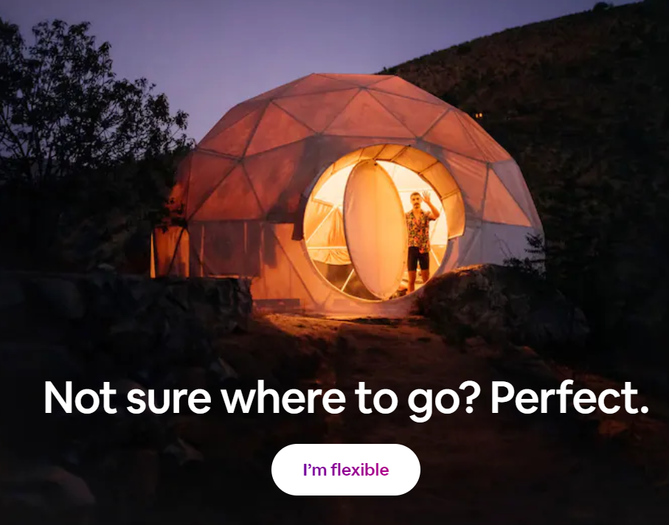
Hazard? - Electrical - Plumbing - Radon - Sleeping (Rental)

Slide 14
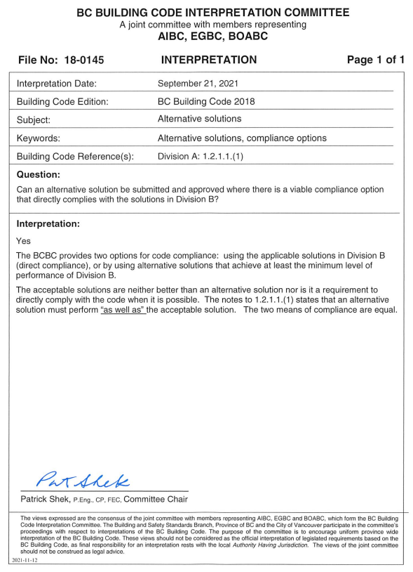
Every Acceptable Solution can have an Alternative Solution

Slide 15
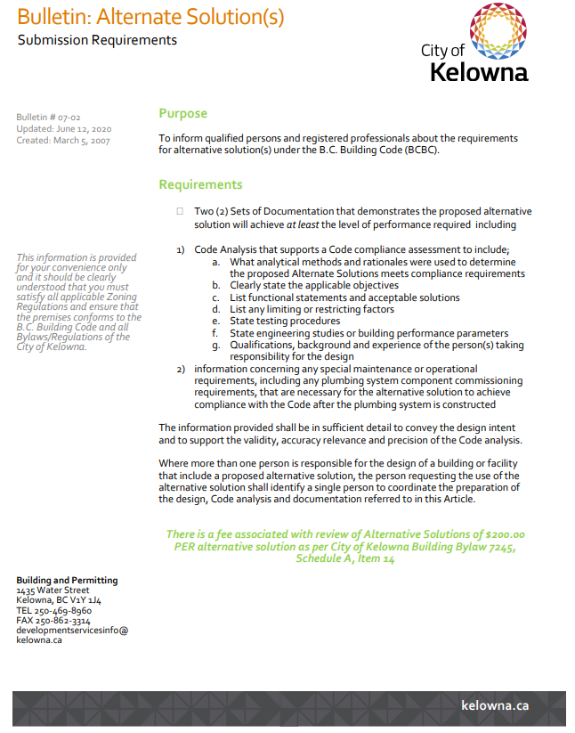
Is this being done at Occupancy?
Does your community have a standardized process – application form?

Slide 16
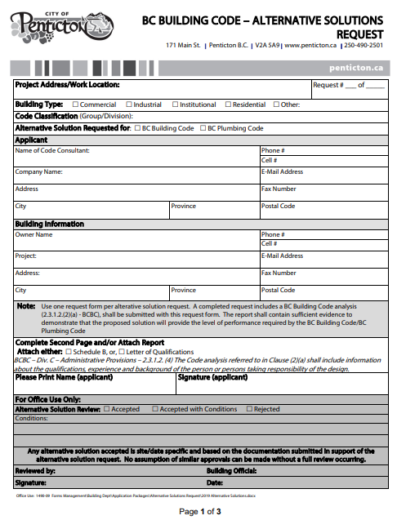
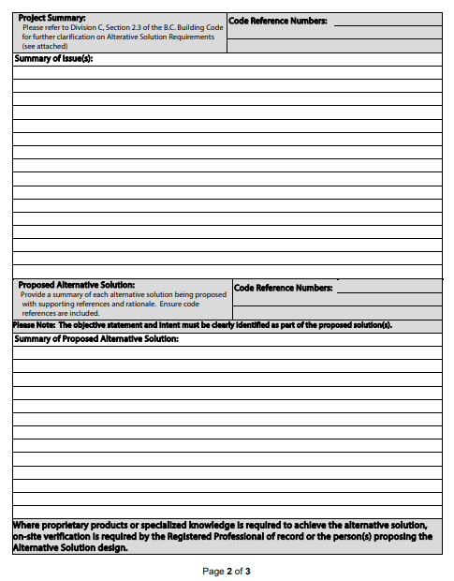
Penticton Example – Needs updating
RP for Complex buildings

Slide 17
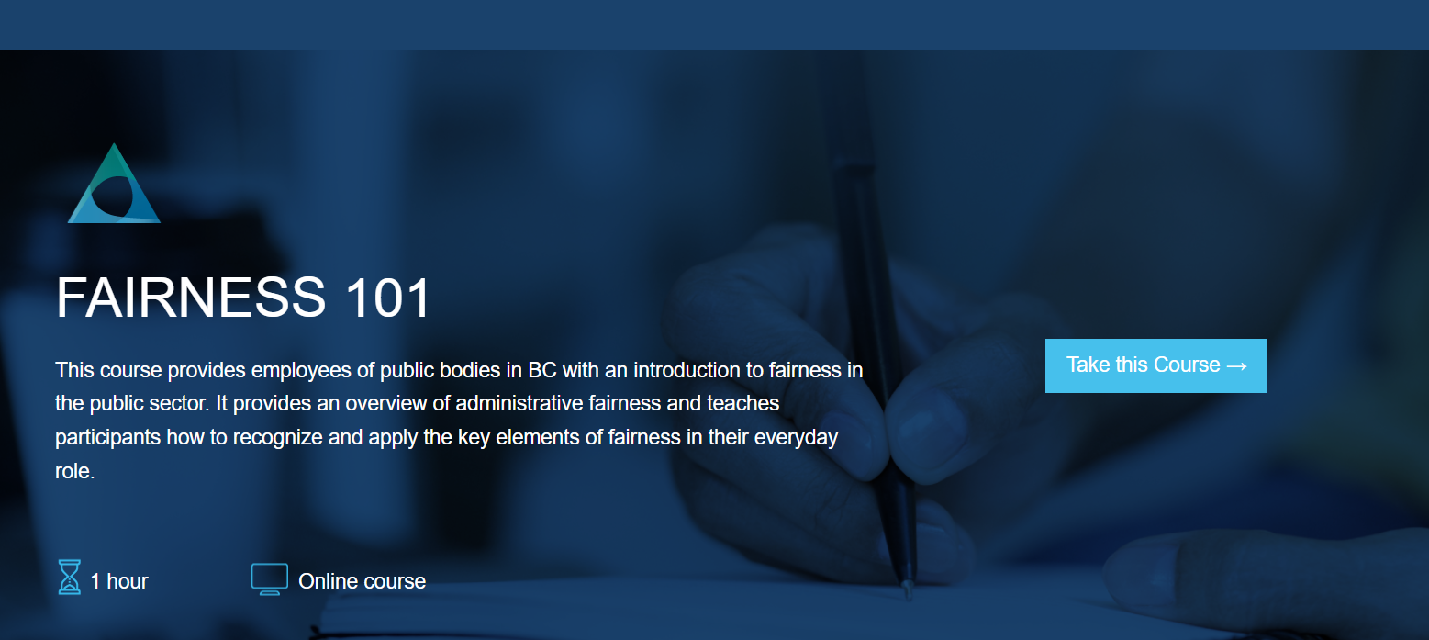
Education Opportunities
FREE!!!

Slide 18
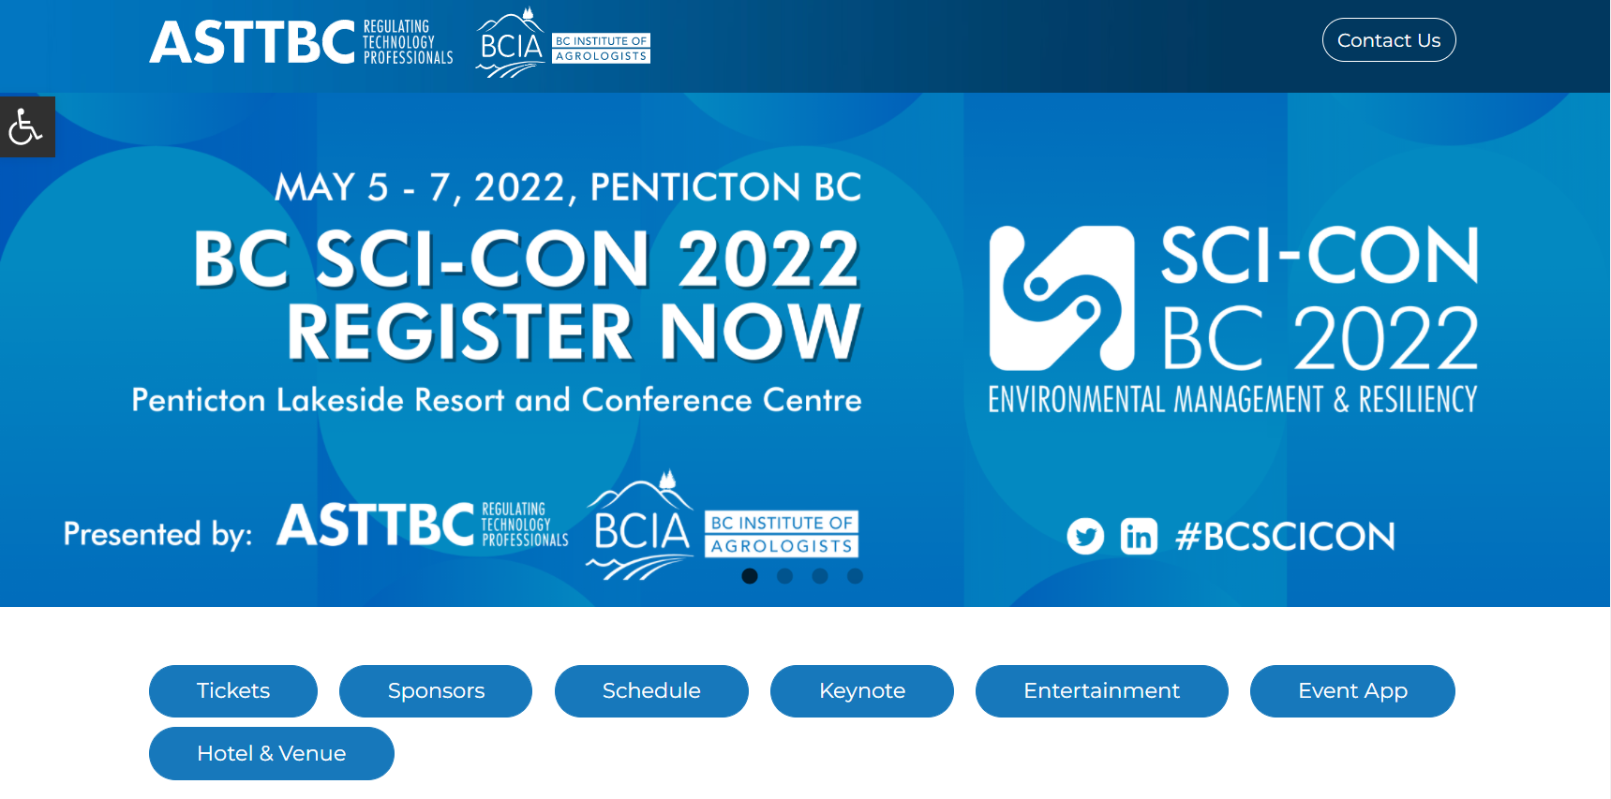
Conferences BC Modular Housing Summit May 02 -04 Free for BOABC members Both in Penticton

Slide 19
Good Listens - Podcasts

Slide 20
Building Official-In-Training

Slide 21
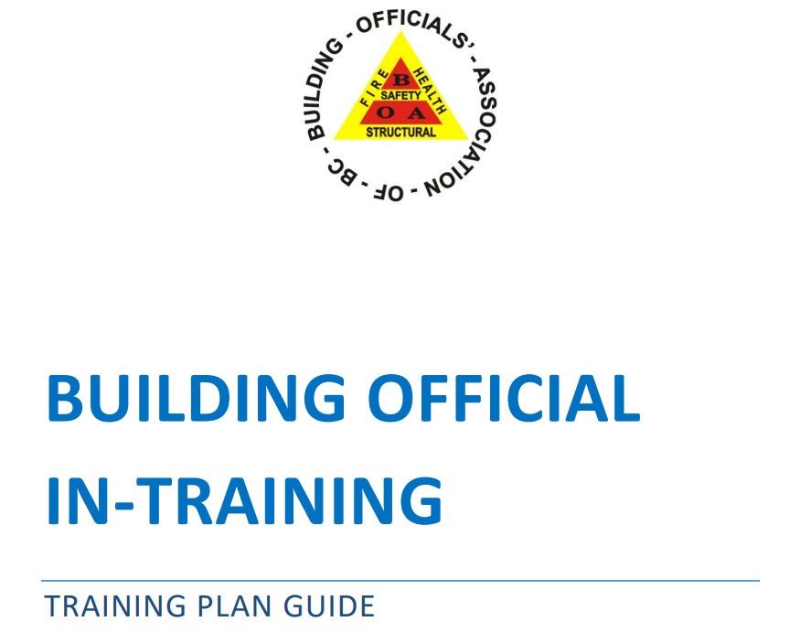
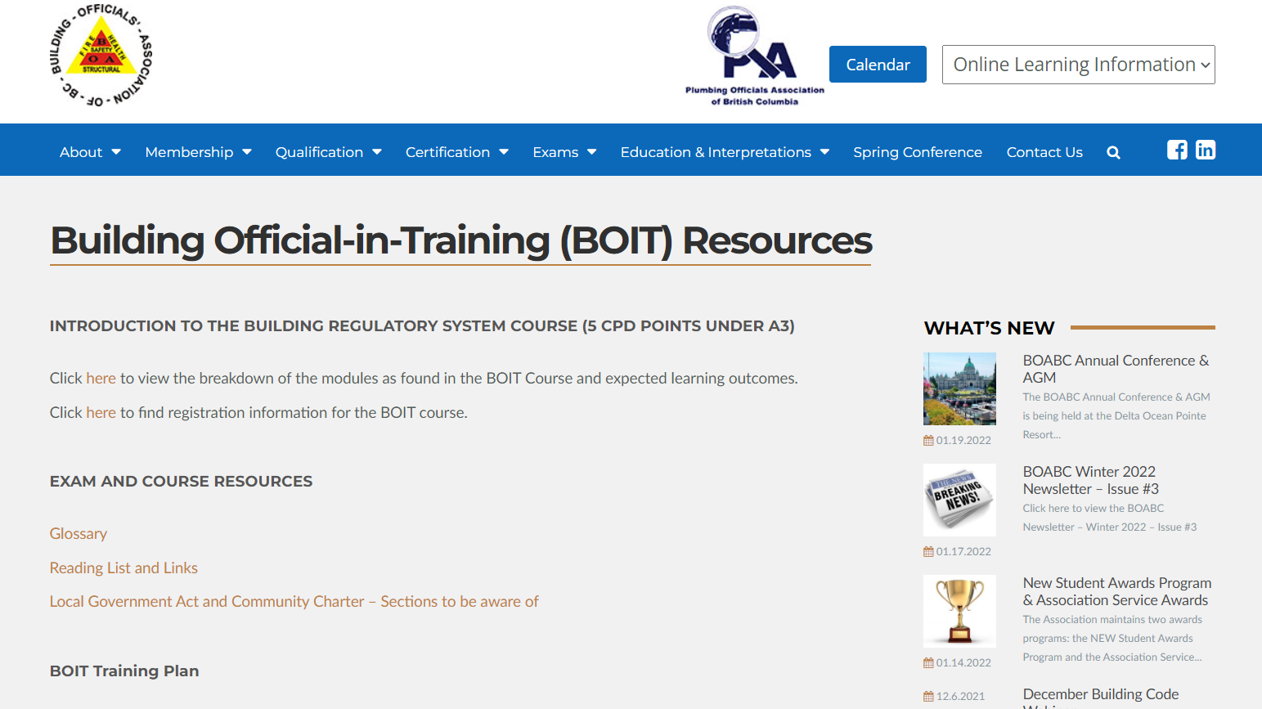
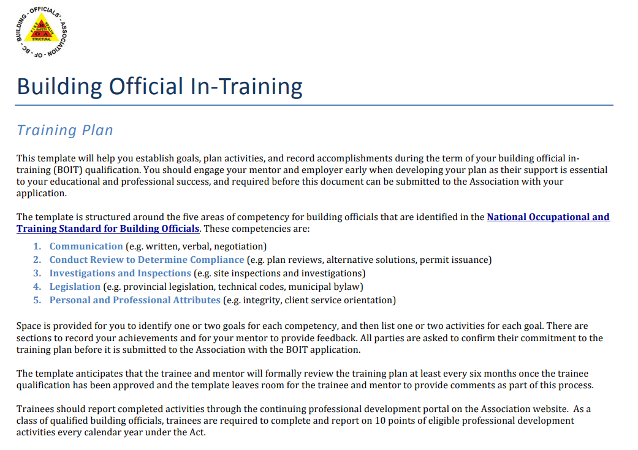
Building Official-in-Training
GLOSSARY
Authority having Jurisdiction: From the B.C. Building Code:
BC Building Code / National Building Code of Canada / B.C. Plumbing Code / B.C. Fire Code
The BC Fire Code

Slide 22
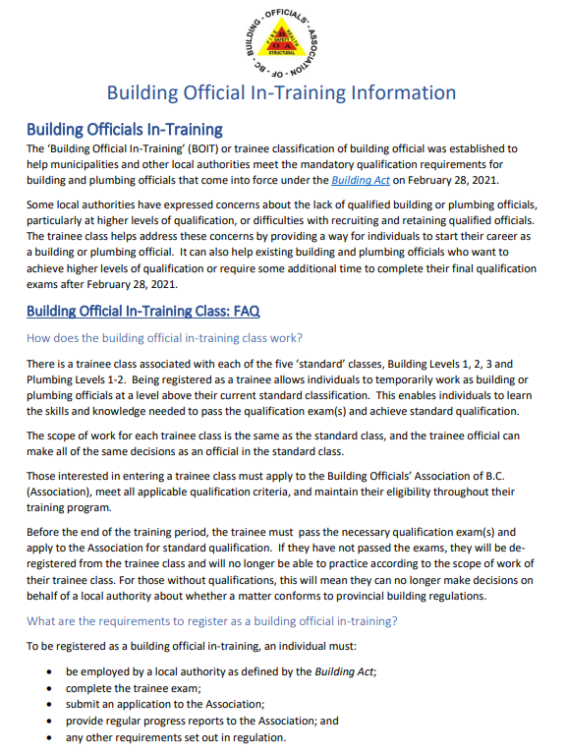
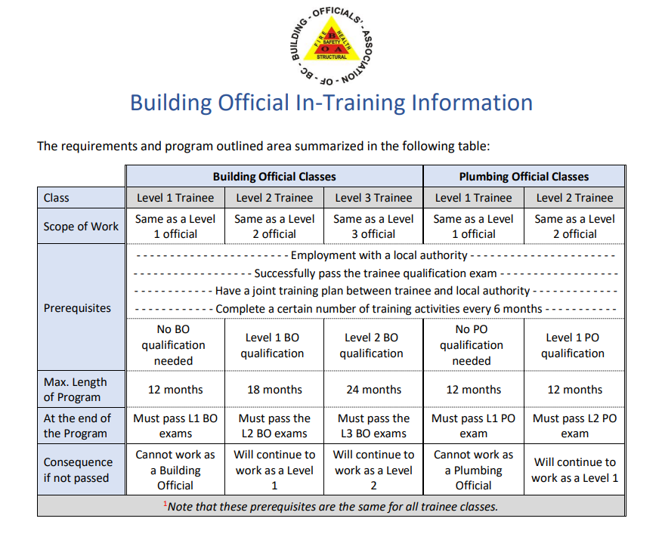
Building Official-in-Training
GLOSSARY
Authority having Jurisdiction: From the B.C. Building Code:
BC Building Code / National Building Code of Canada / B.C. Plumbing Code / B.C. Fire Code
The BC Fire Code

Slide 23
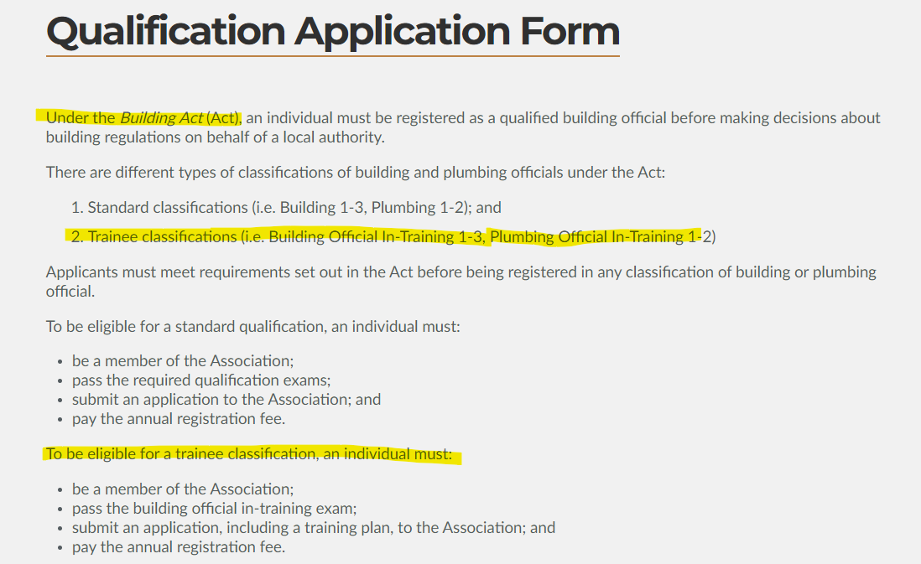
B.O.I.T Qualification Note the difference between Qualified (examinations) and Certified (w/ experience).

Slide 24
Training Plan Guide Trainee
Are you taking a professional attitude in you career development?
Time commitment.
Do you feel supported & is there a variety of work to review?
Do you feel confident in your current level?
What is your ultimate goal in your career path?

Slide 25
Training Plan Guide Mentorship
Do you feel confident at the Level being reviewed on an experience level?
Time commitment to monitor trainee progress.
Do you feel supported to be a mentor?
Provide honest and constructive feedback.

Slide 26
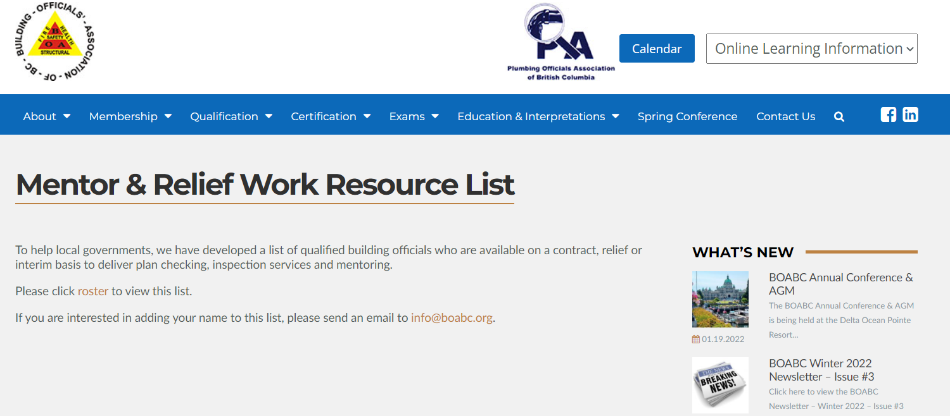

Slide 27
Training Plan Guide Employer
Does you employer take a proactive approach in your development? Willing participant.
Is there an internal education process already developed – technical and soft skills?
Does your employer understand the Act & the benefits to this program? How can BOABC help?
Does your employer have a training budget?

Slide 28
Training Plan Level Up 01 to 02 Does your department have a training program that you can forward to BOABC?
L-01
Need or Desire to Level Up
L-01
BOIT Application
Work time – personal time – or both
L-01
Soft-skill training? In-house or 3rd party opportunities?
Renovations and Alterations
Is the staff member confident/capable in current Level 01 duties?
What areas need to be strengthened?
Is there capacity – budget to complete process in a timely manner?
L-02
Plan laid out and agreed to by Trainee, Mentor, Employer
Expected timelines and training/budget opportunities
Level 02 – Plan reviews, site inspections, other – NOTE the Templates
Calendar set for Technical training opportunities relevant to Level 02
What types of projects will/should be reviewed? How many of each? Peer Reviews?
New Multi Unit residential - Commercial
Business Licence/ Enforcement
Other?
Exams
Continued Level 02 project exposure
Competency/confidence for Level 02 projects without peer reviews

Slide 29
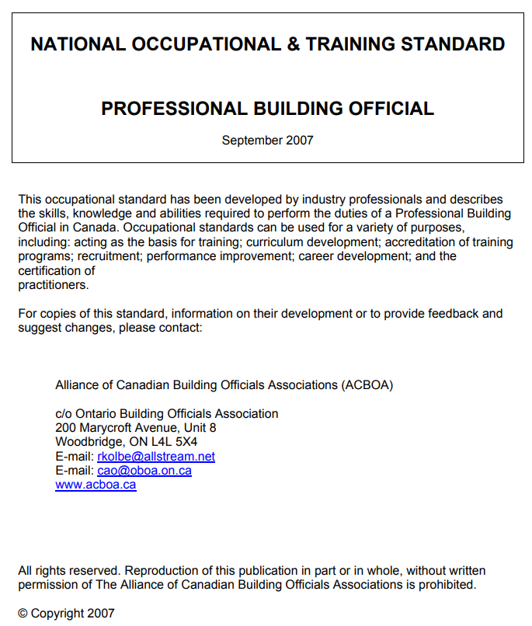
Building Official In Training Plan Template
GLOSSARY
Authority having Jurisdiction: From the B.C. Building Code:
BC Building Code / National Building Code of Canada / B.C. Plumbing Code / B.C. Fire Code
The BC Fire Code
The template is structured around the five areas of competency for building officials that are identified in the National Occupational and Training Standard for Building Officials. These competencies are:
Communication (e.g. written, verbal, negotiation)
Conduct Review to Determine Compliance (e.g. plan reviews, alternative solutions, permit issuance)
Investigations and Inspections (e.g. site inspections and investigations)
Legislation (e.g. provincial legislation, technical codes, municipal bylaw)
Personal and Professional Attributes (e.g. integrity, client service orientation)

Slide 30
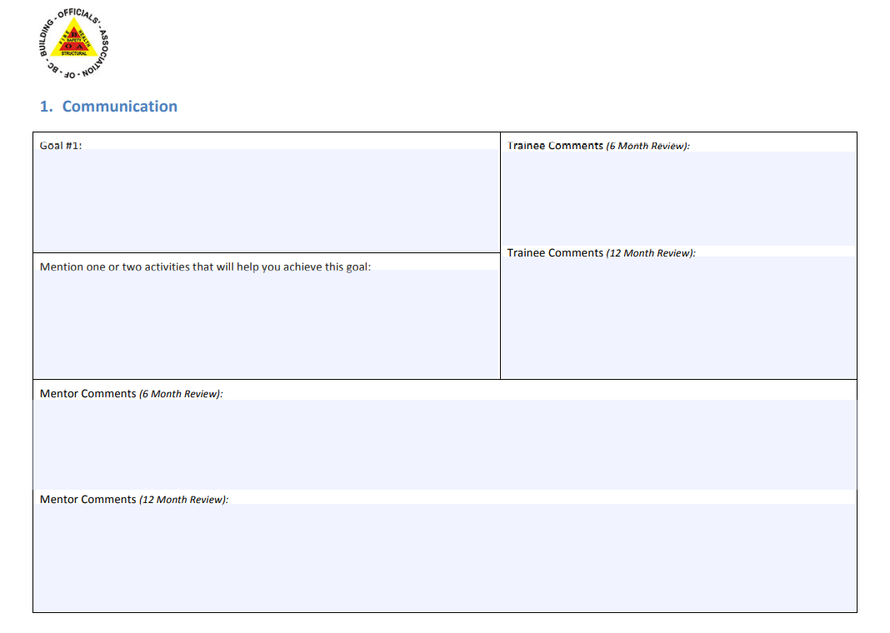
B.O.I.T Training Plan Template - Communication
GLOSSARY
Authority having Jurisdiction: From the B.C. Building Code:
BC Building Code / National Building Code of Canada / B.C. Plumbing Code / B.C. Fire Code
The BC Fire Code

Slide 31
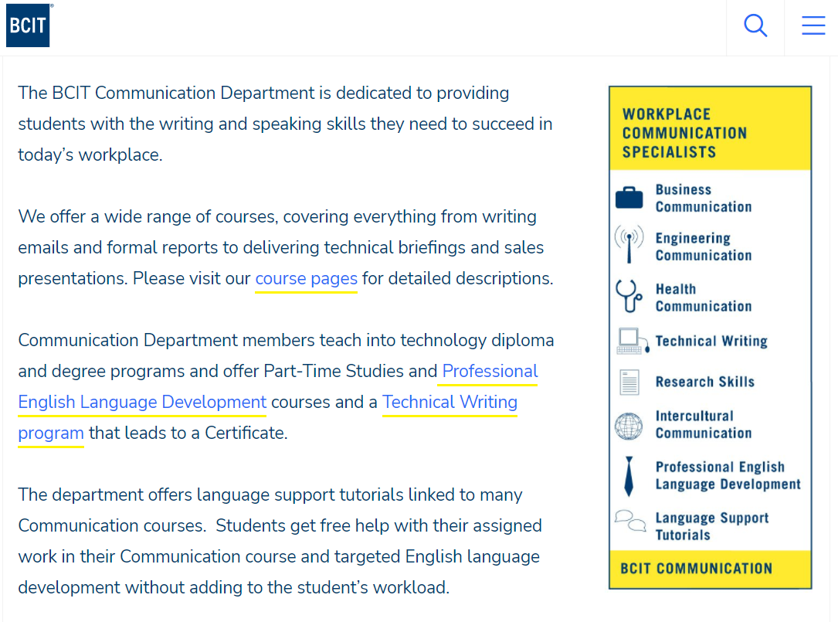
Communication – Training Opportunties

Slide 32
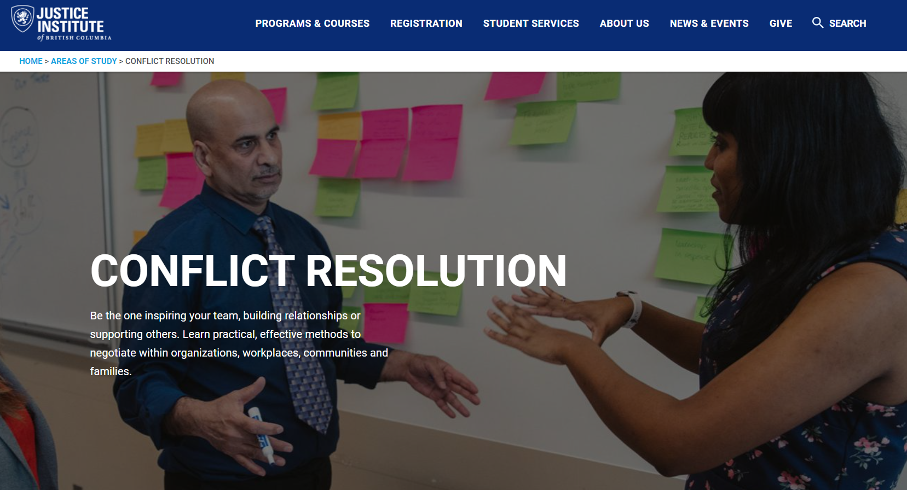
Communication – Training Opportunties

Slide 33
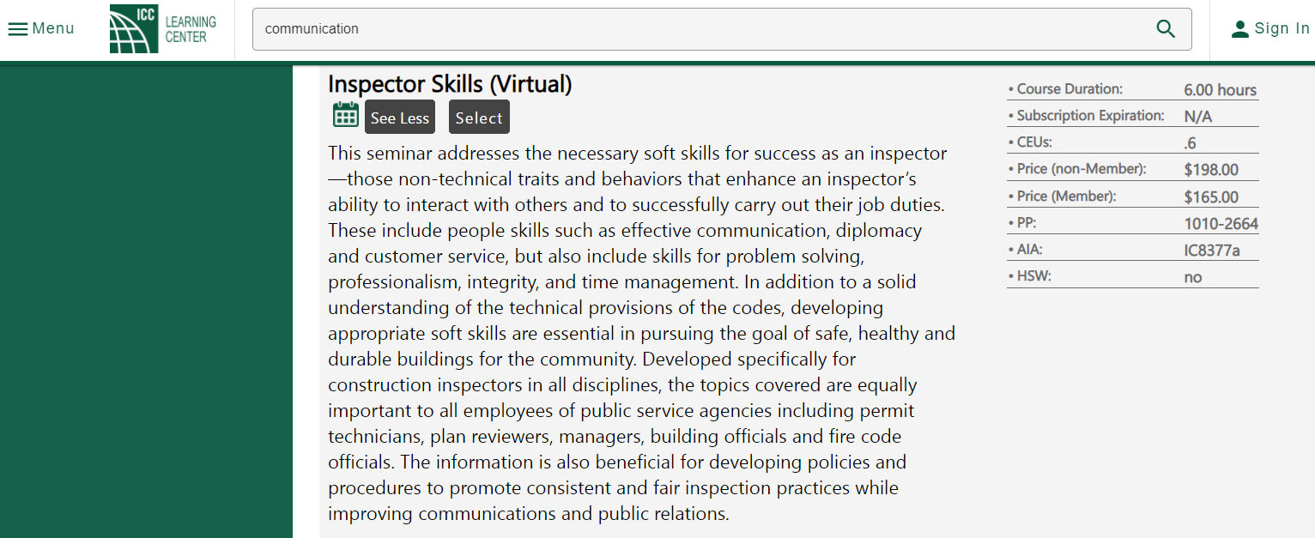
Communication – Training Opportunties

Slide 35
Communication – Good Reads

Slide 36
Does your department have a:
Policy and Procedures related to communication?
Template letters and forms?
Technology available - Handwritten or digital inspections?
Do you have opportunities for communication training? Budget?
Do you think you are a good communicator?

Slide 37
Member comments on the program
Tim W - City of Nanaimo - +3 year as a Building Official – BOIT Level 03
First staff member to go through the program
Provided a professional plan to review with senior leadership and show the benefits to the local government of a certified Building Official
BOIT provides a formal process to establish Career goals (and personal goals) and a Training schedule within an operational budget.
The course is easy follow, but the Trainee needs to put in the energy and time.
Nanaimo has a good in-house training program for “soft-skills”
His Mentor is outside his organization, which exposes him to different viewpoints.
Course Program aha moments
Overview by David Tupper of MIABC – being mindful of the property/permit file information you share.
We are a small but important part of the building process and the community. “With great Power comes Great responsibility”

Slide 38
Residential wood decks and balconies

Slide 39
Preventing - Deck & Balcony Failures

Slide 40
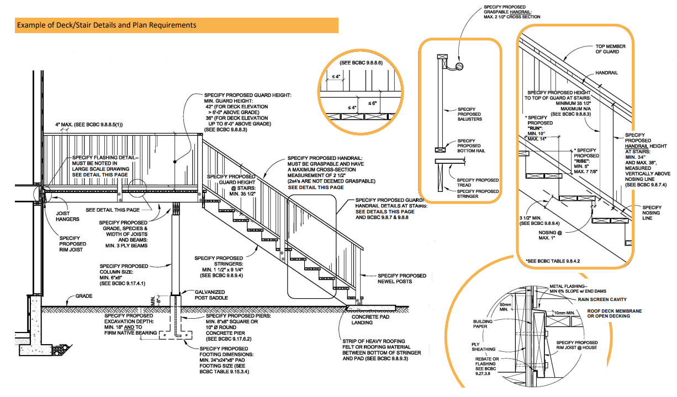
Permit Education Home Owner (DIY) or small scale contractor projects. Typical challenges with understanding the proper construction of a deck. It can get complicated! - Building Official (L1) - Applicant - Builder - Building supply comp.

Slide 41
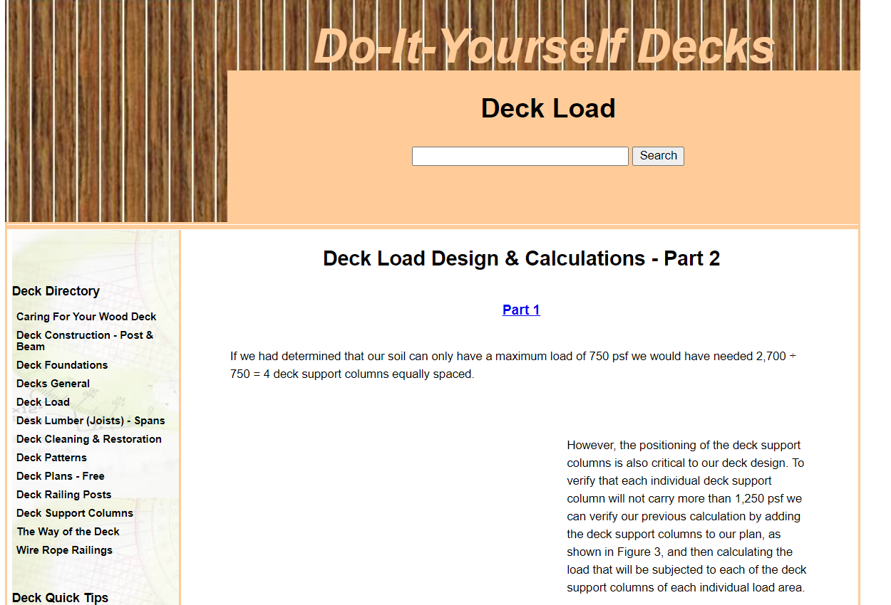
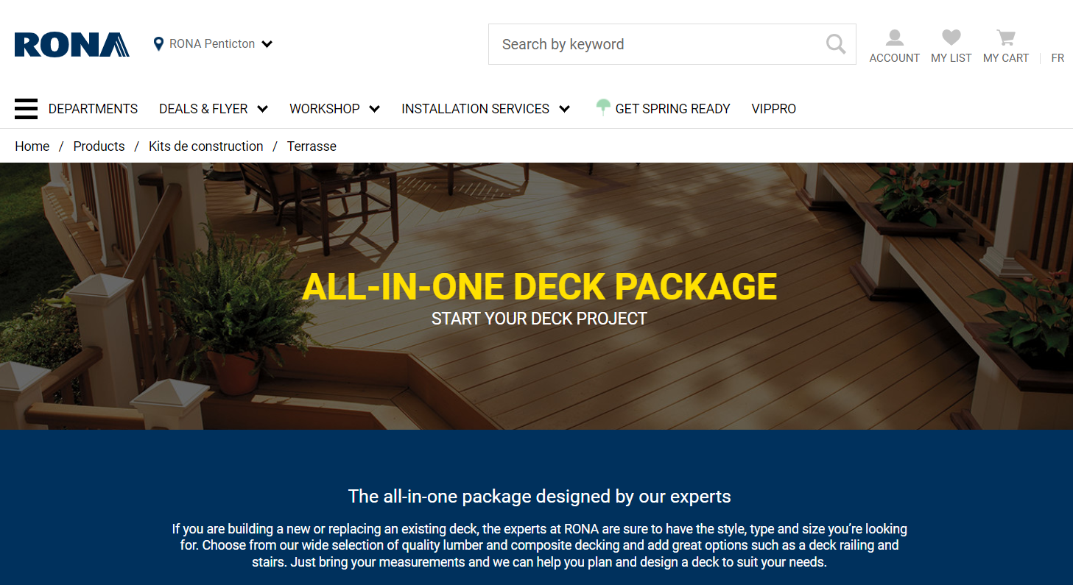
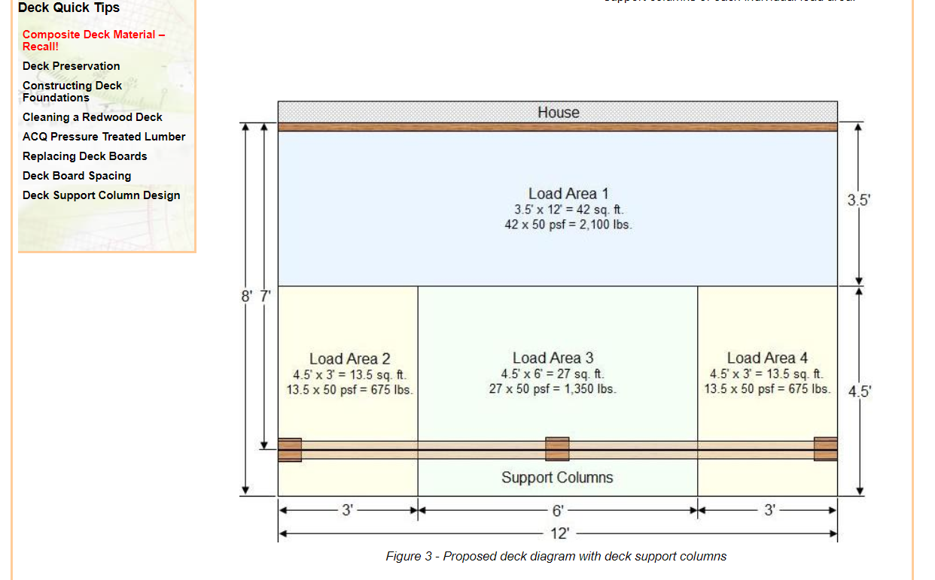
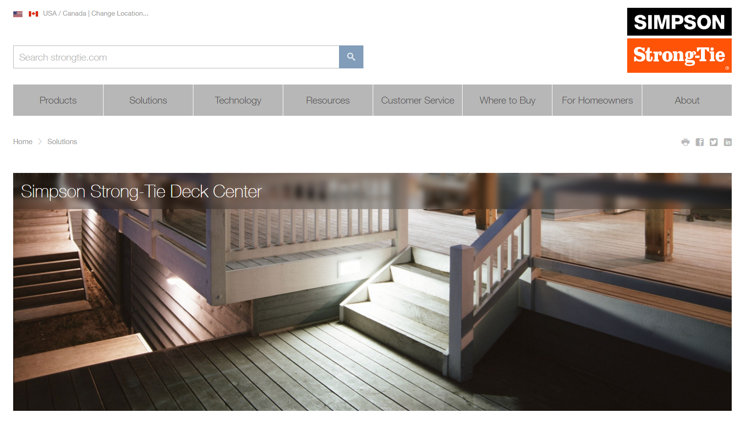
Permit Education Home Owner (DIY) or small scale contractor projects. Where are owners and builders getting their information? - Local Government - Building Code - Online - Building supply comp.

Slide 42
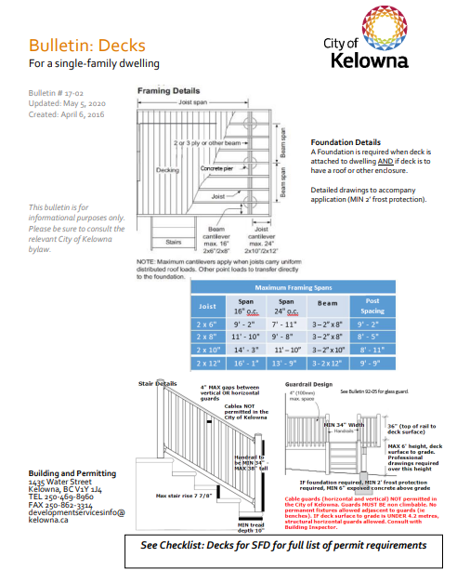
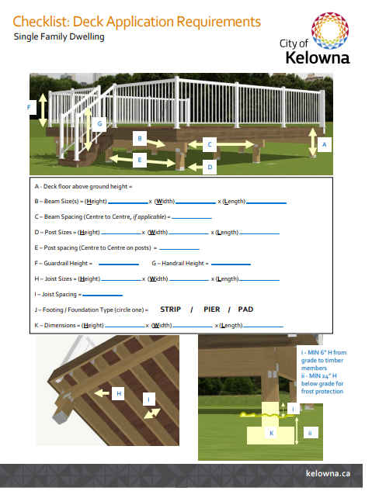
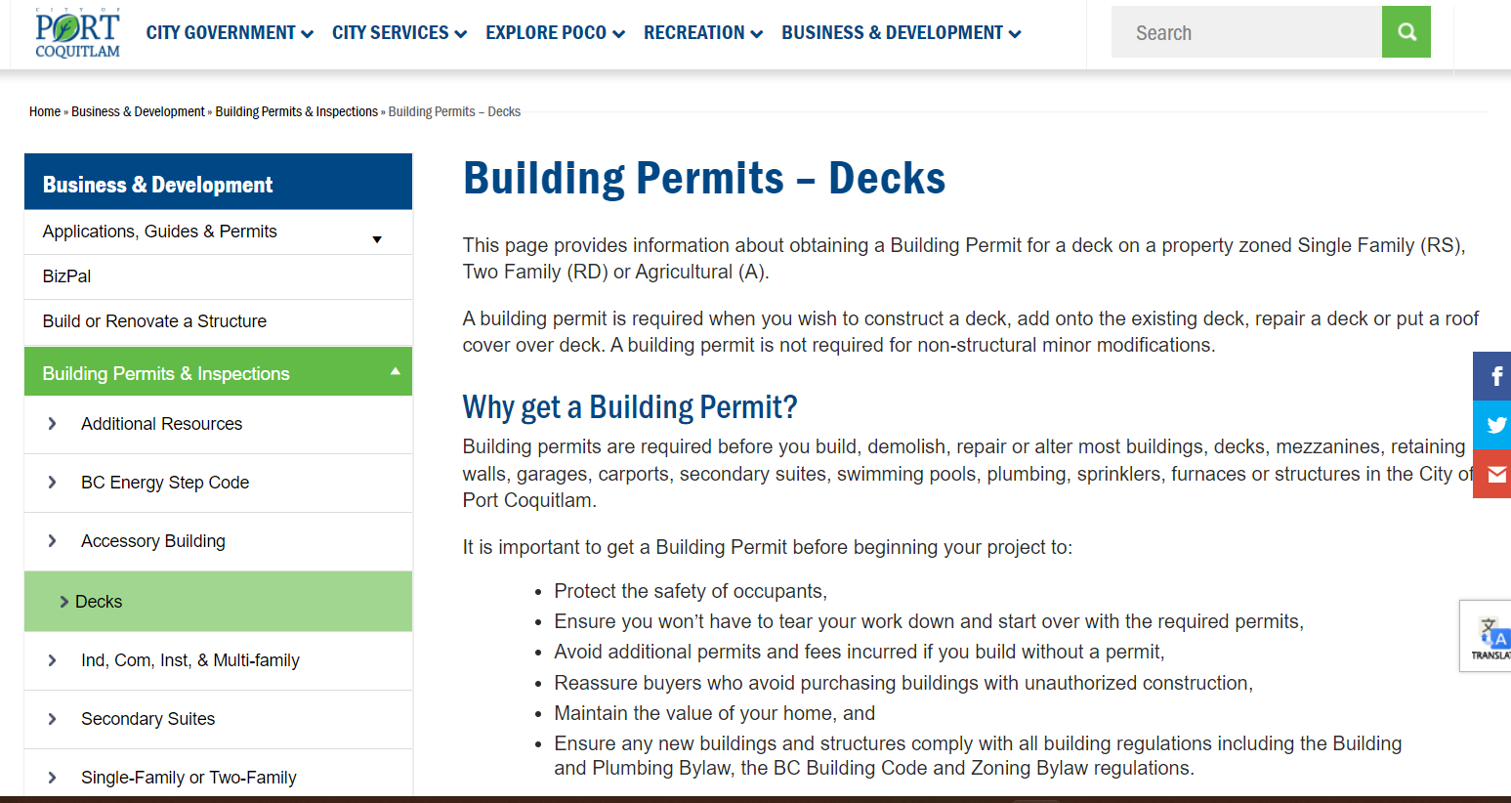
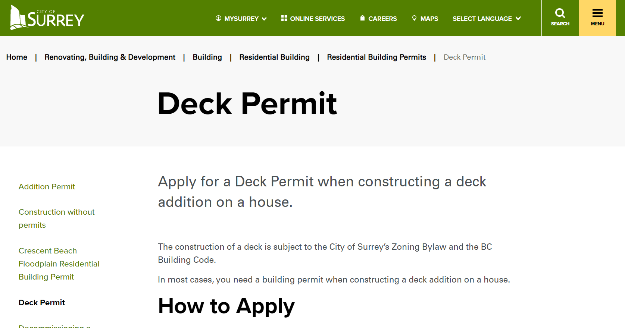
Permit Education Does your department have good information to guide an applicant. - application forms - checklists - guides What quality of drawings are required? Are you covering costs for time invested?

Slide 43
Permit Process Land Use Regulations Zoning Definitions that may be in conflict with Building Bylaw or Code? Site plan – Surveys?

Slide 44
Residential Wood Decks and Balconies BC Building Code
Code Sections related to Decks and Balconies
9.3 Materials
9.3.1. Concrete 9.3.1.1. General - 2) Unreinforced and nominally reinforced site-batched..
9.3.2. Lumber and Wood Products
9.3.2.9. Termite and Decay Protection -CAN/CSA-O80.1, “Specification of Treated Wood,”
9.4 Structural Requirements
9.4.2.3. Platforms Subject to Snow and Occupancy Loads
9.4.4.1. Allowable Bearing Pressures
9.4.4.4. Soil Movement - 2) The potential for slope instability and its consequences, …
9.6 Glass
9.6.1.3. Structural Sufficiency of Glass
9.8. Stairs, Ramps, Landings, Handrails and Guards

Slide 45
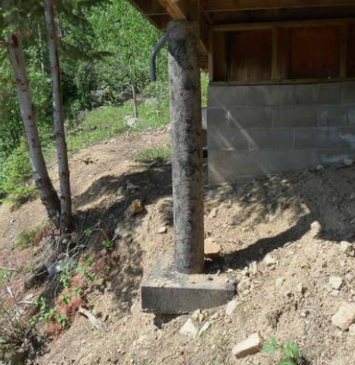
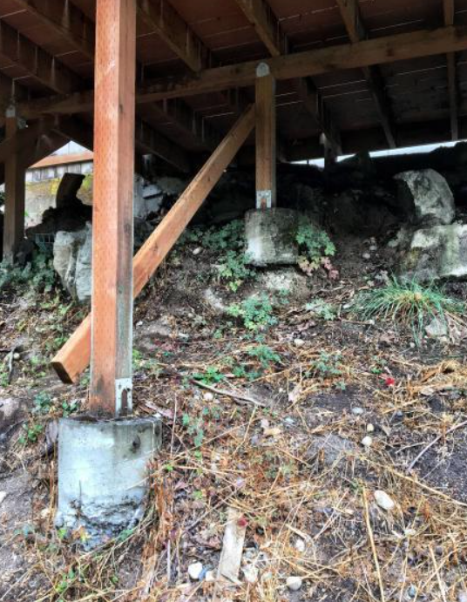
Slope Instability and Footings – 9.4
Increasing failures related to post/column rotation.
Caused by poor backfill stability on sloped lots. Some suggestions to tie deck footing back to main house foundations

Slide 46
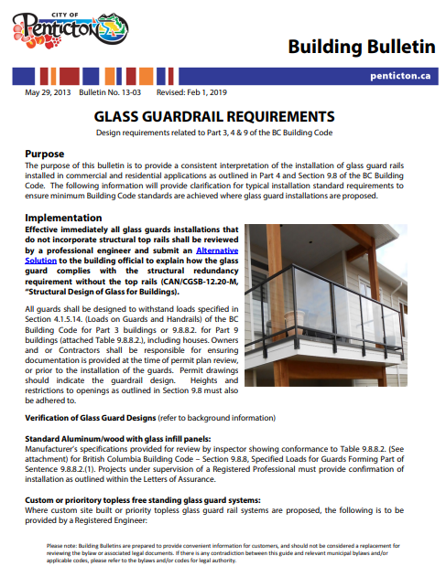
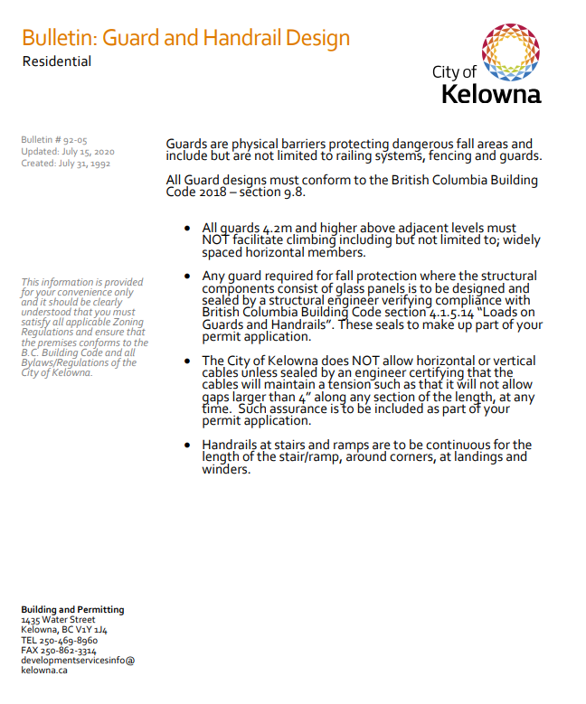
Deck Guard Challenges – 9.8

Slide 47
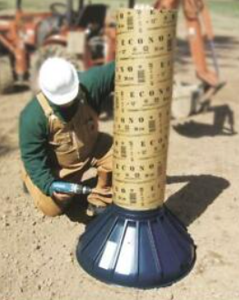
Residential Wood Decks and Balconies BC Building Code
Section 9.9. Means of Egress
9.9.4.4. Openings Near Unenclosed Exterior Exit Stairs and Ramps
Section 9.12. Excavation
9.12.2. Depth
Section 9.15. Footings and Foundations
Table 9.15.3.4. Minimum Footing Sizes - Minimum Footing Area for Columns Spaced 3 m o.c.,(1) m2
9.15.3.7. Adjustments to Footing Area for Columns
9.15.3.8. Footing Thickness
OK ??

Slide 48
Residential Wood Decks and Balconies BC Building Code
Section 9.17. Columns
9.17.1.1. Application 1) This Section applies to columns used to support
9.17.2.1. Location 1) Columns shall be centrally located on a footing conforming to Section 9.15.
9.17.2.2. Lateral Support
9.17.4. Wood Columns
9.17.6. Solid Concrete Columns
9.17.6.2 Sizes
Section 9.19. Roof Spaces

Slide 49
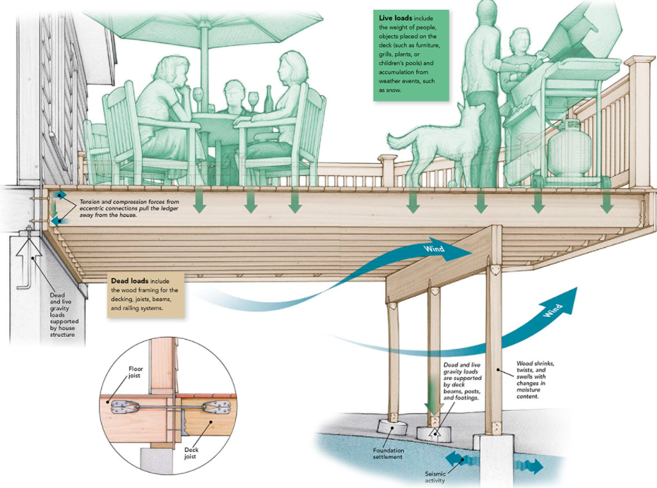
Deck Loads
Fine Homebuilding – How deck load capacity works (US Codes – note potential issues)
TOP 3 weakest points??
Spot the non-compliant BCBC details

Slide 50
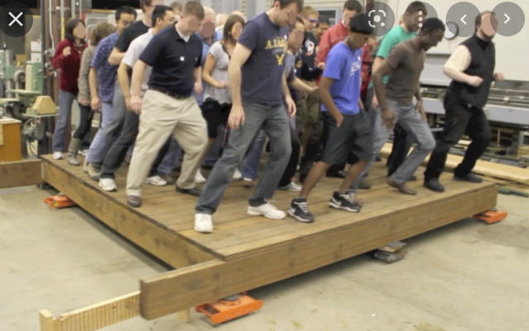
Lateral Loading Challenges

Slide 51
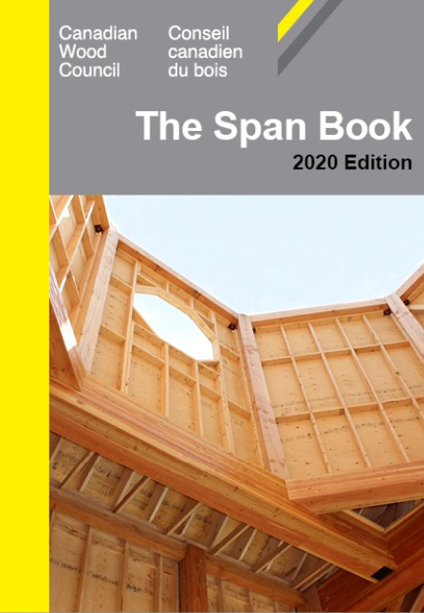
Residential Wood Decks and Balconies BC Building Code
Section 9.23. Wood-Frame Construction
Section 9.25. Heat Transfer, Air Leakage and Condensation Control
Section 9.26. Roofing
Section 9.27. Cladding
Section 9.28 Stucco
Section 9.36. Energy Efficiency
Ok ?

Slide 52
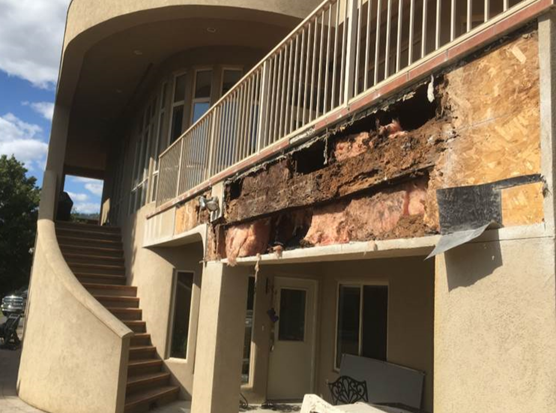
Deck Envelope Challenges

Slide 53
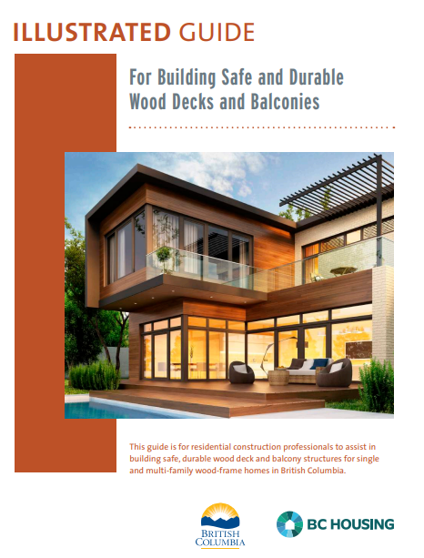
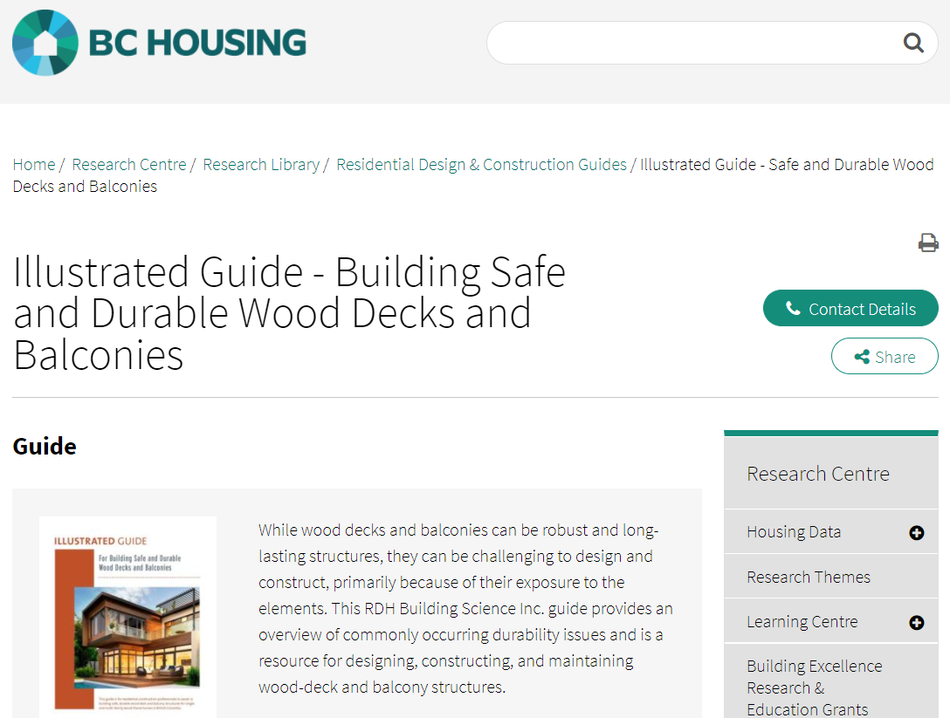
Safe and Durable Wood Decks and Balconies
“Copyright BC Housing. Reprinted with permission.” Disclaimer: The authors, contributors, funders and publishers assume no liability for the accuracy of the statements made or for any damage, loss, injury or expense that may be incurred or suffered as a result of the use of or reliance on the contents of the material being reproduced. The views expressed do not necessarily represent those of individual contributors or of BC Housing.

Slide 54
Safe and Durable Wood Decks and Balconies
“Copyright BC Housing. Reprinted with permission.” Disclaimer: The authors, contributors, funders and publishers assume no liability for the accuracy of the statements made or for any damage, loss, injury or expense that may be incurred or suffered as a result of the use of or reliance on the contents of the material being reproduced. The views expressed do not necessarily represent those of individual contributors or of BC Housing.
Note
Pages 6 to 8 – Common performance issues
Page 11 – approval for helical piles?
Page 12 – framing – Joists and Beams
Page 14 – deck ledgers - there are no specifications for deck ledger attachments in the Code.
Page 16 &17 – Guard and stair attachments
Page 22 to 24 – Building interface details
Not in the guide but growing concerns related to the use of spray foams in deck/roof ceiling assemblies.

Slide 55
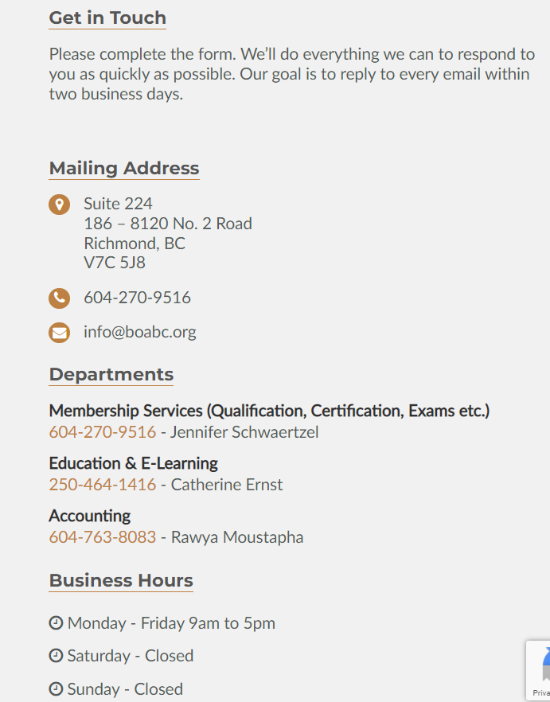
Contact us

