Slide 1
Plumbing Code Appeals and Interpretations
Doug Vance
September 23, 2021

Slide 2
Agenda
WELCOMES and INTRODUCTION
APPEAL PROCESS
RECENT PLUMBING CODE DECISIONS
CODE INTERPRETATION COMMITTEE
RECENT PLUMBING INTERPRETATIONS

Slide 3
Upcoming Professional Development
October
Building Department Accreditation and Recognition (IAS)
Fire and Life Safety Systems (ULC)
HVAC Requirements in the BCBC (HRAI)
November
Mentoring & Coaching (ICC)
Fire Stopping (Hilti)
Fire and Life Safety Systems (ULC)

Slide 4
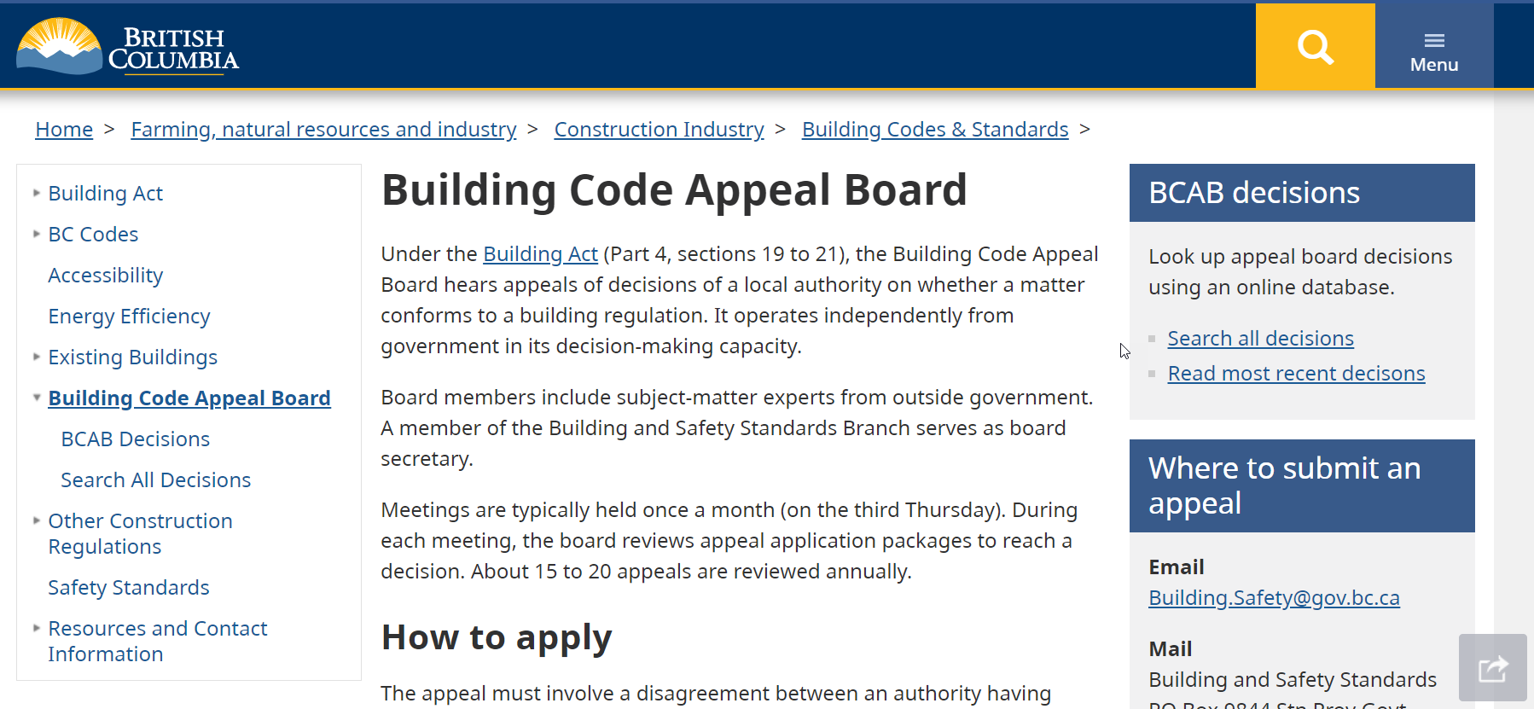
Building Code Appeal Board
Building Act (Part 4, sections 19-21)
Board is comprised of subject matter experts appointed by government
Focus on site-specific disagreements between AHJ and Owner/Agent over application or interpretation of the building code
Decisions are final and binding
The board cannot waive, relax or alter any part of the building code

Slide 5
Appeal Board Decisions
#1773 Backflow Prevention Qualifications (November 2015)
#1796 Mechanical Tees / Saddle Fittings (April 2017)
#1797 Combustible Piping (May 2017)
#1860 Trap & Trap Arm Size in Relation to Fixture Outlet Pipe (April 2021)
Others?

Slide 6
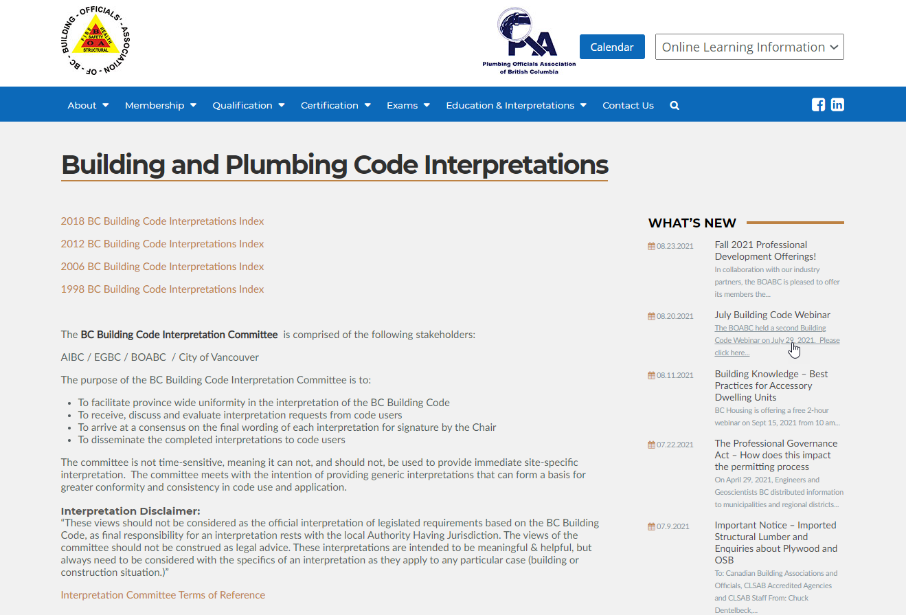
Code Interpretation Committee
Not legislated
Comprised of members appointed by stakeholders
Goal is to facilitate provincial code consistency
Generic and not site-specific

Slide 7
Code Interpretations
#18-0034 Soil-or-Waste Pipe Serving as a Wet Vent
#18-0130 Expansion Joint Requirements for Dry Vents
#18-0110 One Trap Serving Multiple Fixtures
Others?

Slide 8
Final Thoughts…
Remember CPD offerings – and December 31 deadline!
Appeal decisions and code interpretations are a valuable resource.
Send questions or future webinar topics to info@boabc.org

