Slide 1
The Architects Regulation & Part 9 Construction
March 09, 2023
Ken Kunka AScT, RBO
Special Guest – Tony Giroux - BCABD

Slide 2
Disclaimer
Information presented today does not directly represent the opinions of the City of Penticton or the Building Officials Association of BC.​
This presentation is conceptual and for informal educational purposes only. The presenters and association takes no responsibility for application of any concepts or interpretations in this presentation to specific projects.​
(it may ask more questions than provide answers)
The slides must not be considered complete or exhaustive. Code provisions have been generally represented and may not reflect all exceptions.​

Slide 3

Rules of the Room
Registration will be tracked
Presentation is not recorded
  PowerPoint will be posted
Please use raise hand icon if you have a question or comment
PUT IT in the CHAT
Please mute your microphone
You may need to turn off your camera
Please follow up by email if you have specific question or example to share with the membership.
  kkunka@boabc.org

Slide 4
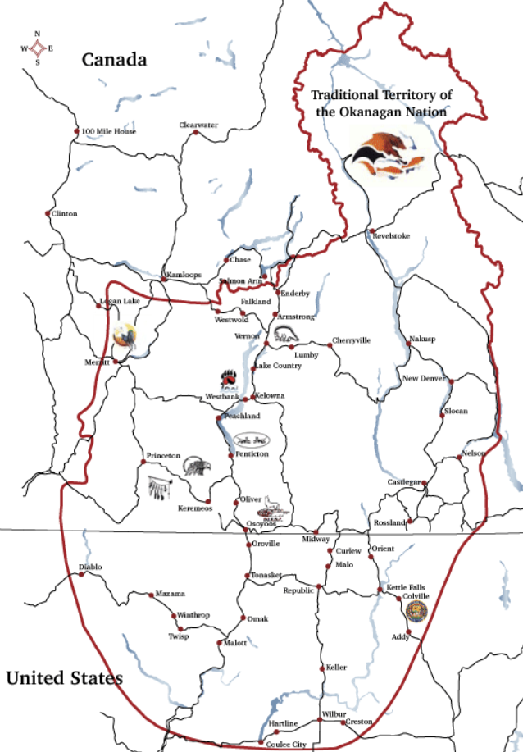
Acknowledge the ancestral, traditional, and unceded territories of Indigenous peoples in British Columbia, on whose territory we are today.
Penticton - Syilx (Okanagan)

Slide 5

Agenda
What’s New.
Code Updating and Training
Architects Regulation
Part 09 – Registered Professionals
Open Discussion

Slide 6
Survey Questions
Location and Qualification Levels of participants (195 Responses)
Regional Representation
Kootenay = 10% (20)
Lower Mainland = 40% (78)
North Central = 9% (18)
North West = 2% (4)
South Central = 15% (30)
Vancouver Is. N = 9% (19)
Vancouver Is. S = 13% (26)
Level of Qualifications
Bldg. 03 = 37% (95)
Bldg. 02 = 10% (27)
Bldg. 01 = 23% (58)
Plmg. 2 = 5% (15)
Plmg. 1 = 19% (50)
Reg. Prof. = 2% (6)

Slide 7
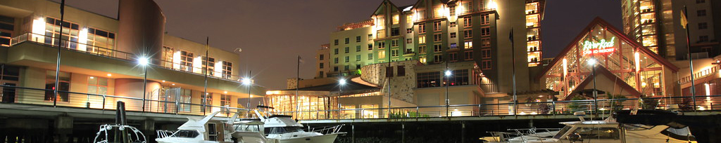
What’s New at the Association
Register now for the 2023 BOABC Conference & Tradeshow taking place from May 28-31, 2023, at the River Rock Casino Resort in Richmond.
Please visit www.boabc.org/2023-conference/ for details and to register online.

Slide 8
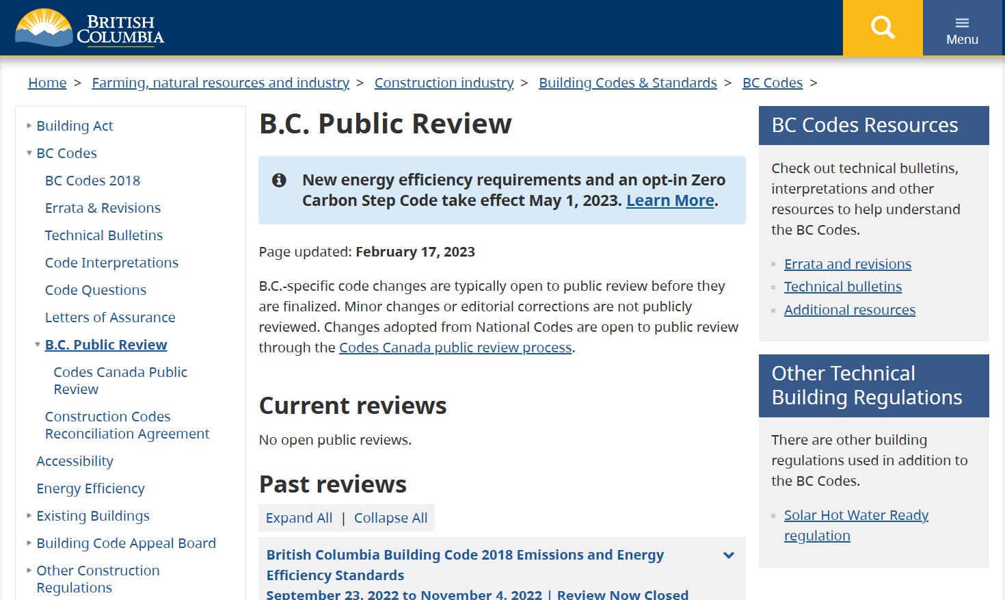
Code Update Training
Working with BSSB, BC Housing, EGBC, AIBC, ASTTBC
Building, plumbing, energy step code content
Online, some in-person
November release (or sooner)
Mandatory to remain qualified

Slide 9
Upcoming CPD Opportunities
Wednesday, March 15 - BC Building and Energy Codes – What to Expect webinar by Fenestration & Glazing Industry Alliance (FGIA)
Monday, March 27 – Hydronic Systems webinar by the Community Energy Association
Wednesday, March 29 - A Legal Update on Development Permits & Development Variance Permits webinar by Planning Institute of British Columbia (PIBC)
Visit www.boabc.org/news/ for more information on each of these webinars and to find the registration links
Thursday, March 30 – CHBA Implementing Digital Permitting - Online

Slide 10

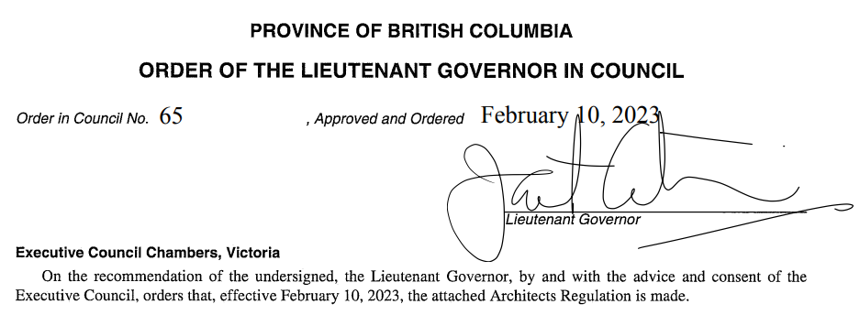
Architects Regulation
Architect Regulation
Architects Act repealed Feb 10/23
now
Architects Regulations & under authority of the Professional Governance Act (PGA)

Slide 11
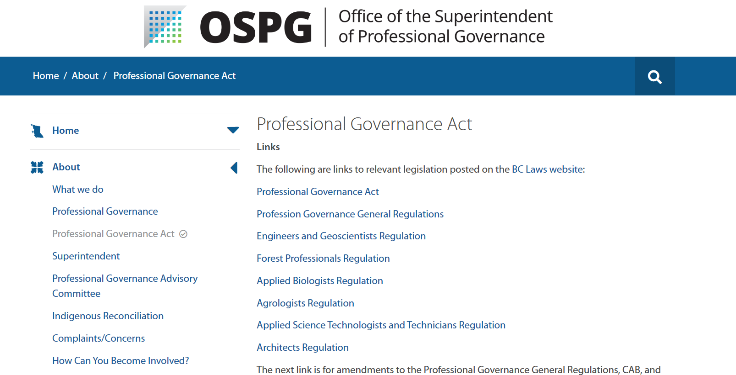
Professional Governance Act
Architects Act repealed Feb 10/23
now
Architects Regulations & under authority of the Professional Governance Act (PGA)

Slide 12
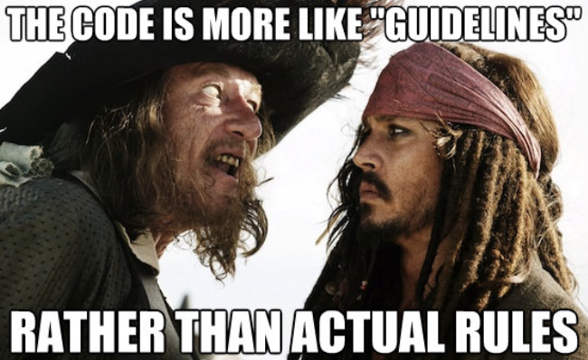
Why are we talking about the Architects Regulation (Act)?
Should the recent repeal of the Architects Act and new Architects Regulation impact your building department permit processing?
Do other regulations and enactments factor into our permit review processes? Building Act - - Home Protection Act.
So why not the Architects Regulation?
ARCH
REG

Slide 13

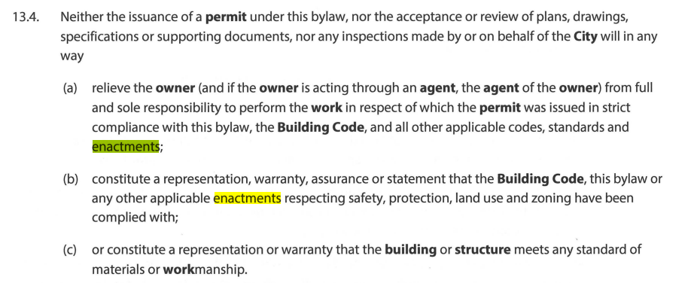
Do our Bylaws exempt us from consideration of other enactments?

Slide 14


Do our Bylaws exempt us from consideration of other enactments?

Slide 15
AIBC vs Langford
July 7, 2021 (AIBC)
The BC Court of Appeal recently dismissed the appeal by the City of Langford of a 2020 Supreme Court ruling that confirmed the requirement of an architect on a mixed-use, multi-family dwelling.
The City of Langford had issued a building permit and allowed construction and occupancy of the building despite the lack of involvement by an architect in the design and supervision of construction. In May 2020, the chambers judge ruled that the Architects Act is a law “respecting health and safety” and that it was not legally acceptable for a municipal building permit to be issued for building that had been designed in contravention of a relevant law respecting safety. That decision is found here: 2020 BCSC 801 (CanLII) | The Architectural Institute of British Columbia v Langford (City) | CanLII.

Slide 16
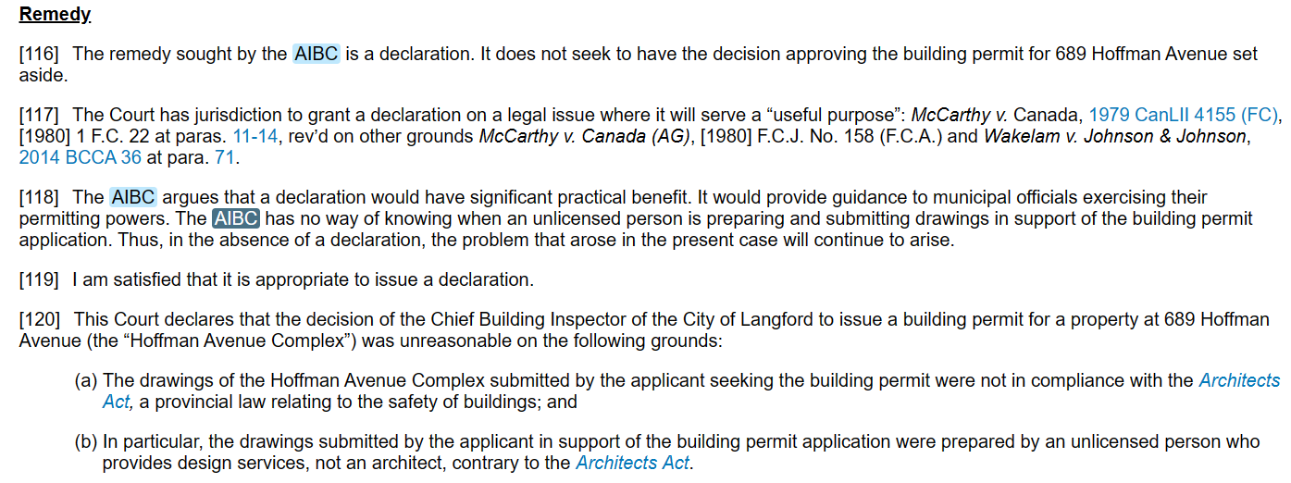
AIBC vs Langford

Slide 17
Survey Questions
Does your Building Department acknowledge the Architect’s Regulation involving Part 9 permit applications? (170 responses)
Yes – 64%
No – Code only 14%
Unknown – 21%
Is there anything specifically written within your Bylaws one way or another – Policy?

Slide 18
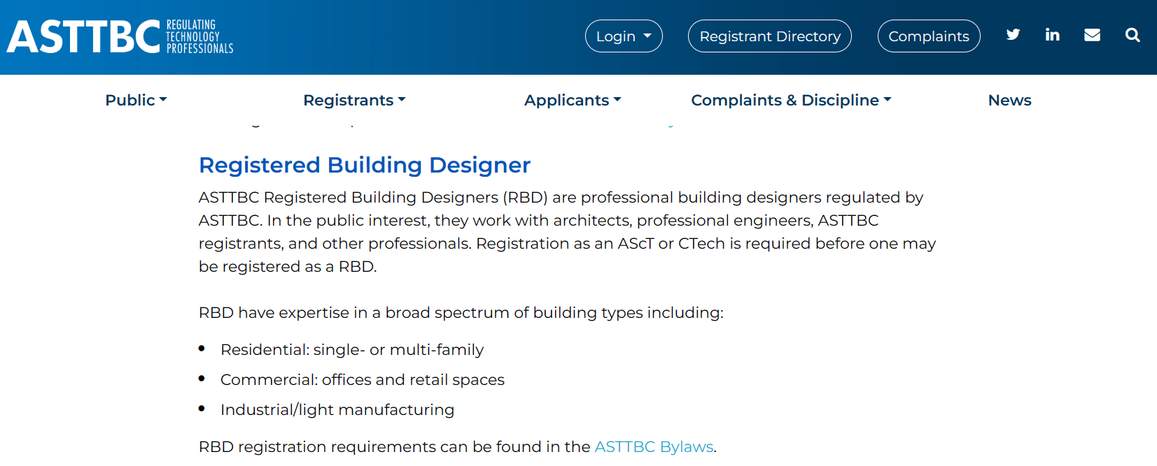
Tony Giroux
ASTTBC-CTech, RBD, BCABD
Owner/Registered Building Designer
Giroux Design Group Inc.

Slide 19
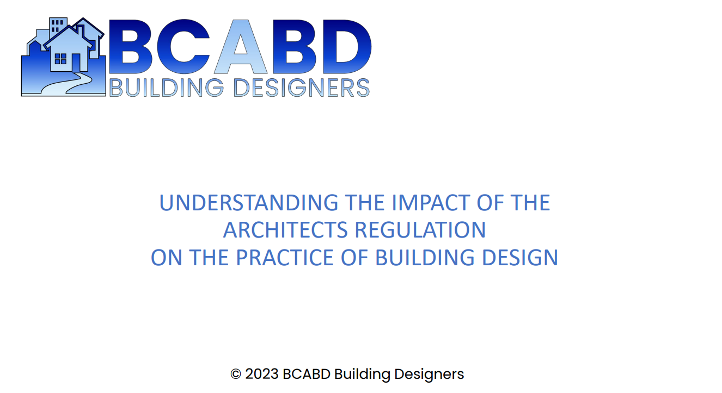
Please refer to BCABD presentation

Slide 20
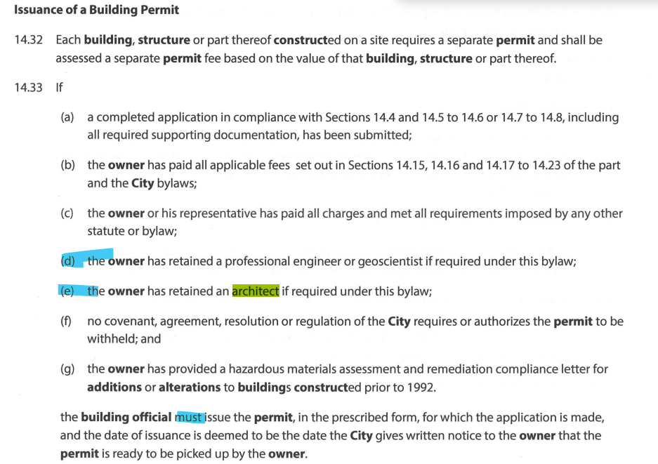
Required Registered Professionals
Typical Building Bylaw wording related to authority to require R.P’s

Slide 21
Survey Questions
Does your Building Department require Letters of Assurance for Part 9 – Geotechnical Requirements? (170 responses)
Yes, all Part 9 – 27%
Only in poor soil conditions or
covenant requirements - 25%
Case by Case - 44%
Typically not - 4%
Perhaps this is creating confusion in the building industry?

Slide 22
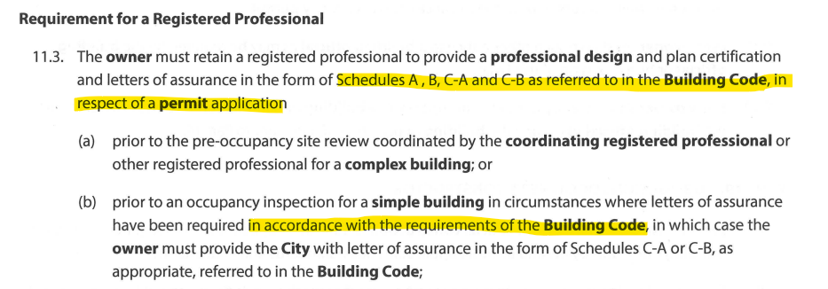
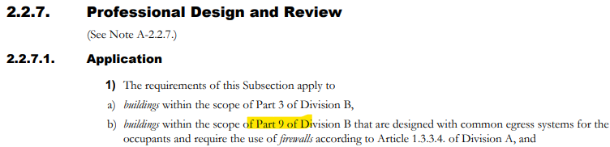
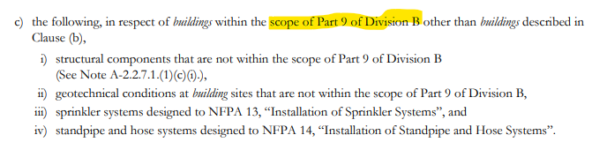
Required Registered Professionals – Part 9
Building Bylaws
BC Building Code – Div. C
When it comes to geotechnical concerns, is there a discrepancy between Building bylaws and the Code that is creating confusion in the building industry? What about Section 56 of the Community Charter & the typical clause – “if the building official (AHJ) determines that the site conditions so warrant”.

Slide 23
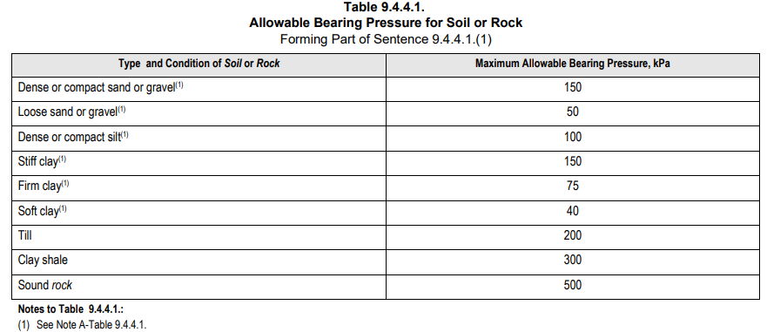
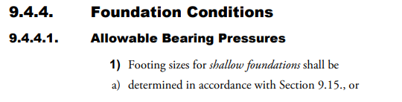

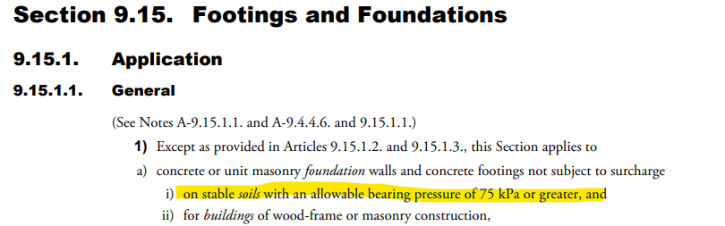
Geotechnical Considerations - LofA
75 kPa = 1,566 psf

Slide 24


Geotechnical Considerations - LofA
Do we all understand what this means or who it’s determined?
30 lbs/cubit foot

Slide 25
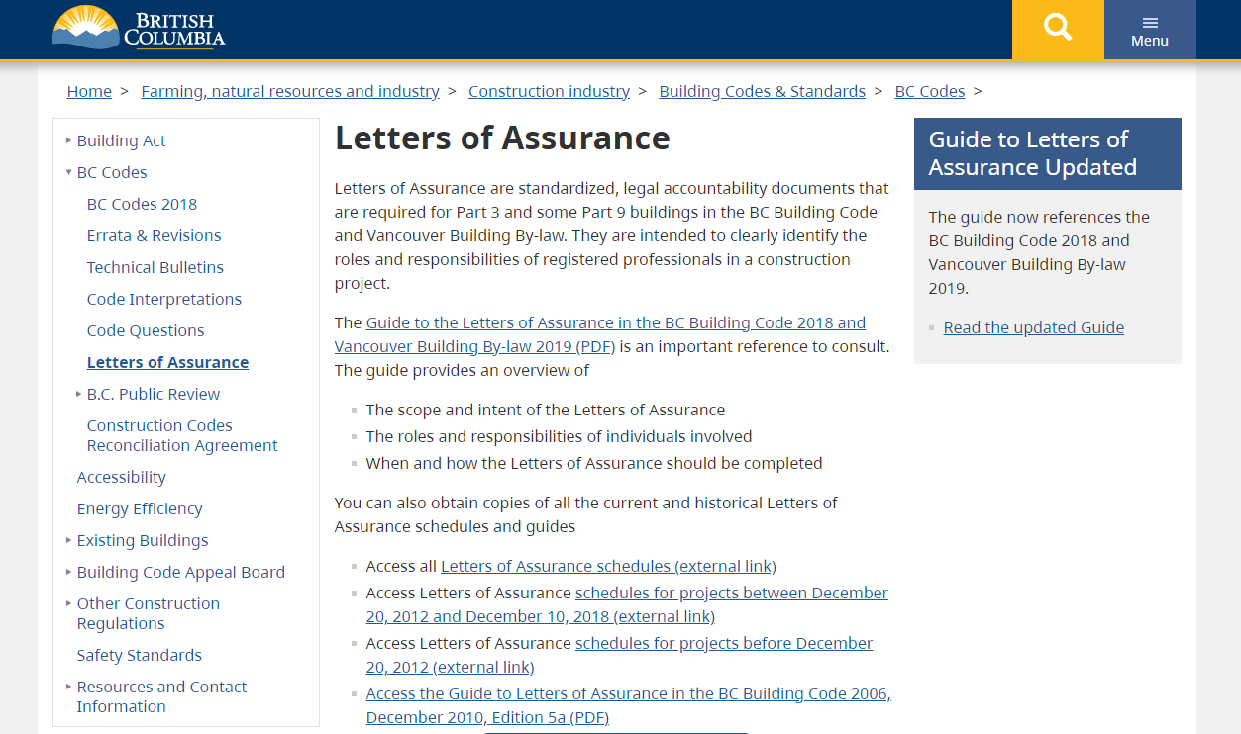
Guide to Letters of Assurance – Part 9
Excellent Resource for consistency.

Slide 26
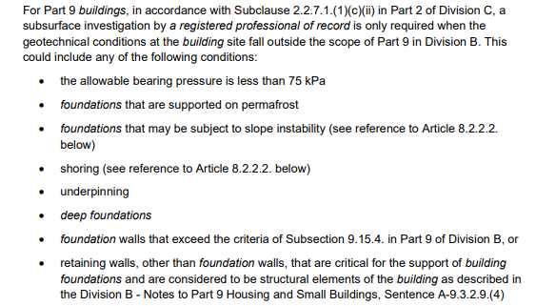
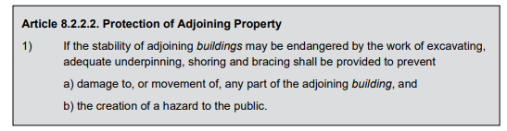

Guide to Letters of Assurance – Part 9
Part 9
Part 8
Retaining
Excerpts taken for the 2018 Guide

Slide 27
Next Session Options – Poll Results (166 responses)
Option 1
Making Sense of the new Energy Code Requirements
  What’s changing
  Prescriptive vs Performance
  Industry capacity
Option 2 – Late April
Secondary Suites and Carriage home requirements
  New & Renovations
  Legalizing Suites
  Industry Guide
48%
52%
PLEASE – forward any checklists, guides or policies related to new, renovations and illegal suites and carriage homes to kkunka@boabc.org

Slide 28


Contact Us

